Slide 1
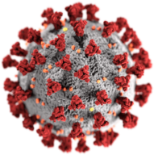



COVID-19: GLOBAL OUTLOOK IN THE FOOD SECTOR
Chilean Food Safety and Quality Agency, ACHIPIA
Presented by:
Adapted from:
Chilean Food Safety and Quality Agency
Chilean Ministry of Agriculture
Pontificia Universidad Católica de Chile

Slide 2






ACKNOWLEDGMENTS
… to original authors
Nuri Gras R.
Executive Secretary Chilean Food Safety and Quality Agency, ACHIPIA
Franco Pedreschi P.
Academic Pontifical Catholic University of Chile Ambassador to Chile of the Global Harmonization Initiative, GHI
Manuel Miranda H.
Senior professional, Chilean Food Safety and Quality Agency, ACHIPIA
Ricardo A. Jacob
Senior professional, Chilean Food Safety and Quality Agency, ACHIPIA
This presentation is an adaptation of a video produced in Chile by the Pontificia Universidad Católica de Chile and the Chilean Food Safety and Quality Agency, ACHIPIA, of the Chilean Ministry of Agriculture, to assist in coping with the Covid-19 pandemic in the food chain. GHI is grateful to these organisations for their permission to use the video.
Notes:
We would like to express our acknowledgement to the original authors of this presentation for allowing their content and materials to be adapted for the global presentation.

Slide 3




ADAPTED BY
Noor Zafira Noor Hasnan
Universiti Putra Malaysia (UPM)
Senior Lecturer/Researcher
Ambassador to Malaysia of GHI
Field: Food manufacturing and factory design, food processing, food safety
Email: noorzafira@upm.edu.my
Mohd Zuhair Mohd Nor
Universiti Putra Malaysia (UPM)
Senior Lecturer/Researcher
Field: Food engineering, membrane filtration
Email: zuhair@upm.edu.my
Rozita Vaskoska
Co-chair GHI WG Food Microbiology
Field: food science, food microbiology, food law, meat science
Email: rozita.vaskoska@globalharmonization.net
Nur Hamizah Abdul Ghani @ Hashim
Universiti Putra Malaysia (UPM)
Senior Lecturer/Researcher
Field: Food engineering, food process modelling
Email: nurhamizah@upm.edu.my
Notes:
The presentation is adapted by a team consisting of four members from the Universities of Melbourne; Australia; and Putra Malaysia (UPM) with the aim to present the impact of COVID-19 from a global perspective.

Slide 4
Contents
Introduction and Context
COVID-19 : Global Situation & Strategies in Food Supply Chain
COVID-19 and the Food Industry
Scientific and Technological Advancements
Future Perspectives
Conclusion
Acknowledgement
References
Notes:
Contents of the presentation

Slide 5
Introduction
SARS-CoV-2
The World Health Organization identified a new type of coronavirus after the December 2019 outbreak in China, that then spread to other countries.
The virus is called severe acute respiratory syndrome coronavirus 2 (SARS-CoV-2) and causes the disease COVID-19 that affects both the upper and lower respiratory tract.
Infections range from mild to deadly.
COVID-19 is currently a pandemic affecting many countries around the world.
Notes:
Currently it is known that coronaviruses are an extensive family of viruses that can cause disease in both animals and humans. In humans, various coronaviruses are known to cause respiratory infections that can range from the common cold to more serious illnesses, such as Middle East respiratory syndrome (MERS) and severe acute respiratory syndrome (SARS).

Slide 6
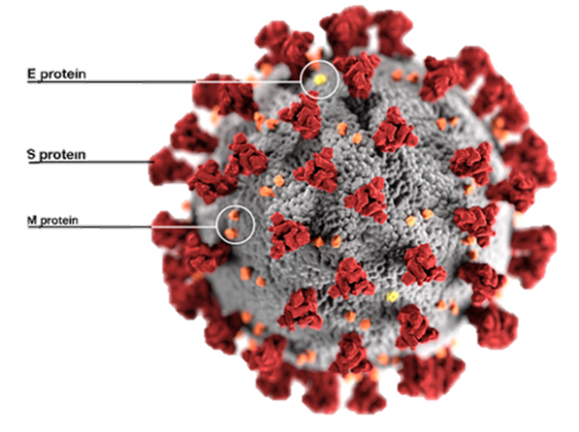
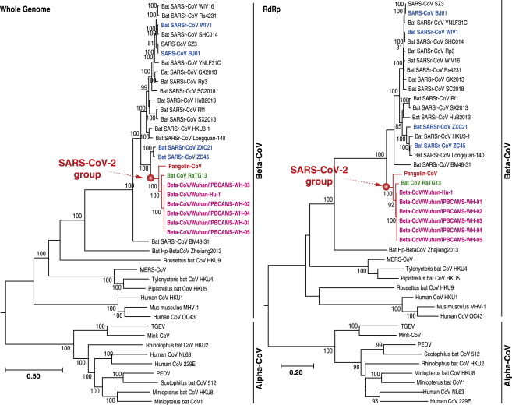
Introduction
SARS-CoV-2
The proteins on the virus surface bind to host proteins (receptors) on the host cell membrane, allowing it to gain entry.
Source: Current Biology (2020)
Notes:
The coronavirus structure is made up of genetic material (RNA); proteins, that allow it to adhere to other cells; and a membrane of lipids (fatty acids) that surround it, protects it and help it spread and invade cells.
Source: https://www.sciencedirect.com/science/article/pii/S0960982220303602

Slide 7
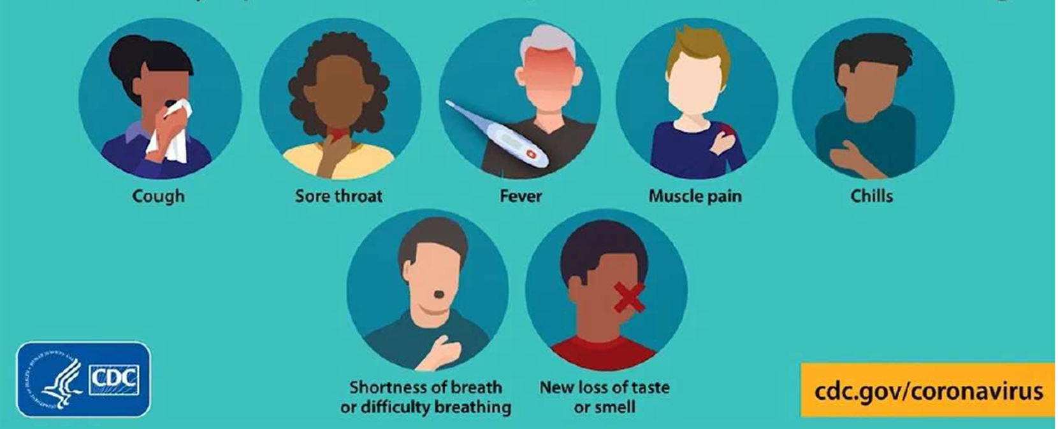
Introduction
Symptoms
Notes:
The most common symptoms of COVID-19 are fever, dry cough, and tiredness. Other less common symptoms that affect some patients are pain, nasal congestion, headache, conjunctivitis, sore throat, diarrhea, loss of taste or smell, and skin rashes or color changes on the fingers and toes. These symptoms are generally mild and begin gradually.

Slide 8


Introduction
How does COVID-19 spread?
Mainly spread from person to person i.e., an infected person is in close contact with another person.
Direct contact with respiratory droplets generated when an infected person coughs or sneezes.
Touching the surfaces that have been contaminated with the virus from infected people → then touch eyes, noses or mouths without cleaning hands
Aerosol transmission can occur in specific settings (indoors, crowded and inadequately ventilated spaces) where infected person(s) spend long periods of time with others. More studies are underway to better understand the conditions in which aerosol transmission can occur.

Slide 9
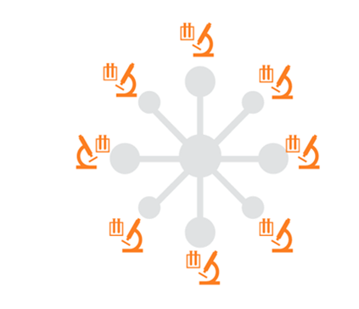








Introduction
Public Health
Health services
Laboratories for analysis
Movement restriction
Traceability
Procedures and recommendation
Sanction and penalties
Border control
Educational campaign
Notes:
Regarding general health measures, sophisticated strategies have been gradually adopted for patient care in health services, as well as border control and mandatory confinement throughout the country, dependent on the prevalence of COVID-19 in each country.
In detail, the strategies have been mainly based on community testing; strengthening the network of laboratories that perform analyses; traceability of positive cases; and strict isolation from the community. Protocols and recommendations have been drawn up and include aspects of cleaning and disinfection of surfaces; a guide to the use of personal protective equipment; facilitation of immunological diagnostic tests; and communication of definitions in the framework of the pandemic, among others.
Sanctions for violations of health provisions have been enforced, and stringent sanitary measures and exhaustive controls have been established.

Slide 10
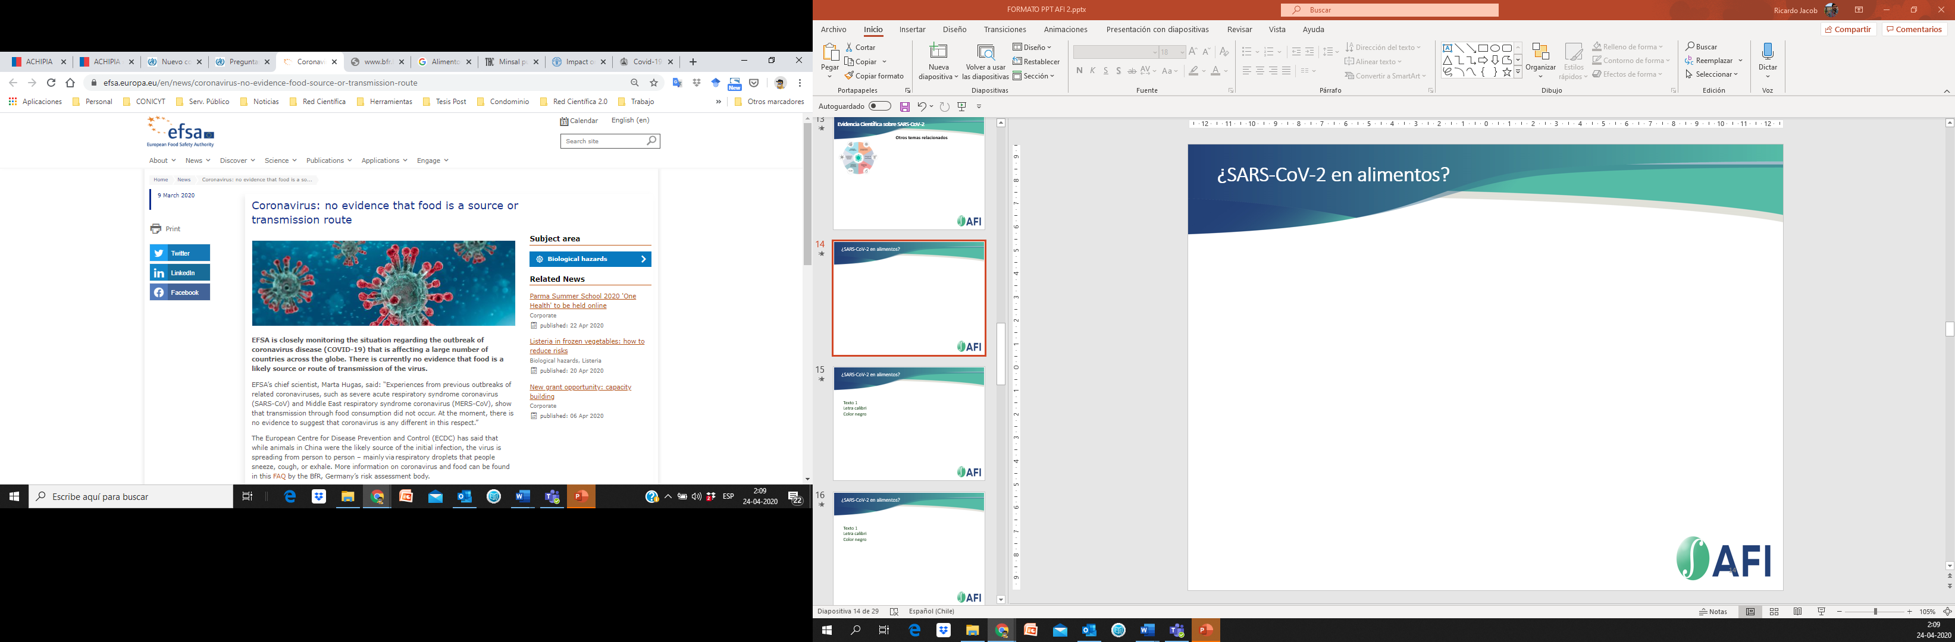
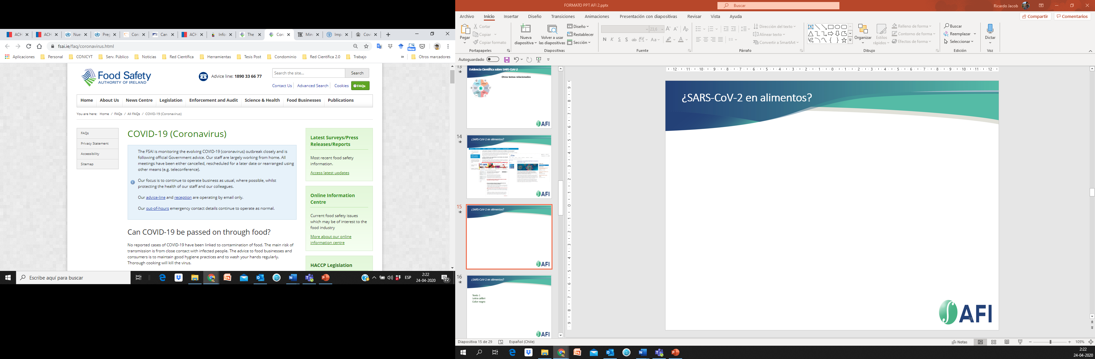
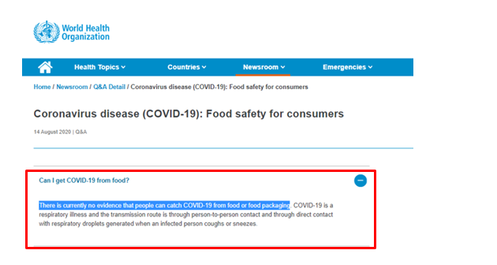
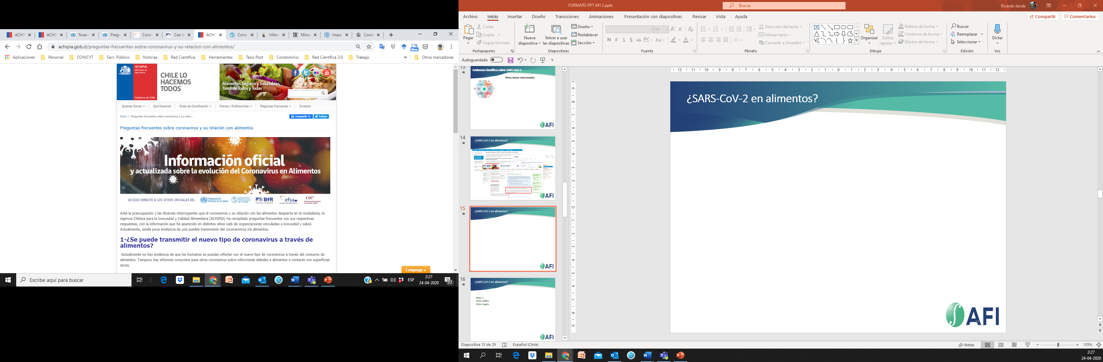
Introduction
There is currently no evidence that Covid-19 can be transmitted via food or packaging – World Health Organization (WHO)
Notes:
On the other hand, to date there is no evidence that viruses that cause respiratory illness are transmitted through food or food packaging. Thus, foodborne exposure to this virus is not known to be a route of transmission and therefore SARS-CoV-2 is not considered a foodborne virus, but rather a respiratory virus which can also enter the bloodstream via mucous membranes in the eyes, nose, and mouth.
Coronaviruses cannot multiply in food; they need an animal or human host to multiply. It is highly unlikely that people can get COVID-19 from food or food packaging. There is no evidence that someone can contracts the virus that causes COVID-19 after touching food containers and food packaging.
Although China has reported coronavirus detection on frozen food packaging, there's no credible evidence to show people are being infected via the cold chain.

Slide 11
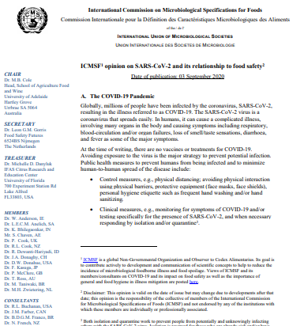
Introduction
ICMSF opinion on SARS-CoV-2 and its relationship with food safety
SARS-CoV-2 shall not be considered a food safety hazard as these enter the body through the gastrointestinal tract
ICMSF does not advise that food products or the environment to be tested for the presence of the virus

Slide 12
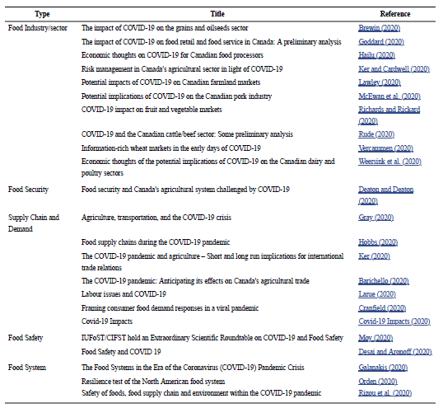
Available references on the impact of COVID-19 on the food industry; food security; supply chain and demand; food safety; and the overall food system.
Source: Nakat and Bou-Mitri (2020)

Slide 13
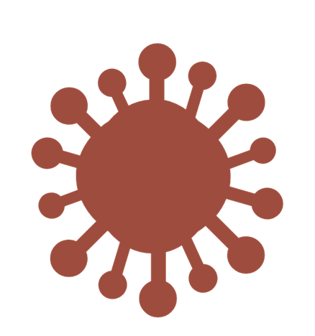

COVID-19 : GLOBAL SITUATION & STRATEGIES IN THE FOOD SUPPLY CHAIN
Notes:
COVID-19 : GLOBAL SITUATION & STRATEGIES IN THE FOOD SUPPLY CHAIN

Slide 14



THE FOOD SUPPLY CHAIN
The pandemic has impacted all segments in the supply chain from the field to the consumer.
Labour shortage
Panic-buying and stockpiling behavior
Closure of food production facilities and foodservice
Disruption of transportation network
Growth
of online grocery & meal delivery sector
Reduced & suspended production
Interrupted and delayed supply chain to the market
Food consumed at home
Restricted market opening hours
Limited access to food & malnutrition (lower income groups, foreigner and refugees
Dumping of fresh produces due to market access difficulties
Increase in price of limited food items
Export-restricted policies
Increased demand for functional food, canned and frozen food
Notes:
COVID-19 has impacted on all segments of the food supply chain, simultaneously affecting farm production; food processing; transport and logistics; and final demand. Not all sectors and products have been equally affected, and different products have experienced disruptions at different stages of the supply chain.
Explanation as in slide

Slide 15
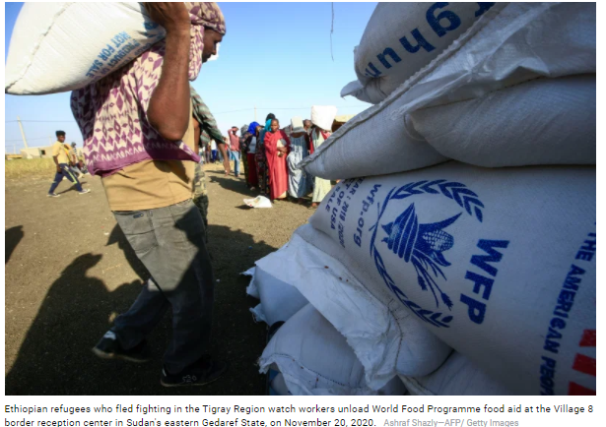







STRATEGIES IN THE FOOD SUPPLY CHAIN
Relief fund and community support for ensuring food access
.
At global level : COVID-19 Global Humanitarian Response Plan with allocated fund has enabled agencies such as WHO, UNICEF, and the WFP to provide food as well as other essentials to the most vulnerable communities
At national level : Government agencies and NGO execute response plan to deliver food and essentials
Notes:
As a result of the current global pandemic, tackling malnutrition is expected to become harder. Food access for vulnerable groups is of particular concern during the pandemic, especially due to restricted movement and economic disruption. In March 2020, the UN set up the US$2 billion COVID-19 Global Humanitarian Response Plan, to enable agencies, such as WHO, UNICEF, and the WFP to provide food, water, sanitation, and vaccinations, as well as COVID-19 testing materials and medical equipment, to the most vulnerable communities. Efforts at national level have also been initiated by government and non-government organisations to ensure access to food is not hindered. It is imperative to note that poorly nourished individuals are at a greater risk of various viral infection during the pandemic.

Slide 16
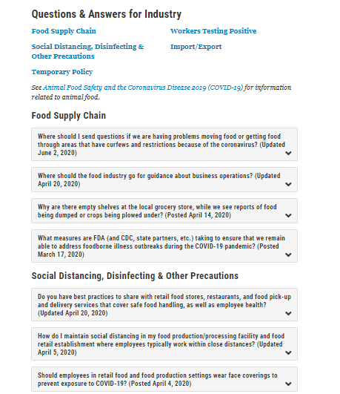
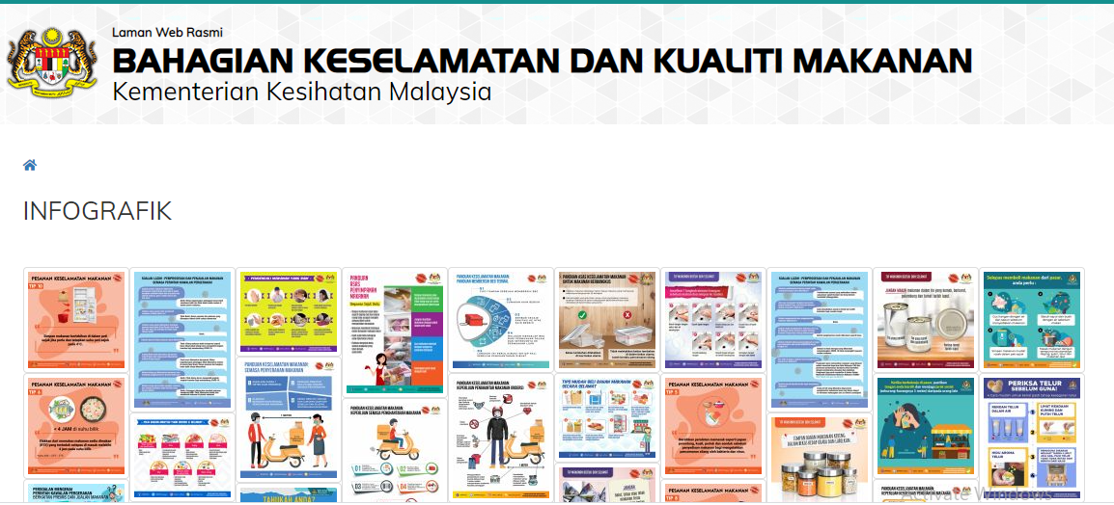

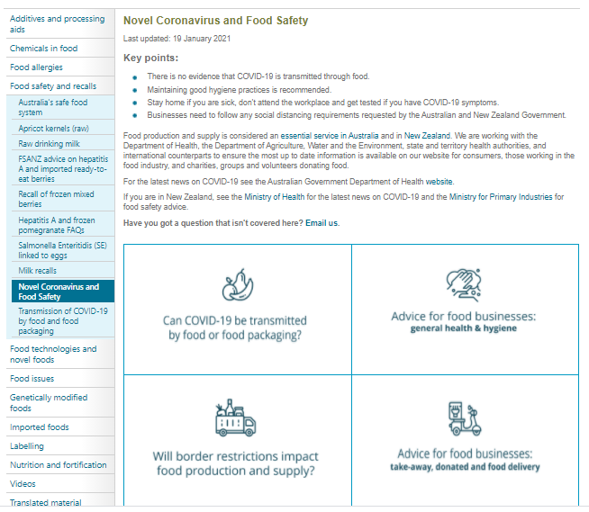

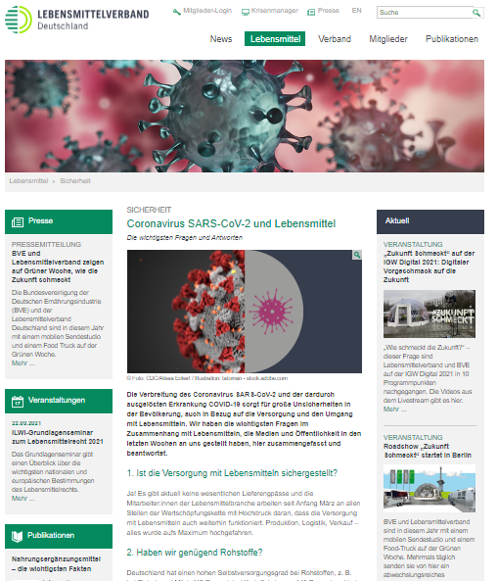
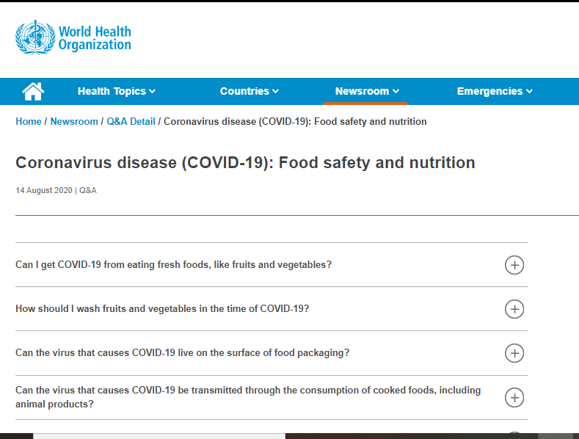
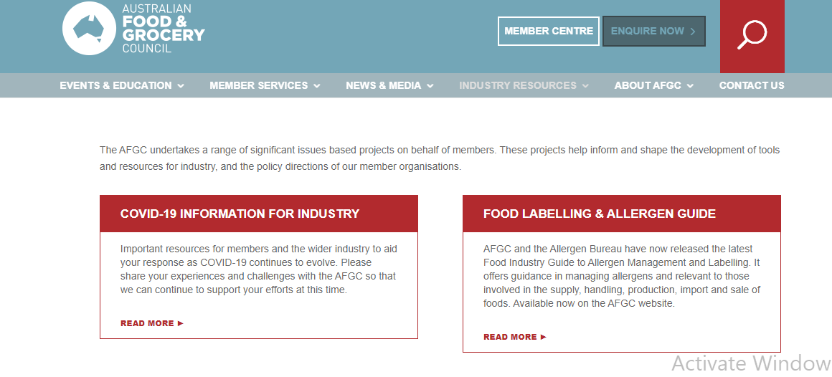
STRATEGIES IN THE FOOD SUPPLY CHAIN
Online platform for public and food businesses to gain information on the food supply chain amidst the pandemic
Notes:
Up to date information is provided by authorities and organisations on the food supply chain for consumers and businesses via online platforms
Question and answer
Information on infection route
Information on best practice

Slide 17

STRATEGIES IN THE FOOD SUPPLY CHAIN
Implementation of Green Lanes and keeping international trade open
The opening of priority lanes and borders solely for emergency services, cargo flow and other essentials including food
Ensure continuity in the supply chain for essential products across borders in the internal market despite the COVID-19 threat
Ex: creation of “green lanes” at intra-EU border crossings
Source: F & D Technology (2020)
Notes:
The recovery of logistics was facilitated by policy decisions. An example of such policy is “green lanes” at intra-EU border crossings where the total time spent on border crossing now should not exceed 15 minutes.
While new restrictions limiting the number of drivers in a vehicle were necessary, EU Member States suspended other restrictions (e.g., bans on driving at night or driving on weekends)
Other policy measures to protect the functioning of food supply chains included exemptions of food and agriculture from lockdown restrictions; measures to ensure the health of agriculture and food workers; loosening visa restrictions to attract foreign seasonal workers; and administrative flexibility. Although some countries have introduced export restrictions during the current crisis, so far their number and impact has been limited. Moreover, WTO members responsible for two-thirds of global exports of agriculture and agri-food products issued a joint declaration expressing their commitment to keep international trade open
Source:
Deconinck, K., Avery, E., & Jackson, L. A. (2020). Food Supply Chains and Covid‐19: Impacts and Policy Lessons. EuroChoices, 19(3), 34-39.
http://www.oecd.org/coronavirus/policy-responses/food-supply-chains-and-covid-19-impacts-and-policy-lessons-71b57aea/

Slide 18
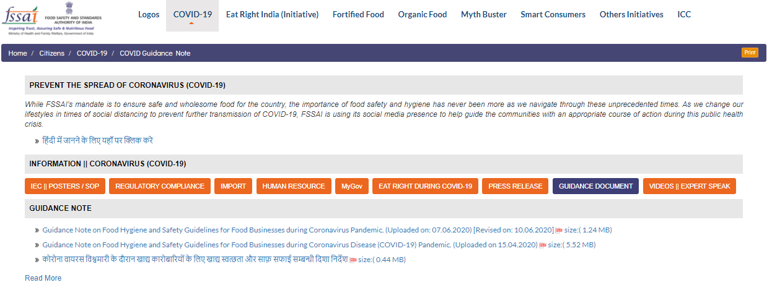
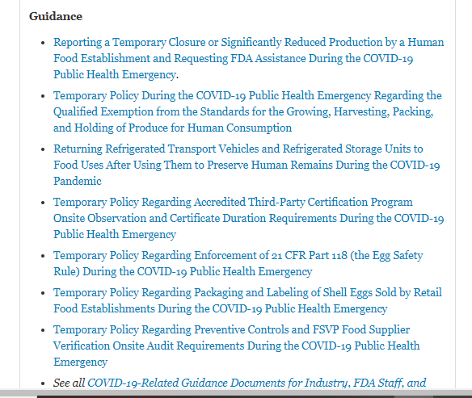

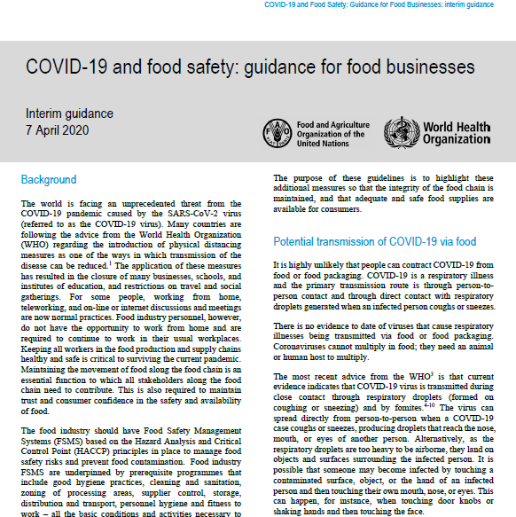
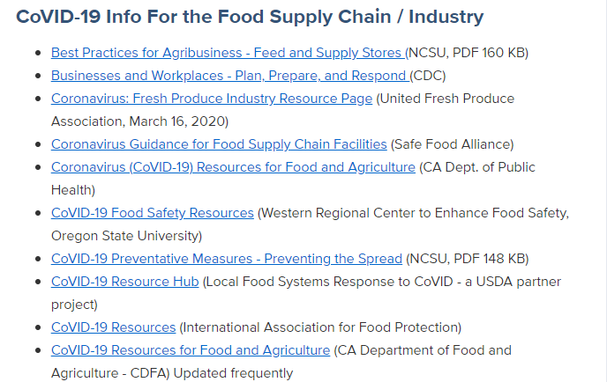
STRATEGIES IN THE FOOD SUPPLY CHAIN
Specific guidance for mitigating the risk of spreading COVID-19
Notes:
Specific guidance and best practices were drawn up by authorities and organisation in own countries for mitigating the risk of spreading COVID-19 specifically in the food supply chain

Slide 19
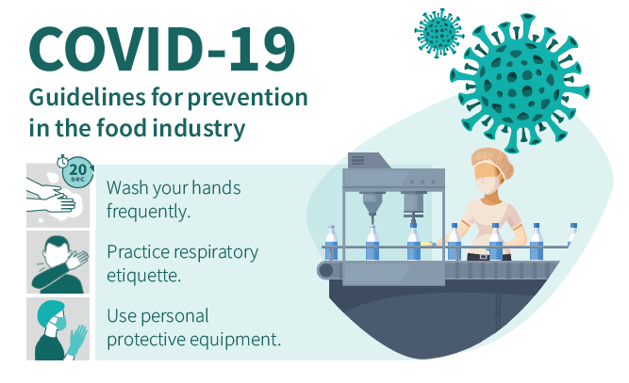
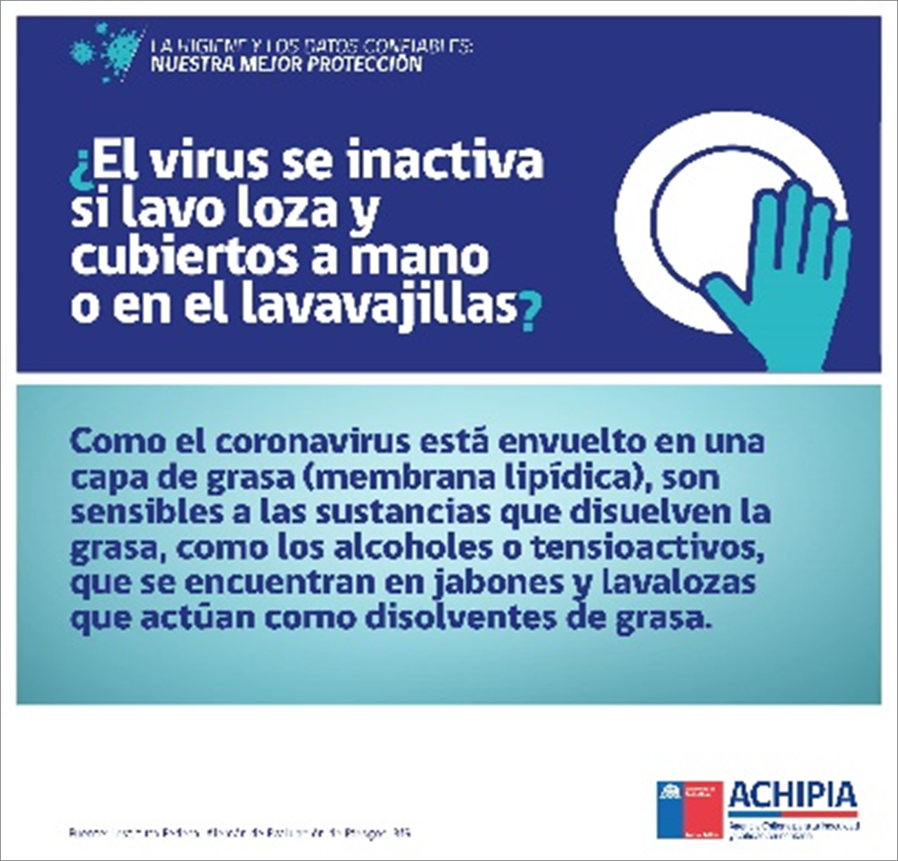
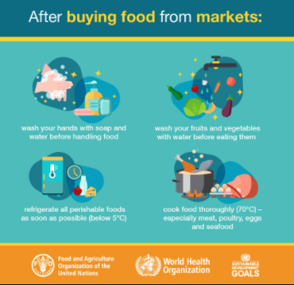
STRATEGIES IN THE FOOD SUPPLY CHAIN
Hygiene campaign
The food industry is already known for its long-held requirements for hygiene and handwashing as part of their food safety management systems → key protection against coronavirus infections
The threat of COVID-19 calls on the need for additional hygiene and sanitation measures to ensure protection for workers in the food environment → reinforced hygiene campaign throughout the entire supply chain (including consumers) with practical demonstration and allocated resources
Notes:
Explanation as in slide

Slide 20
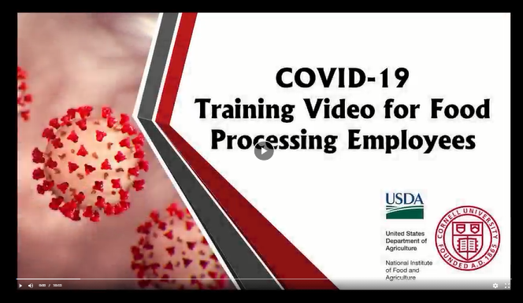
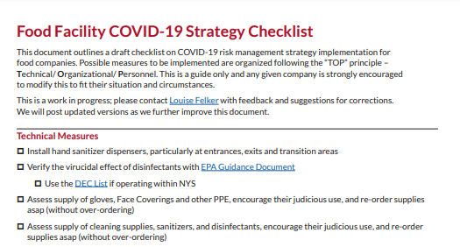
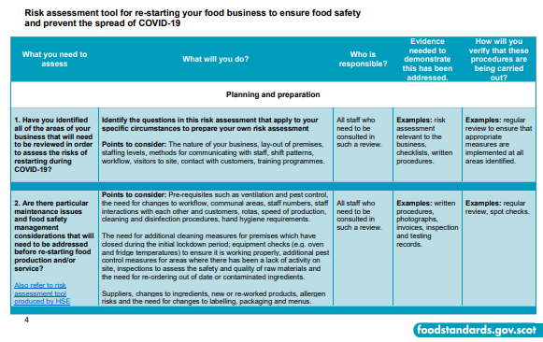
STRATEGIES IN THE FOOD SUPPLY CHAIN
Key tools and training for mitigating the risk of spreading COVID-19
Training videos
Decision trees
Risk assessment
Checklists
Standard operating procedures
Verification spreadsheets
Remote food safety consulting and auditing
Source: Cornell University (2020) & Food Standards Scotland (2020)
Notes:
Explanation as in slide

Slide 21

STRATEGIES IN THE FOOD SUPPLY CHAIN
Industry support
Economic stimulus and relief measures
Technological support & technical assistance
Infra-structure support
Digital facilities
Flexibility in regulatory requirements
Market support program
Research supports
Source: Agroknow (2020)
Notes:
Explanation as in slide
-Digital facilities
-Infrastructure such as warehouse
Funding for research
*Policy makers also streamlined certification procedures (by allowing scanned copies or electronic signatures) and relaxed regulations on trade in food (e.g., some labelling requirements

Slide 22
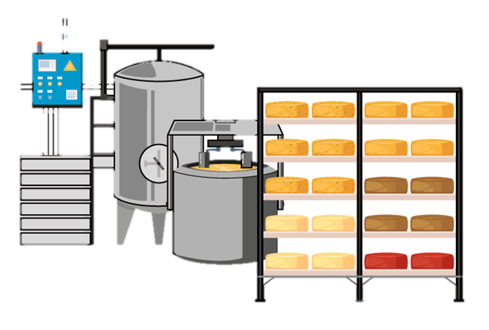
COVID-19 AND THE FOOD INDUSTRY
Notes:
COVID-19 AND THE FOOD INDUSTRY

Slide 23
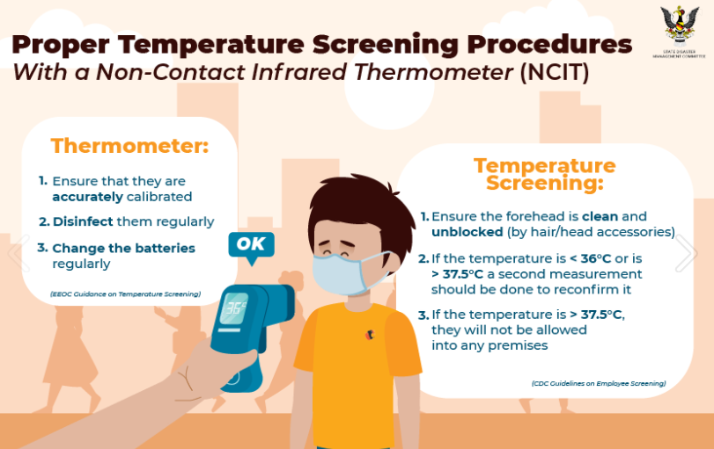
Health screening at the entrance of plant
Daily health screening prior to starting work or entering premises
Self-assessment for COVID-19 Risk – Fill in form or application
Temperature check using a touchless accurate Infrared (IR) thermometer
Procedures for employee that develop COVID-19 symptoms or tests positive for the virus (Sickness reporting procedure)
Procedures for employees that have been exposed to a person with suspected or confirmed COVID-19
Safety of staff conducting the screening
Visitor’s screening
Confidentiality
Source: Sarawak Disaster Communication, Malaysia (2020)
Notes:
A key concern shared by all food companies is preserving the employee’s health, and the provision of an adequate workforce due to those who could not work because of sickness, movement control or due to coronavirus fear. It is very important to protect and maintain the health of people working in the food supply chain during this time of crisis (FAO and WHO, 2020).

Slide 24


Hygiene and sanitation measures in food industry
Proper hand hygiene
More frequent cleaning schedule
Glove usage
GMP
Personal protective equipment (PPEs)
Clean and disinfect high-touch surfaces
Mask usage
Laundry
Source: CDC, USA
Notes:
Food facilities should be vigilant in their hygiene practices, including frequent and proper hand-washing and routine cleaning of all surfaces.
Hygiene should be maintained by the food operators because the survival time of the SARS-CoV-2 virus on the surface of the steel, plastic, etc., is very long. Also, food operations should be designed to prevent contamination of food by the virus. Safety measures to guarantee the continuous flow of the food supply chain at each stage can be divided into personal hygiene; health screening of the workers; use of personal protective clothing such as gloves, masks, and helmets; maintenance of social distancing; frequent surface and work area cleaning and disinfection; safe delivery of food, etc. Implementation of preventive measures at the end of the food supply chain is more difficult because it involves so many people (Rizou et al., 2020).

Slide 25



Communication and training
Training plans with up-to-date training on COVID-19 risk factors and protective behaviors
Reinforced food safety teaching and cleaning practices
Guidance on mental health and well-being aspects of COVID-19
Training materials that are easily understood and available in the appropriate language and literacy level for all workers
Infographics and videos that can be used to communicate the training
Employee cross-training to perform various functions in case of absenteeism
Physical distancing during the training sessions
Remote training
Notes:
Training plans with up-to-date training on COVID-19 risk factors and protective behaviors (e.g., COVID-19 symptoms, infection prevention, sickness reporting, cough etiquette, avoiding touching the face, proper hand washing and care of PPE).
The methods used to deliver training is changing to virtual platforms with use of videos, and the use of infographics
Explanation as in slide
In this effort, communication and collaboration between the private world and public institutions have been very relevant, to incorporate the prevention measures required by the authority and, on the other hand, to ensure supply in the distribution chain.

Slide 26
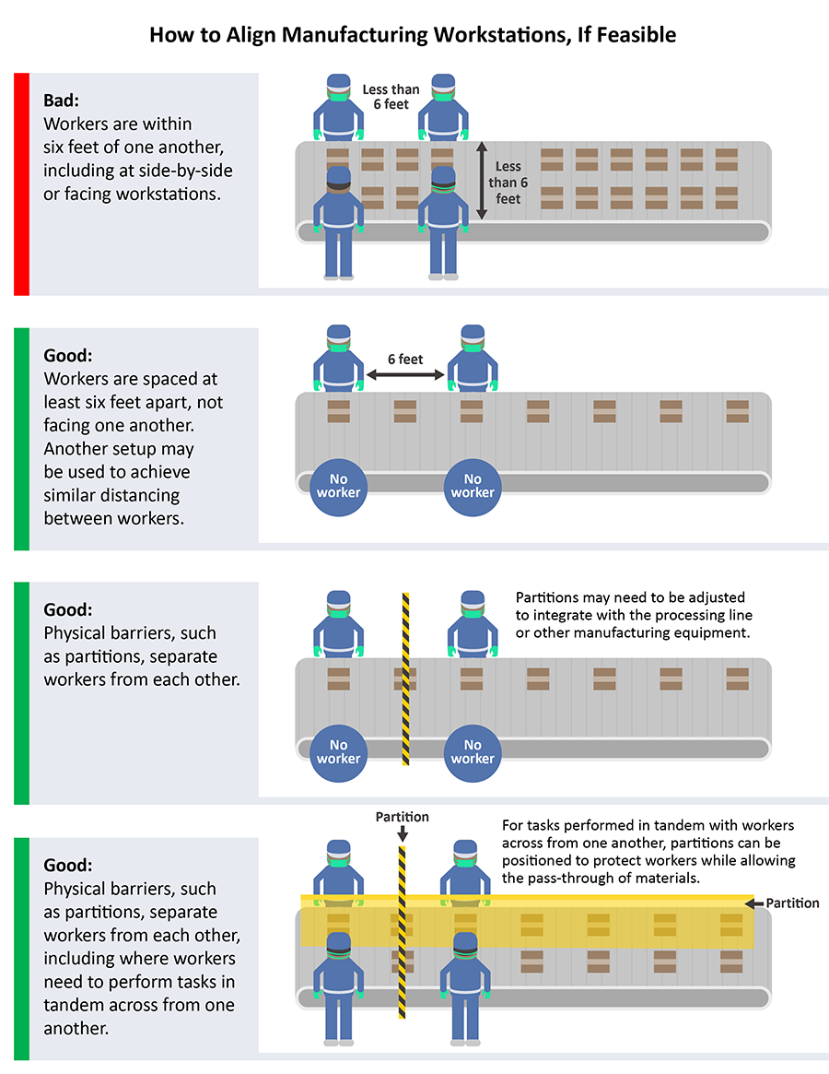
Physical distancing measures
Source: CDC, USA
Notes:
The CDC recommends that individuals employ social distancing or maintain a distance of approximately 6 feet from others, when possible. In food production/processing facilities and retail food establishments, an evaluation should be made to identify and implement operational changes that increase employee separation. However, social distancing to the full 6 feet will not be possible in some food facilities.
The risk of an employee transmitting COVID-19 to another is dependent on the distance between employees; the duration of the exposure; and the effectiveness of employee hygiene practices and sanitation.
When it’s impractical for employees in these settings to maintain social distancing, effective hygiene practices should be maintained to reduce the chance of spreading the virus.
Maintaining social distancing in the absence of effective hygiene practices may not prevent the spread of this virus.

Slide 27
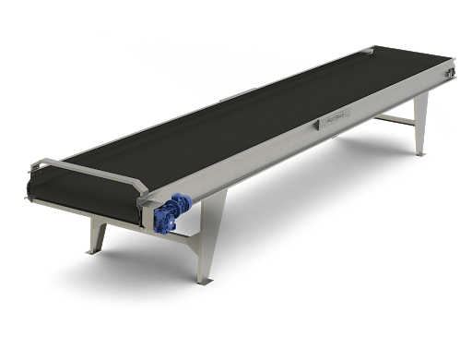




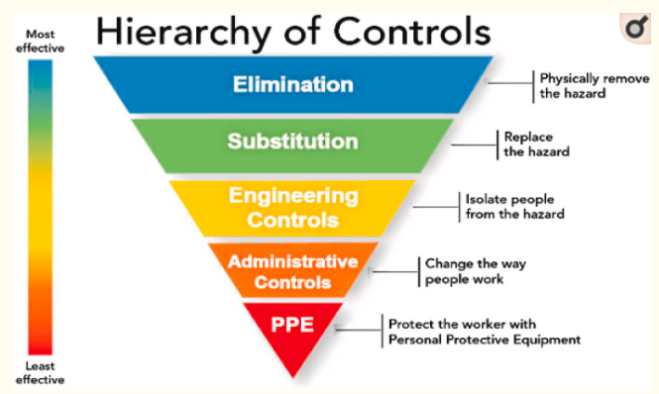
Integration of occupational safety with food safety
Reinforced safety plans that integrate food safety, environment and occupational safety to work out on biosafety issues
Notes:
With the goal to address biosafety issues, the industry has reinforced its safety plans to avoid the spread of infections between people. The plan integrates the disciplines of food safety, environmental safety, and occupational safety, whereby these were previously achieved by separate functions, now they work together to achieve biosafety through enforcement of personal hygiene, working distances, health checks etc.

Slide 28



System and standard to encourage safety culture
The nurture of hygiene and prevention culture through standards and systems , based on the same concepts that have been applied for safety.
Notes:
By warning that the arrival of the new coronavirus would put the various food safety standards to the test in the production sector, and by evaluating the different scenarios in this regard, it is anticipated that the concepts of "Safety Culture" will also be strengthened after this pandemic. From the workers to the managers, the importance of hygiene and prevention culture, to ensure people's health, has been understood, as has the fact that this is based on the same concepts as those for safety culture.

Slide 29




Other strategies by food industries
Reduction of working hours and employee rotation
Reduction of product variety with focus on popular products
Division of number of employees into groups and adjustment of break time to avoid overcrowding
Reduction of costly and time-consuming changeovers and simplified inventory management
Alternative sources of disrupted raw material supply
Use of digital technologies & platform
Temporarily unavailable source of raw material due to exports suspension and lockdown is replaced with new suppliers immediately
Sales & services, customer feedback, maintenance, commissioning, start-up and training during the pandemic
Notes:
Explanation as in slide

Slide 30

SCIENTIFIC & TECHNOLOGICAL ADVANCEMENTS
Notes:
SCIENTIFIC & TECHNOLOGICAL ADVANCEMENTS

Slide 31
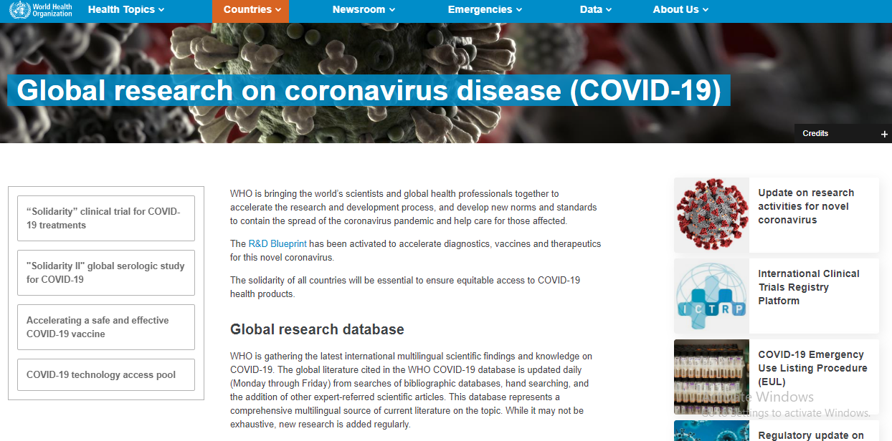
RESEARCH & DEVELOPMENT
Notes:
WHO is gathering the latest international multilingual scientific findings and knowledge on COVID-19. The global literature cited in the WHO COVID-19 database is updated daily (Monday through Friday) from searches of bibliographic databases, hand searching, and the addition of other expert-referred scientific articles. This database represents a comprehensive multilingual source of current literature on the topic. While it may not be exhaustive, new research is added regularly.

Slide 32
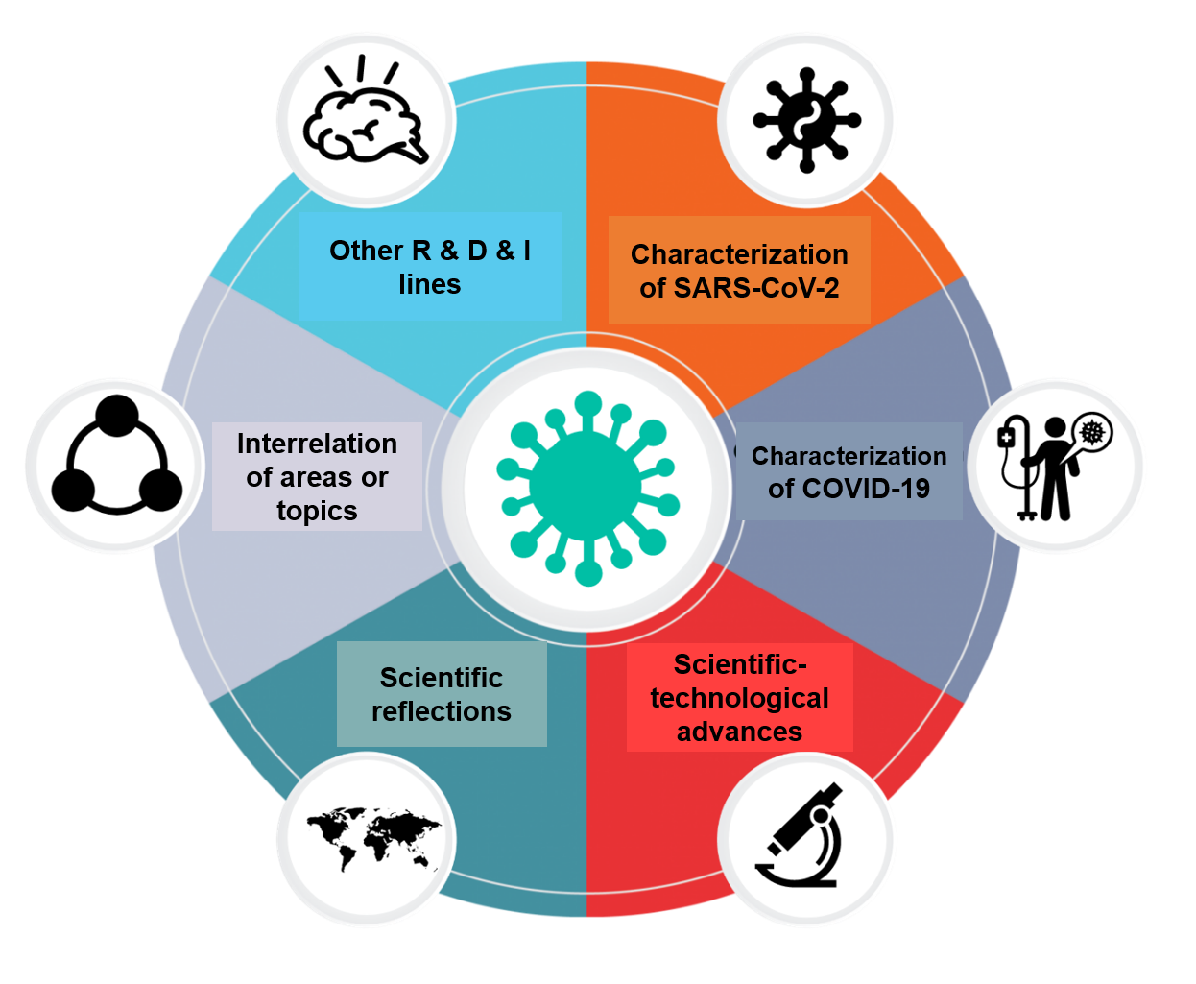


SCIENTIFIC ADVANCES
Pursuit of knowledge related to SARS-CoV-2 /COVID-19
Notes:
To support the supply chain and to raise awareness among consumers at all levels, scientific researchers have focused on the collection, analysis and dissemination of scientific evidence on SARS-CoV-2 and COVID-19.
The knowledge generated has been varied and has risen very quickly, meaning that scientific publications and journals have had to adapt their review processes to maintain the high quality of their publications. Scientific activities in relation to the following aspects of SARS-CoV-2 and COVID-19 have been recognised to date:
- Characterisation of SARS-CoV-2
- Characterisation of COVID-19
- Scientific-technological advances for sanitary control
- Scientific reflections
- Inter-relation of areas or topics
- Other Research, Development and Innovation (R & D & I) lines

Slide 33
SCIENTIFIC ADVANCES
Application of knowledge related to SARS-CoV-2 /COVID-19
Public politics, actions and operations
Preventive measures
Surface studies
Aspects of transmission
Relationship between the illness and gastrointestinal symptoms
Others
Scientific evidence
Notes:
Consequently, it is important to emphasize the relationship between scientific findings, preventive measures, and decision-making, in which the lifting of actions must be supported by objective and gathered information.
Today there are some approaches where scientific evidence has benefitted us, and that serve to guide the food industry. For example, studies on surface survival of the virus; aspects of faecal-oral transmission; and the relationship of the disease with gastrointestinal symptoms, among others.
.

Slide 34
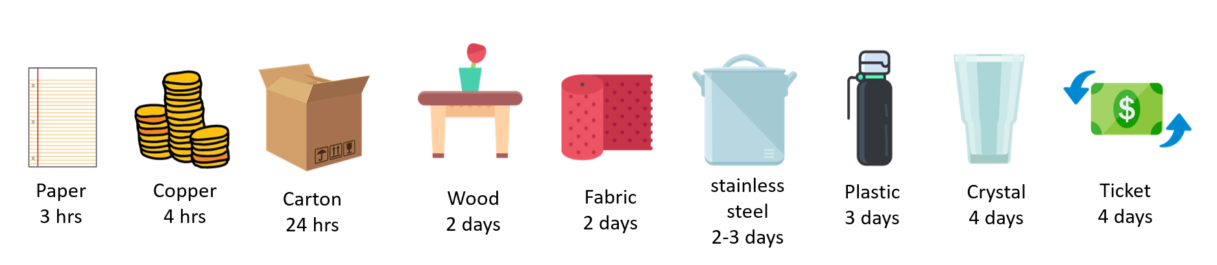

SCIENTIFIC ADVANCES
SARS-CoV-2 /COVID-19 survival
*Source: New England Journal of Medicine, 2020
?
Notes:
One example of this scientific evidence is the research that has evaluated the survival time of the SARS-CoV-2 virus on different surfaces. This reported that the virus can remain viable for up to 72 hours on plastic and stainless steel; up to four hours on copper; and up to 24 hours on cardboard. The research was conducted under laboratory conditions (controlled temperature and relative humidity) and should be interpreted with caution in the real-life environment.
*Source: New England Journal of Medicine, 2020

Slide 35
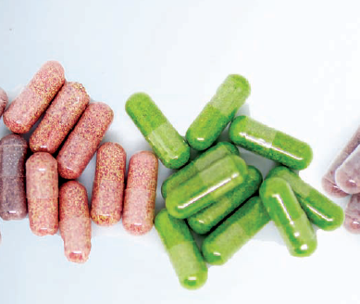
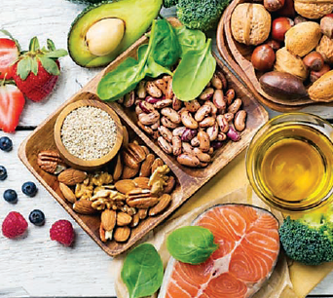
SCIENTIFIC ADVANCES
Role of food ingredients and bioactive compounds for preventing or treating COVID-19
Studies across the globe to test the efficacy of dietary supplements, such as Vitamin C, Vitamin D, Antioxidant Oral Nutrition Supplementation, Natural Honey, Zinc Gluconate, Ayurveda herbal supplement.
Examples:
Vitamin C as potential mitigation of COVID-19 symptoms (Hemilia and Chalker, 2019 and Cheng, 2020)
Vitamin D deficiency was debated as a putative risk factor for novel coronavirus infection (Watkins, 2020)
.
Source: Mathure, V. (2020, May). India is rich in immunity boosting food ingredients. NUFFOODSSPECTRUM, 31-32. www.nuffoodsspectrum.in
Kulkarni, N. (2020, May). 10 studies underway on dietary supplements to tackle COVID-19. NUFFOODSSPECTRUM, 16-21. www.nuffoodsspectrum.in
Cheng, R. Z. (2020). Can early and high intravenous dose of vitamin C prevent and treat coronavirus disease 2019 (COVID-19)?. Medicine in Drug Discovery, 5, 100028.
Hemilä, H., & Chalker, E. (2019). Vitamin C can shorten the length of stay in the ICU: a meta-analysis. Nutrients, 11(4), 708.
Watkins J. Preventing a covid-19 pandemic. BMJ 2020; 368: m810. https://www.bmj.com/content/368/bmj. m810/rapid-responses
Notes:
Supplementation with micronutrients, such as vitamins and minerals, has gained growing attention as part of the supportive management of COVID-19. Thus, we can see that many studies are being taken up across the globe to demonstrate the efficacy of using a dietary supplements, such as Vitamin C, Vitamin D, Antioxidant Oral Nutrition Supplementation, Natural Honey, Zinc Gluconate, Ayurveda herbal supplement, specifically to prevent or to treat COVID-19
Interestingly, several studies have shown potential mitigation of COVID-19 symptoms by vitamin C. During infection, vitamin C levels can become depleted and a person’s requirement for vitamin C increases with the severity of the infection. In severe cases, this may require intravenous administration of gram doses in order to achieve high enough levels in the body to compensate for the turnover of the vitamin.
Another example is the debate by researchers on Vitamin D deficiency as a putative risk factor for novel coronavirus infection.

Slide 36

SCIENTIFIC ADVANCES
Validation of preventive measures and corrective actions
Constant evaluation of risks
?
Design and validate new technology
Promote continuous studies that consider multiple variables for a phenomenon
Increase the promotion of R+D+I in the long term
Improvement in sampling
Improve the distribution of information
Notes:
It is worth mentioning that, based on what is observed in various documents, we still have many challenges to address from the perspective of knowledge, technological development, and innovation.
Some challenges are already mentioned in the articles published by researchers and specialists, which particularly refer to (among others);
-improvements in study sampling
-better availability of information from and to the scientific community
-increased promotion of R & D & I in the long term
-promotion of continuous studies that consider multiple variables for a phenomenon
-the design and validation of new technology
-continuous evaluation of risks
-proposal and validation of preventive measures in non-critical times

Slide 37

FUTURE PERSPECTIVES
Notes:
FUTURE PERSPECTIVES

Slide 38


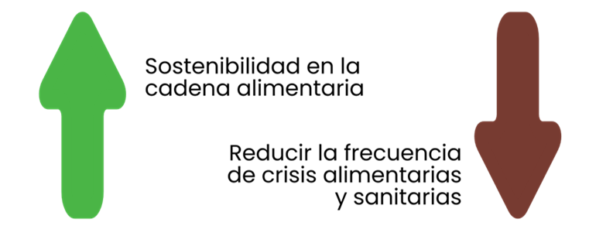
FUTURE PERSPECTIVE
Sustainability and flexibility in food supply chain to improve resilience
Sustainability, flexibility and resilience in the food chain
Reduce the frequency of food and health crisis
Notes:
The changes in lifestyle and measures taken to reduce the spread of COVID-19 have had a disruptive impact on the food supply chain, for example job loss; income loss; constrained movement; and limited economic activities. In order to avoid or reduce the frequency of relevant food and health crisis due to this disruption, it is expected that more approaches towards sustainability, flexibility and resilience are incorporated in the food supply chain. This will allow a better response to new challenges in the future.
The unanticipated shock of COVID-19 has underscored the need for a shift from “business as usual” policy to a more forward looking policy package that invests in the productivity, sustainability, and resilience of the global food system.

Slide 39





FUTURE PERSPECTIVE
Major development of functional and fortified foods that promise healthy life
Product development focus
Health and wellness benefit
Sensory experience (esp. taste)
Clean with recognisable ingredients
Not adulterated
No artificial colors, flavours, preservatives
Less processed
Low/no sugar
Affordable
Address consumers’ time constraints
Consumption is easy to be integrated in daily routine
Source: Functional Food & Beverage 2020 Report Highlights by Hartman Group at :
https://s3.us-west-2.amazonaws.com/storage.www.hartman-group.com/videos/Et9LczZ1cLurRXvB0lFrA1qbOqMAegU1Qo2qcOjB.pdf
Notes:
Because of the COVID-19 pandemic, consumers are increasingly seeking out functional food and beverage products that they believe might boost immunity, as well as overall health and wellness, and thus could aid their body’s defense systems and as part of a general preventive effort.

Slide 40




FUTURE PERSPECTIVE
Better standard for biosecurity and more scientific information
Up-to-date information
Food processors , consumers, farmers, ranchers
Notes:
More information and insights into the pathogenicity and ecological dynamics of coronavirus are being researched and communicated as swifty as posible, by professionals operating along the food supply chain and in government, with the aim of assisting them to establish appropriate biosecurity measures.

Slide 41

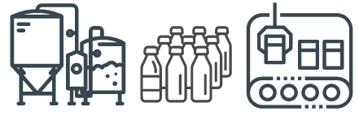
FUTURE PERSPECTIVE
Promote training and interdisciplinary work to improve the design and operation of production plants
Integration between different disciplines
Capacities empowerment
Notes:
To promote the formation of interdisciplinary teams from different fields, for example, between food hygiene, occupational safety and the environment when working on design and operational management aimed at minimising the spread of COVID-19 in food processing plants. Emphasis is directed towards developing a well-integrated system that can prevent exposure to the virus. Examples: integrate the cleaning and disinfection SOP for high contact surfaces into the current cleaning SOP; design the ventilation system for a clean room

Slide 42







FUTURE PERSPECTIVE
Develop better technologies, considering the features of workflow in food processing plants
Notes:
Anxieties due to the pandemic and the need to maintain the food supply chain have triggered many food businesses to seek new technologies and innovations. Example: to develop reliable microfluidic models in food processing plants regarding aerosols or droplets generation and movement, according to the number of workers, and the way in which they are located for optimal production.
Other interest: usage of automation in replacing labour in warehouses and grocery stores (self-kiosk), and the use of artificial intelligence.

Slide 43





CONCLUSIONS
COVID-19 is primarily a respiratory illness. At the time of this presentation, there has been no evidence that food and food packaging is a significant source or transmission for SARS-CoV-2 to the consumers → it is NOT considered as foodborne disease.
Disruptions at different stages due to the pandemic has called for mitigation strategies by government, agencies, institutions and associations : provision of info, best practice, training, hygiene campaign, food program , relief and exemption in policy, economic and technology assistance, researches etc.
Food processors also take step mainly to prevent workers from being exposed to the virus via procedures, use of technologies, training, design of facility, and operation management.
Scientific information continues to evolve through R&D&I and have provided a basis for preventive measures and decision-making. Yet, there are still challenges that need to be addressed by research for better technological development, availability of information and sampling size.
Future works: trend in functional food, building resilience in food supply chain, better technologies and acquisition of more scientific information for better biosecurity arrangement
Notes:
Explanation as in slide

Slide 44
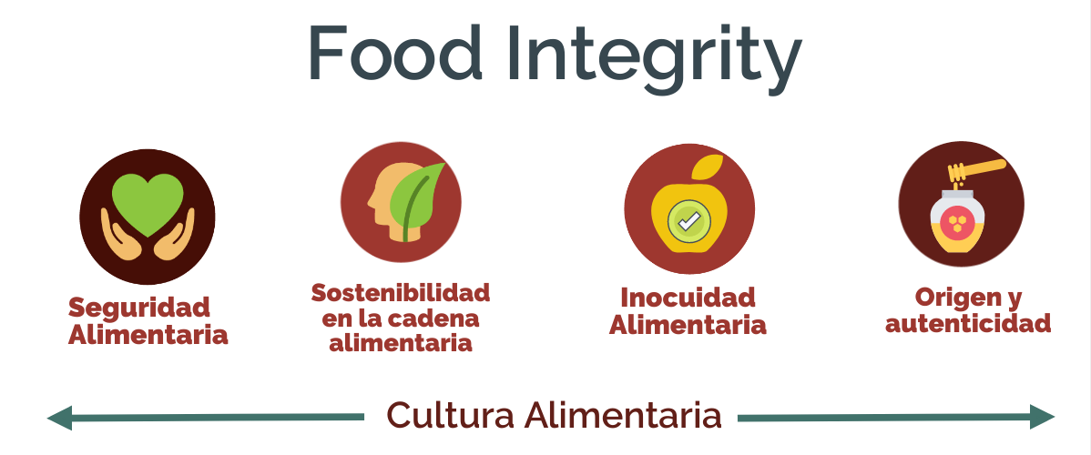
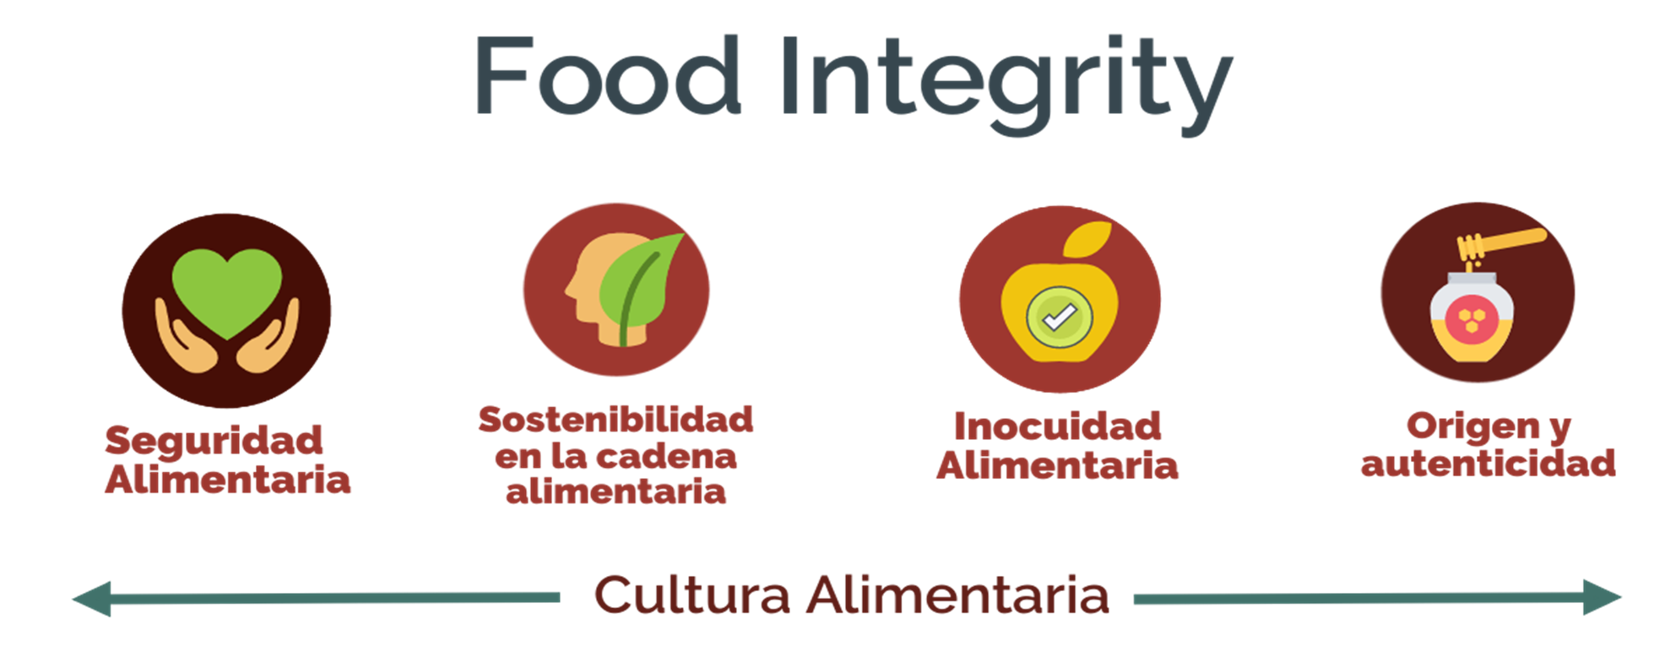
Food
security
Sustainable food supply chain
Food
safety
Authenticity
Food Culture
Notes:
The presentation concludes with a strong urge on maintaning food integrity at this time of pandemic, and this emphasizes on food security, sustainability, food safety and authenticity as part of the food culture.

Slide 45
References
https://www.webmd.com/lung/coronavirus
https://www.wfp.org/emergencies/covid-19-pandemic
https://www.fda.gov/food/food-safety-during-emergencies/food-safety-and-coronavirus-disease-2019-covid-19
https://www.foodanddrinktechnology.com/news/32214/eu-to-ensure-green-lanes-for-food-during-coronavirus/
https://instituteforfoodsafety.cornell.edu/coronavirus-covid-19/food-industry-resources/
https://www.who.int/news-room/q-a-detail/coronavirus-disease-covid-19-food-safety-and-nutrition
https://www.foodstandards.gov.scot/downloads/COVID-19_-_Risk_Assessment_Tool_for_Re-starting_Food_Business_Operations_During_COVID-19.pdf
https://agroknow.com/wp-content/uploads/2020/11/Agroknow-Digital-Transformation-of-Food-Quality-Safety-final.pdf
https://www.food-safety.com/articles/6776-covid-19-food-safety-the-importance-of-research-and-extension-in-mitigating-the-negative-impacts-of-covid-19
https://all-free-download.com/free-vector/download/food-jar-02-vector_163440.html
Aday, S., & Aday, M. S. (2020). Impact of COVID-19 on the food supply chain. Food Quality and Safety, 4(4), 167-180.
Chin, C. (2020). The impact of food supply chain disruptions amidst COVID-19 in Malaysia. Journal of agriculture, food systems, and community development, 9(4), 1-3.
Hobbs, J. E. (2020). Food supply chains during the COVID‐19 pandemic. Canadian Journal of Agricultural Economics/Revue canadienne d'agroeconomie, 68(2), 171-176.
Eftimov, T., Popovski, G., Petković, M., Seljak, B. K., & Kocev, D. (2020). COVID-19 pandemic changes the food consumption patterns. Trends in food science & technology, 104, 268-272.
Sharaf, O. (2020). „Hygienic Food Practice among Food Workers in Jordanian Food Factories during pandemic crisis: COVID-19: comparative study.“Research Square.
Note: Several references have been quoted directly in the related slide.
Notes:
The Reference used for this presentation, aside from original information from the orginal authors, are listed here. There are also references that have been quoted directly in the slides.

Slide 46

Website: https://www.globalharmonization.net/

