Slide 1


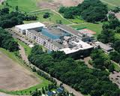
Development of Total Health Care System based on Research of Food Safety and Functionality
Innovation Net Award 2016
Hokkaido Information University
~Ebetsu Model: Current and future~
Professor NISHIHIRA Jun (M.D., PhD.) , Faculty of Medical Informatics, Hokkaido Information University
Ambassador of GHI for Japan
Hokkaido Information University

Slide 2

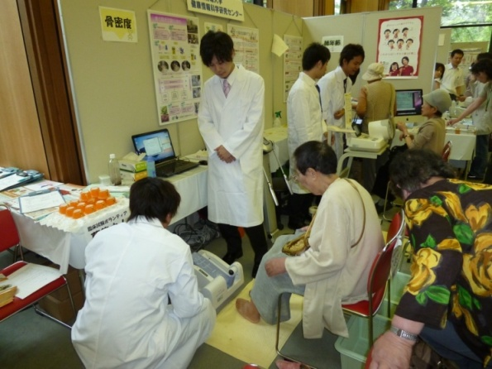
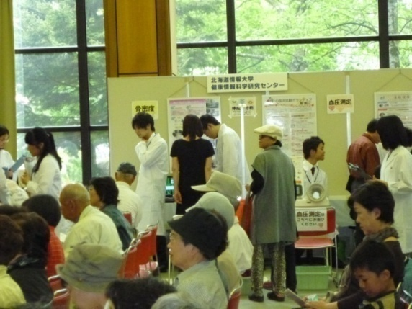

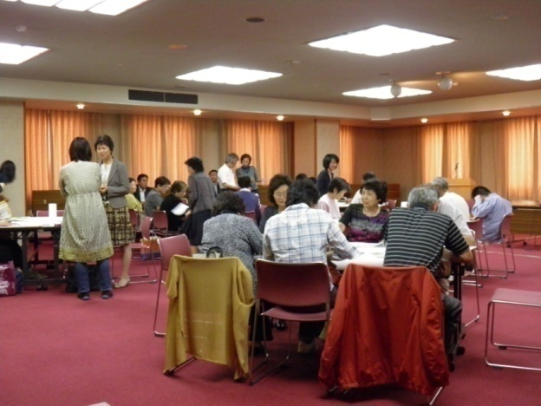
Ebetsu Model – The Community-Based Clinical Trial System for Foods
Ebetsu Public Health Center
Economic Affairs of Ebetsu
Residents’ Association
Consumer’s group
Support &Promotion
Citizen groups of Ebetsu
As volunteers
Partnership
with Ebetsu City
Collecting Clinical data
Providing health information
The system is a collaborated work of citizen groups and residents’ associations, and that students also joined to promote their activities and citizens’ health by providing health related events.
The numbers of volunteer registration: approx. 6,000 (January 2016)
Food industries
Public research Inst.
Univeristies
Clinical Trial
Health Science Center of HIU
Clinical Trial for Foods
Evidence

Slide 3



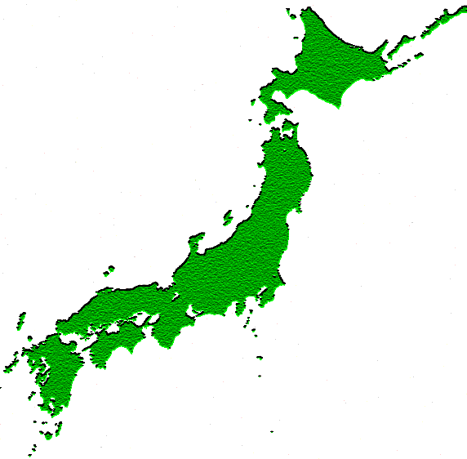
Development of Netword Based on ICT
＜Integration of Medicine and Food＞
“New Ebetsu Model”
・Hokkaido University Hospital
・NOASTEC
・Food manufacturers
Ebetsu City Hospital
Internet
&
Cloud
Universities, Institutes
Affiliated hospitals and clinics
Food companies
＜Total Health Care System＞
Global Network
Volunteers
Clinical Trial System for foods
Data base of local foods
Data mining
Nutrigenomics
National Network
＜Global Harmonization＞
Approx. 6000
Health Science Center in HIU
Notes:
3

Slide 4
The Strategic Regional Innovation (value chain) and Ebetsu Model
Sapporo Health Innovation “ Smart-H”
Food ingredients project
Screening
Function
verification
Clinical Trial
Safety test
Products
Food stuff
Sea urchin
Cell assay
Nuclear assay for total 18 varieties
Cytotoxicity
Nrf2
and others
Specific evaluation
Food ingredients
Maitake
Potatoes
Onions
Black rice
Bowel condiitions
Ebetsu Model
（Clinical Trial）
Enteric bacteria
High-level lipid analysis
Animal model analysis
Safety evaluation
Applying for “Food for Specified Health Uses”
(FOSHU)
Applying for supplement ingredients
Applying for Healthy-DO
Citizen participation
Seamless support
Academic support
High quality & Low price
Development
Marketing
New food ingredients
Functional analysis
Required for Health Claim
Value added products

Slide 5

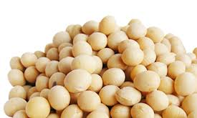
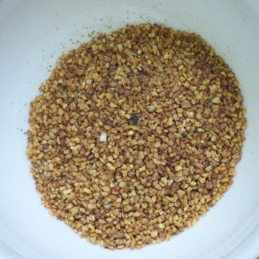
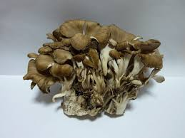







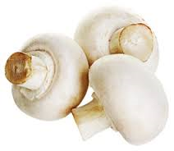
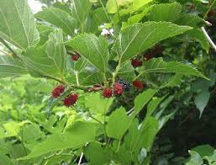


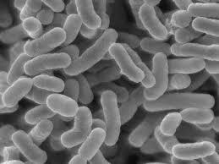
Examples of Ebetsu as for Clinical Studies （2012-2015）
HIU Health Science Center
General Manager: Professor NISHIHIRA Jun
Ingredients made in Hokkaido
Soybeans (new) Tartary Buckwheat (new) Maitake (new) Onions (new) Aspeaagus
大豆（新種） 韃靼ソバ （新種） マイタケ（新種） タマネギ（新種） アスパラガス
Pumpkin (new) Chicories (root) Leeks Rice (enriched) Hering roe
カボチャ（新種） チコリ（根） 長ネギ 道産米 （富化米） カズノコ
Mushrooms Malberry leaves Ume Green tea (new) lactobacillus products
(Kanagawa Prefecture） （Wakayama Prefecture) （Shizuoka Prefecture) Yogurt, supplements, etc.
Red letters：Joint study with National Agriculture and Food Research Organization Blue letters：Joint study with Hokkaido Research Organization

Slide 6


Global Harmonization Initiative （GHI）
➪ The Ambassador for Japan (NISHIHIRA Jun, November 2015)
“Contribution for Food Safety and Globalization (International Standardization )
of Food Functionality”
GHI was founded in 2004 as a joint activity of the US-based Institute of Food Technologists (IFT) International Division and the European Federation of Food Science and Technology (EFFoST). GHI is a network of scientific organizations and individual scientists working together to promote harmonization of global food safety regulations and legislation. GHI's objective is to achieve consensus on the science of food regulations and legislation to ensure the global availability of safe and wholesome food products for all consumers. GHI facilitates global discussion about the scientific issues that support decisions made by national governments and international regulatory bodies. GHI has legal non-profit entity status and its charter and constitution are registered in Vienna, Austria as the GHI Association (ZVR: 453446383). While oversight is provided by the Executive Committee, issues are identified and prioritized by the general membership at workshops held at various locations throughout the world.
＜New Mission of Ebetsu Model＞
Ebestu Model established by Industry-Academia-Government collaboration intends not only promoting food safety and functionality, but also contribute for globalization (international standardization) of food and health as an academic institution.

