Slide 1

Food Safety Regulations Based on Science
Presenter Name
Affiliation
and
Global Harmonization Initiative (GHI)
Ambassador for [country]

Slide 2
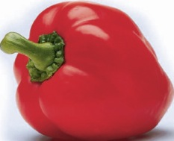
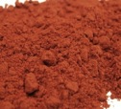
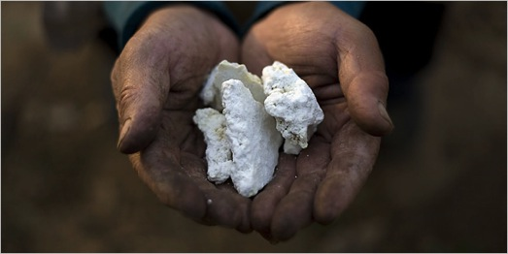
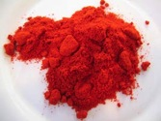

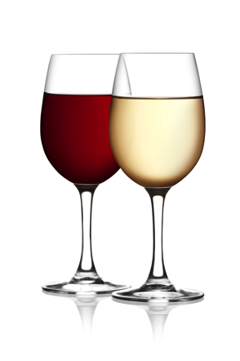
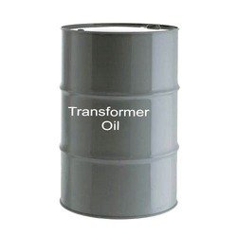
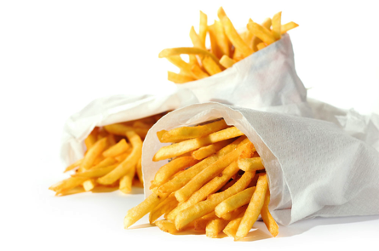
Illegal additives
Lead oxide
Melamine
French fries
Diethylene Glycol
Notes:
1. In Hungary, in 1994, lead oxide was added to dried paprika to enhance the colour and that way made low-quality product look better. Source: Williams Carol J. Market Focus : Tainted Paprika Poisons Hungary's Culinary Pride : Fifty-nine people are arrested in the scandal, which sent 46 to the hospital. The health of the industry is also at stake. Los Angeles Times, 11 October 1994.
2. This is a well known, similar case. Adding melamine and water to increase the apparent amount of milk, the nitrogen content being adjusted by the melamine. It increased the nitrogen value (Kjeldahl analysis) giving the impression that the protein concentration was correct.
3. In spring 1999, it was found that some 500 tons of feed contaminated with polychlorinated biphenyls (PCBs) and dioxins were fed to farm animals in Belgium and to a lesser extent in the Netherlands, France and Germany.
4. Diethylene Glycol in wine (Austria) and toothpaste.

Slide 3
Chemicals that are not allowed but nevertheless present in food are not necessarily additives. Most man-made chemicals occur in nature in concentrations that can be detected now, but not previously. They are produced by
  animals
  microbes (bacteria, fungi, parasites)
  plants
  geochemical processes (e.g. volcanos)
they include chlorinated organic compounds. More than 5000 different natural organic halogens have been identified in nature.
Notes:
G.W. Gribble. Chemosphere 52 (2003), 289–297 and Heterocycles, 84 (1) (2011), 157-207

Slide 4
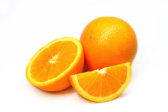
30-03-2012 USA:
Carbendazim in orange juice
Carbendazim is approved as pesticide in many countries, but no longer in the United States.
MRLs (maximum residual levels) for carbendazim
EU: 100 ppb - 700 ppb
Canada: 500 - 6000 ppb
USA: 10 ppb (per 30-03-2013)
US Environmental Protection Agency:
“... consumption of orange juice with carbendazim at the low levels that have been reported does not raise public health concerns.”
GHI
Notes:
Requiring absence makes that the methods of analysis determine how much is allowed. In the past 50 or so years, the detection limits for many chemicals have gone down by a factor of about a million. That means that absence not is a million time less that 50 years ago. Not because of scientific evidence of toxicity, but only because of the improvement in analysis. The slide shows detection capability of antibiotics in milk (examples).

Slide 5
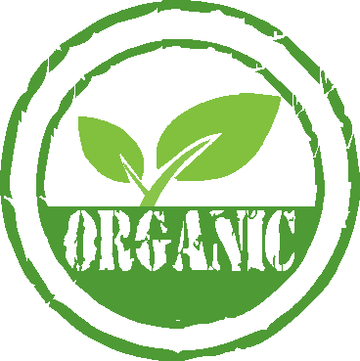
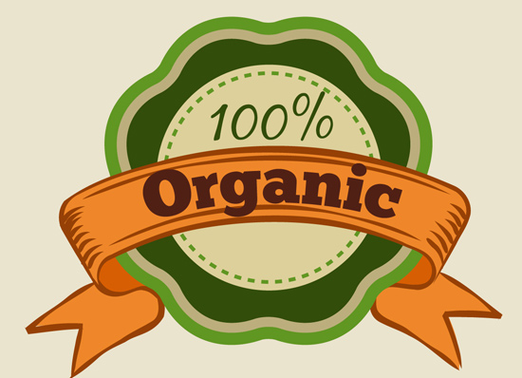
Organic food may contain more pesticides than normal food
Most pesticides
are
organic
Notes:
A very important issue. See in particular:
Swirsky Gold L., Slone T.H. and Ames B.N., ‘Prioritization of possible carcinogenic hazards in food’. In: Food Chemical Risk Analysis, ed Tennant D R, New York, Chapman and Hall, 1997 267–295.
Complete text also on: http://toxnet.nlm.nih.gov/cpdb/text/maff.html

Slide 6
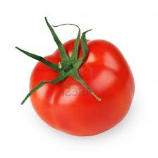
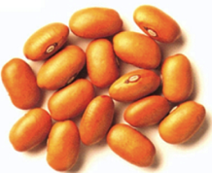
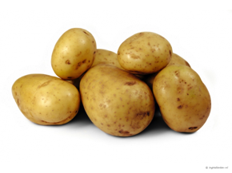
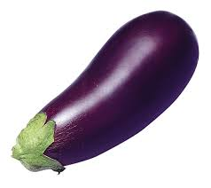
Natural, potentially toxic substances in food
1
lectins (or hemaglutinins) (pulses)
enzyme inhibitors (soy, peas, beet, cereals)
piperidines (black pepper)
caffein, threobromin, theophilin (coffee, chocolade, tea)
solanine (potatoes, tomatoes, aubergines)
tomatine (tomatoes)
Notes:
All foods contain substances (chemicals) that are toxic if consumed in too high amounts. This and the next two slides give examples. There are no exceptions. People who do not eat food with (potentially toxic) chemicals will starve to death.

Slide 7
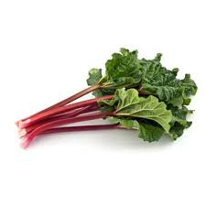
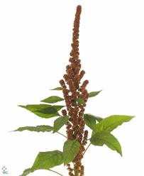
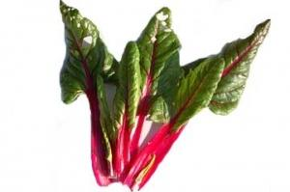
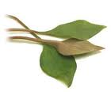
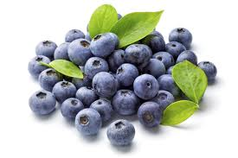
Natural, potentially toxic substances in food
2
oxalates (rhubarb, spinach, parsley, chives, purslane, cassava, amaranth, chard, taro leaves, radish, kale, monstera fruit)
coumarin (cinnamon, peppermint, green tea, chicory, blueberries)
glucosinolates such as sinigrin, progoitrin (cabbage, broccoli, Brussels sprouts, cauliflower, turnip, radish, horseradish, mustard, rapeseed)

Slide 8
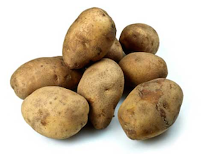
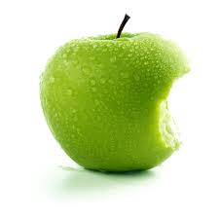
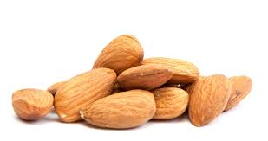
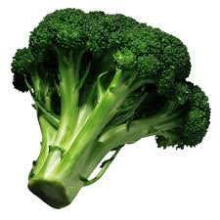
Natural, potentially toxic substances in food
3
cyanogenic glycosides, such as amygdalin (almond, laurel) and linamarin (cassave)
saponins (peanut, soy, spinach, broccoli, potato, apple)
growth hormones
antibiotics

Slide 9

Acetaldehyde
Benzaldehyde
Benzene
Benzofuran
Benzo(a)pyrene
Caffeic Acid
Catechol
1,2,5,6-dibenzanthracene
Formaldehyde
Furan
Furfural
Hydroquinone
Isoprene
Limonene
Styrene
Toluene
Xylene
Etc.
Notes:
Some of the chemicals in coffee. All potentially (geno)toxic/carcinogenic, but toxicity is a matter of amounts. See later.

Slide 10
Coffee Consumption and the Risk of Colorectal Cancer
Stephanie L. Schmit, Hedy S. Rennert, Gad Rennert, and Stephen B. Gruber
Conclusion
Coffee consumption may be inversely associated with risk of colorectal cancer in a dose–response manner.
Notes:
Cancer Epidemiol Biomarkers Prev; 25(4); 634–9.
Abstract on http://cebp.aacrjournals.org/content/25/4/634
Some of the chemicals in coffee. All potentially (geno)toxic, but toxicity is a matter of amounts. See later.

Slide 11
A Comprehensive Overview of the Risks and Benefits of Coffee Consumption by L. Kirsty Pourshahidi, Luciano Navarini, Marino Petracco, and J.J. Strain
Investigation of 1277 studies (1970-2015)
Conclusions
Overall, results of this comprehensive review show that the health benefits (or null effects) clearly outweigh the risks of moderate coffee consumption in adult consumers for the majority of health outcomes considered........
Notes:
2016 Institute of Food Technologists®
doi: 10.1111/1541-4337.12206 Vol. 00, 2016
Comprehensive Reviews in Food Science and Food Safety

Slide 12
Differences in regulations
result in needless destruction of healthy food in a world where a billion people have very little or no food
hamper international trade and innovation

Slide 13
The making of food safety regulations
The main problem is the lack of understanding of toxicity by
        politicians
        general public
        activists (antis)
        press
and the strong influence of professional lobbyists
Notes:
Politicians have a strong tendency to promise to do what makes them look good so that they will be re-elected. They do not use time to look at facts and most of them find scientists just troublemakers who they do not trust.
The general public has the information from newspapers. Most journalist prefer to publish negative messages, because that is what the publisher wants, it sales better. Writing in a newspaper that all is fine and right does not sell.
Many activists are just against. The topic often does not matter. In the case of food. Everything is wrong, because governments want to control people and industries want to make money, all at the expense of the people. So they try to make “the people” believe this and be against e-numbers, preservatives, processed food, etc. etc.
With - in most countries - just a few exceptions, the press cares about how many copies they can sell, not about correctness of the information. Checking the information takes too much time.

Slide 14

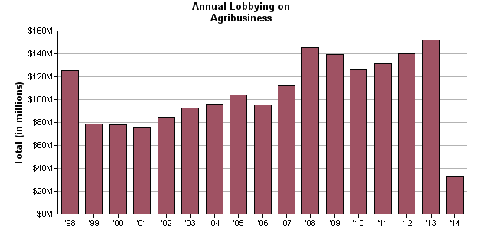
Lobbying
USA
2013
Total for Agribusiness: $151,730,315
Total Number of Clients Reported: 453
Total Number of Lobbyists Reported: 1,154
Notes:
This is from the webpage https://www.opensecrets.org/lobby/indus.php?id=A
All lobbying expenditures on this page come from the Senate Office of Public Records. Data for the most recent year were downloaded on April 28, 2014.
The amount of money spent on trying to influence the politicians, to get them doing what is good for the industry is huge, more that 150 million US$ (or far more than € 100 million).

Slide 15
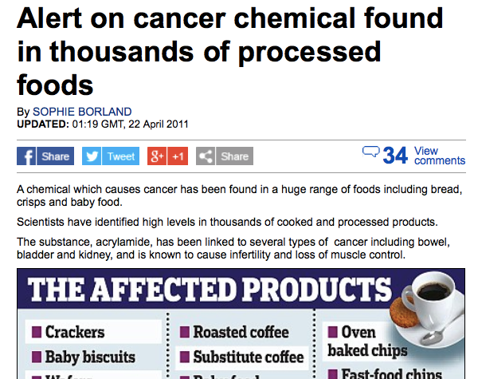
Notes:
No further explanation required, or?

Slide 16

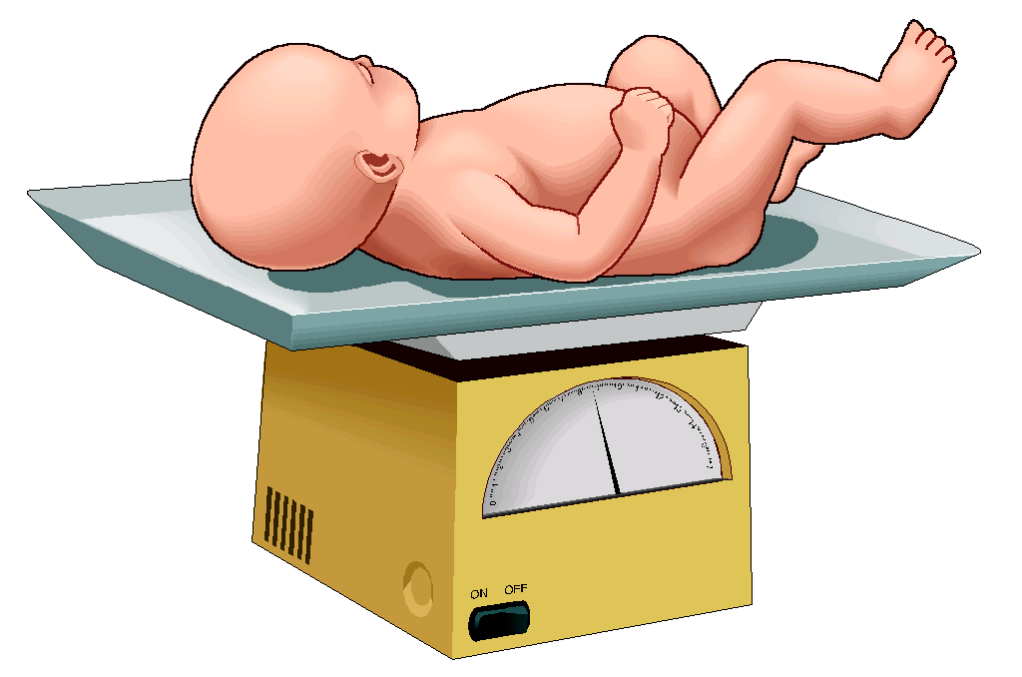
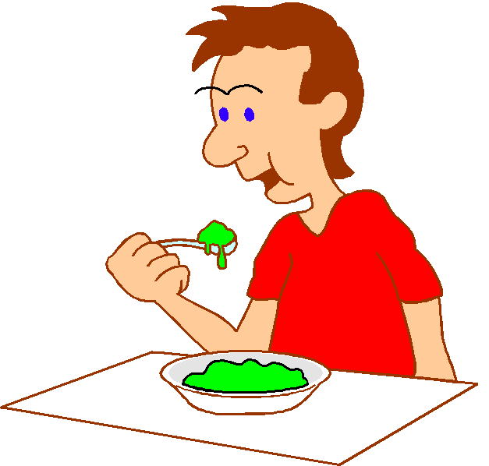
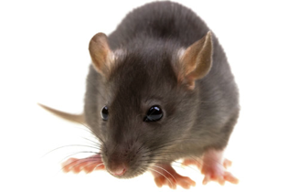


Absurd regulations
ZERO-TOLERANCE
Antibiotics in food
Soedan Red
= ABSENCE OF ...
20.000 kg/day
800.000 kg/day
ppt* in products with ingredients form China
* About 1 grain of 2mm in an
Olympic swimming pool)
800 l per day life long
Notes:
Antibiotics may no be added to food and therefore, if present in food, governments seize the food and destroy it. Even entire shiploads. The amount of antibiotics, however, is very far below the level at which it can do harm. The same antibiotics are given to people and even babies in million times higher amounts. For a very small chance of harm, a baby would have to eat 20,000 kilograms of the antibiotic-containing food per day the rest of its life. Adults even more of course. The regulations are in such cases absurd. If an antibiotic is added to food and that is illegal, the perpetrator should be prosecuted, but destroying the food is totally useless – senseless.
The same applies to many other chemicals present in food (added ot naturally prresent). Soudan Red is an example of absurd measures taken by a govenment. A person who drinks 800 liter per day pf worchester sauce (just an example) for the rest of his life has a chance to suffer damage from the chemical. Nevertheless, the UK government at the time demanded the recall and destruction of huge amounts of food, worths more than € 15,000,000.

Slide 17

The Netherlands, June 2014
Furazolidon from feed into meat
Average exposure to humans eating meat 1.2 μg per meal (and worst case 8 μg per meal)
Internationally recognised potential harm at 3 μg per day during a life time (i.e. 50 or 70 years)
There are NO reports of harmful effects of therapeutic doses of 200 mg per day during 21 days (WHO) - this is 25,000 times more than the worst case amount
Conclusion: the meat is safe
Destruction of 2474 calves and 100 companies closed
Source: Netherlands Food and Consumer Product Safety Authority
Notes:
Another example. An antibiotic in feed for calves (and other animals). Conclusion of the food safety authority is that the meat of the calves is safe. Nevertheless the government orders the destruction of almost 2500 healthy calves.

Slide 18
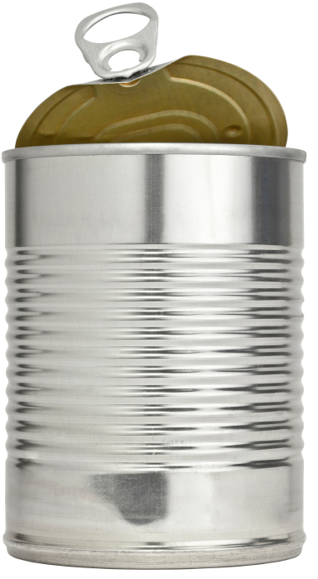
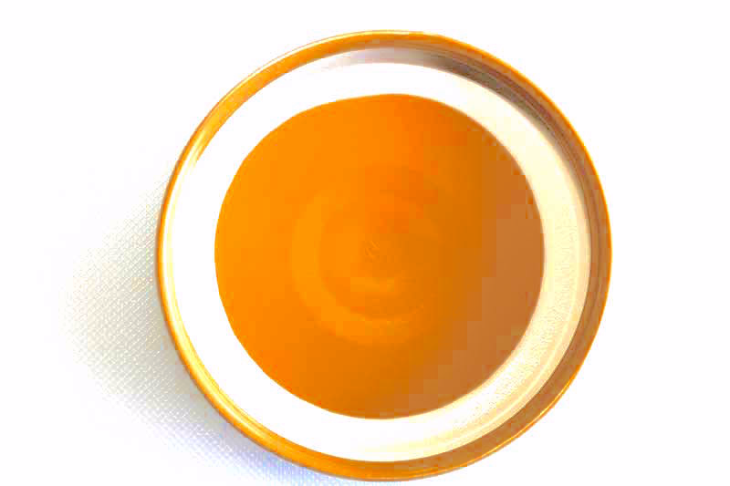
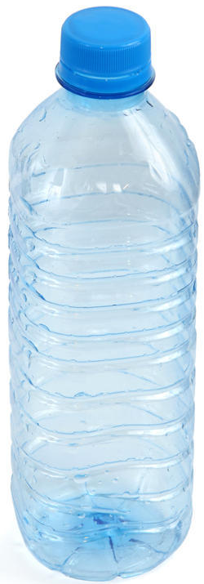
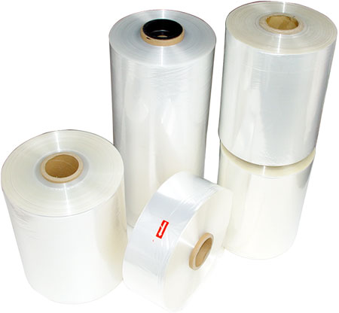
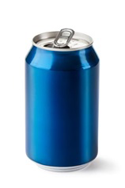
Packaging materials in contact with food
Examples
phthalates
perfluorooctanoic acid
bisphenol-A
aluminium
iron
Notes:
If the concentrations are high enough, these chemicals (and many others) present in food packaging materials may be unsafe for human consumption. The question is what doses are dangerous. Iron can be very toxic in high concentrations but helps to prevent anemia.
Picture of can: http://teenology101.seattlechildrens.org/wp-content/uploads/can.jpg
Picture of plastic bottle: http://assets.babycenter.com/ims/2013/09Sepb/144871875_4x3_soundoff2.jpg
Picture of plastic wrapping material: http://pimg.pack.cn/uploadfiles/ware//img/product/2007/8/31/214058448.jpg
Picture of lid of jar: http://www.meatsandsausages.com/public/images/canning-equipment/equipment-jar-lid-continuous-thread-1.jpg
Picture of aluminium can: http://www.wastenet.org.nz/~/media/WasteNet/Images/OrangePages/AluminiumCanshutterstock101028916%20Small.ashx?as=1&w=158

Slide 19
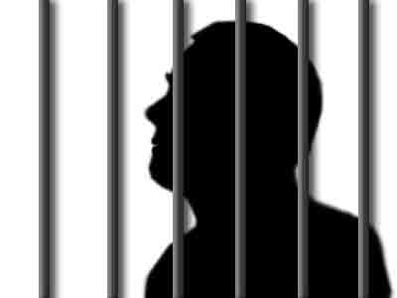
If chemicals have been added illegally:
those responsible should be prosecuted
the product should be confiscated
but if safe, the product should not be destroyed

Slide 20
Now
ACTIVISTS
General public
LOBBYISTS
PRESS
Politicians
Scientists
Regulators
Notes:
Politicians get most of the signals on which they base their decisions from Activists and lobbyists. The activists receive their donations from that part of the public that is easily influence by activists. The regulations are paid to do that the politicians have decided. Scientists communicate with each other but hardly with those who could make a difference.

Slide 21
Future
ACTIVISTS
General public
LOBBYISTS
PRESS
Politicians
Scientists
Regulators
Notes:
Scientists and their organisations need to learn communicate with the stakeholders. That way politicians eventually may make better decisions on food safety issues. This is what GHI strives to do.

Slide 22

The Global Harmonization Initiative wants to improve food regulations and remove absurd regulations by obtaining global scientific consensus
and convincing those who need to know

Slide 23
Damage
Dose
The perception of the general public
Notes:
This figure shows the interpretation of toxicity by the general public: a toxic substance does damage independent of the dose, i.e. damage can be prevented only if the substance is totally absent. This leads to absurd regulations, as those that lead to the destruction of safe and nutritious food. Also some chemicals are no longer allowed for use in packaging materials or process equipment even when the concentration resulting from leaching into the food is so low (sometimes below the natural concentration in the food), that harm is not possible and indeed never has been reported.

Slide 24
Damage
Dose
Understanding of most politicians and policy makers
Notes:
This figure shows what most politicians and policy makers may believe and make the regulators apply: the higher the concentration the more damage to health, but a very low concentration where e.g. only one person on a million will suffer is acceptable. Still the idea is that there is always damage and no damage will require total absence.

Slide 25

Damage
Dose
Threshold
Toxicologists: there is a threshold of no concern makes (NOAEL, no adverse effect level). All food contains toxins.
Notes:
This figure shows the evidence-based opinion of toxicologists: there is a threshold below which there is no effect. That means below a certain dose there will be no damage. That is why the human body for instance has a liver and kidneys.

Slide 26
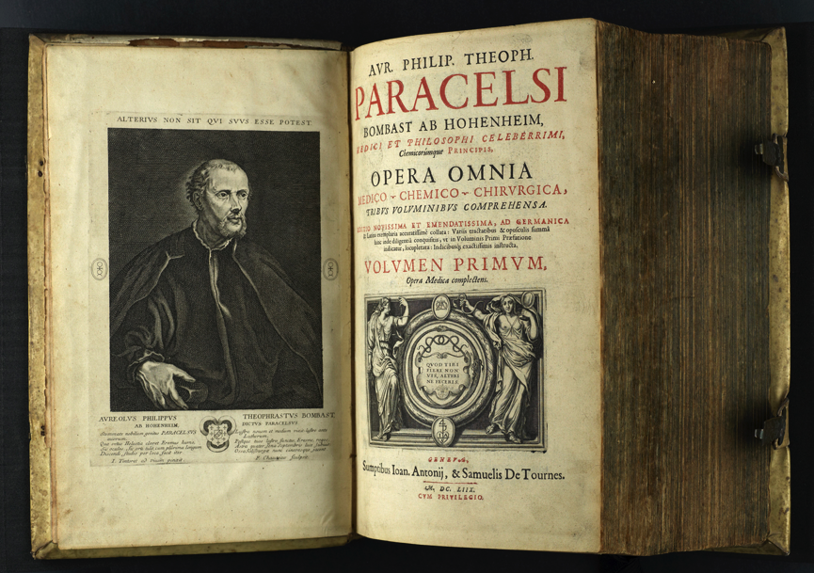
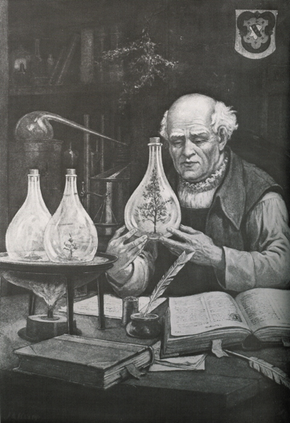
Everything is poisonous if the amount is high enough
or
There are no toxic substances, only toxic concentrations
Notes:
Already about 500 years ago, Paracelsus had concluded that toxicity depends on amounts.

Slide 27
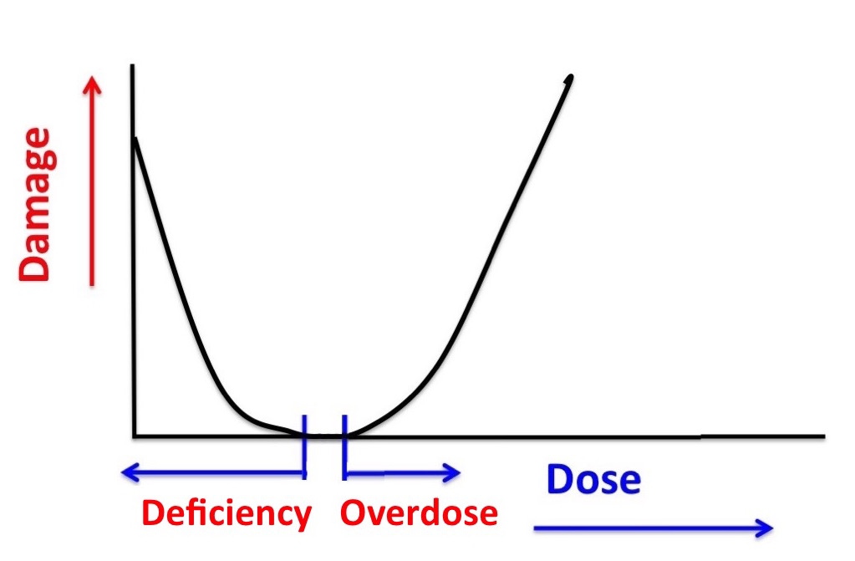
Many substances are harmless in the right amounts but harmful if too much or not enough
Notes:
For many substances the situation is as Paracelsus discovered: if the dose is too high, damage is done. However sometimes a too low dose of the substance is also a health risk, as it is the case with vitamins and minerals. Without them we get ill and may die, but too high a dose has the same results.

Slide 28
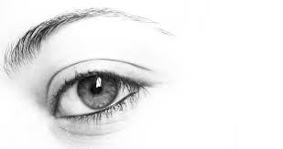
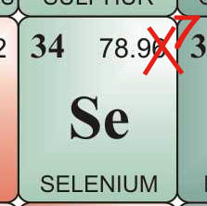
Vitamin A
Adults: needed 1 mg per day
harmful at 3 mg per day
Seleen
Adults: needed 50-150 μg per day
harmful at 300 μg per dag
(Netherlands Health Council)
Notes:
Examples:
Vitamin A and Selenium are essential for your health but too much is harmful. The amount consumed determines whether it is healthy or toxic. Sometimes the difference is very small.

Slide 29
Evolution
Humans and their predecessors have been exposed to all those most scary chemicals for millions of years and developed a biological system (with liver, kidneys, etc.) to cope with them or even use them beneficially.
The system, however, can be overloaded and then the chemical becomes toxic.

Slide 30

GHI Working Group Genetic toxicology
Dr. Firouz Darroudi, the lead expert in this field gives GHI endorsed courses to make governments and industry aware of the test tube methodology.
Until recently: Head of the department Genetic Toxicology, University Medical Centre, Leiden (still leading projects)
Still: Senior Advisor of Unesco, WHO, IAEA and the National Institute for Occupational Safety and Health (USA)
More recently:
Director of Biomedical Research and Head of Radiation Genetics and Chemical Mutagenesis in Doha (Qatar)
Director of the Center of Human Safety & Health and Diagnostic Genome Analysis in Dubai (UAE)
Supervisor of research programs of a recently opened cancer research center in Tehran
Notes:
Animal testing for genotoxicity is not relevant to humans, that has been demonstrated many times. Therefore the EU funded large projects to find alternatives. The research was successful, using hep g2 (human liver) cells, tests can be done in a single day, without animals, cheaply and fully relevant to humans. Regulators seem not to notice and animal testing is still required (the test-tube method exists for more than 10 years!).

Slide 31
WG Genetic toxicology
Chair: Firouz Darroudi
Currently evidence of safety of new food products, new ingredients and new technologies is typically obtained by animal testing.
Testing using animals is not popular and therefore the industry is reluctant to introduce improved products and processes. Moreover it is slow and expensive.
The alternative, developed in the past three decades is in vitro testing, using intact human liver cells. It is:
  more accurate
  relevant to humans (not test animals)
  cheap
  fast
But it is NOT IN CURRENT REGULATIONS

Slide 32
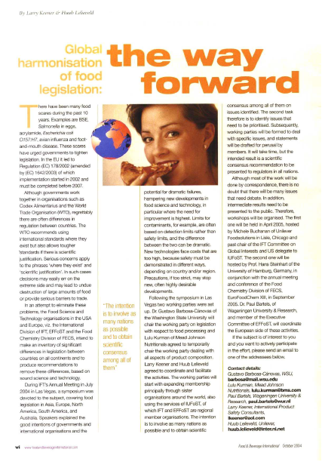
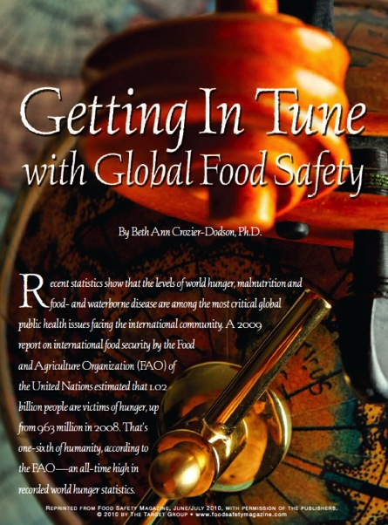
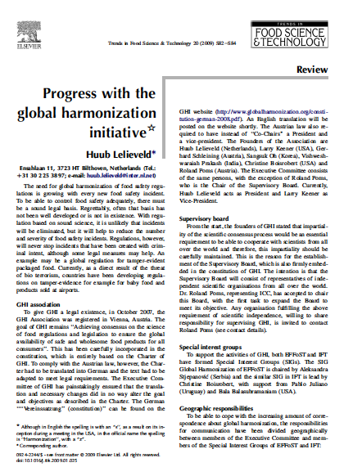
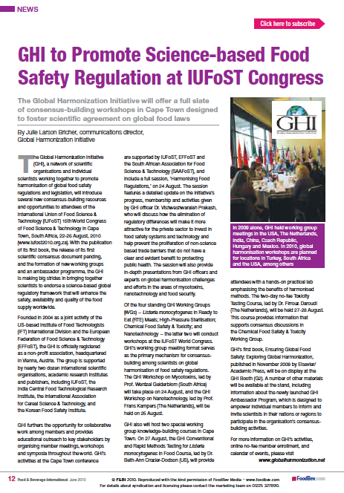
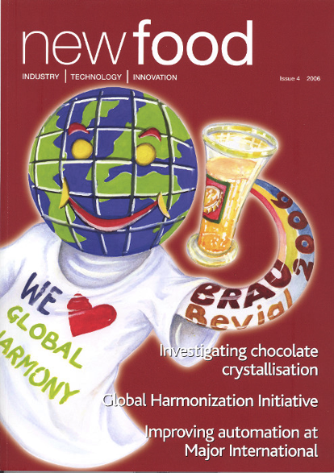
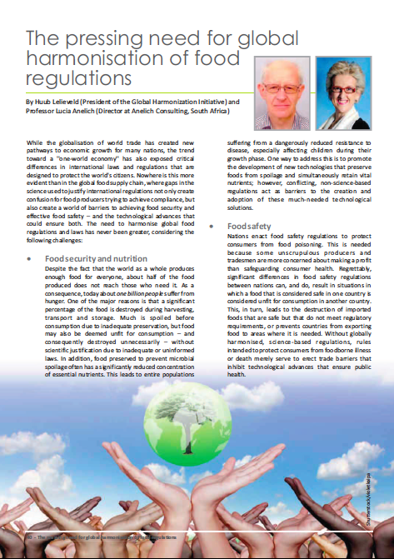
Notes:
There are more publications, this is just an example.

Slide 33
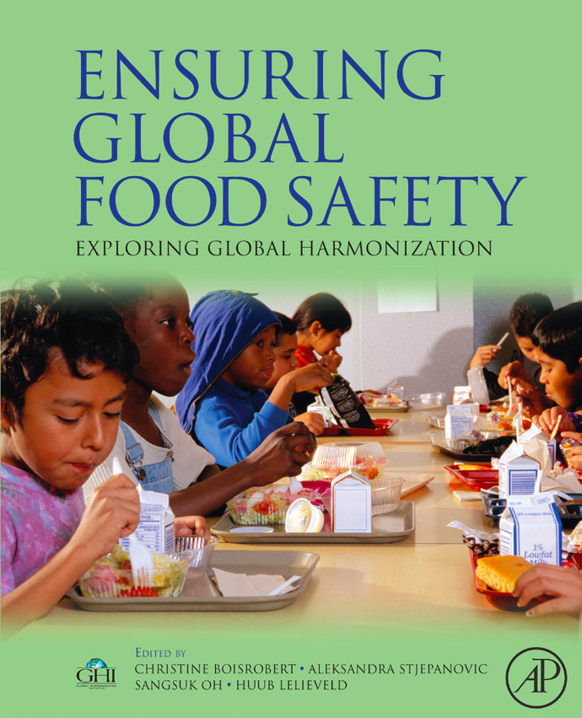

Published by Elsevier
in 2010
Use promo code GHI30 for 30% discount
Notes:
Ensuring Global Food Safety – Exploring Global Harmonization (http://www.elsevierdirect.com/9780123748454)

Slide 34
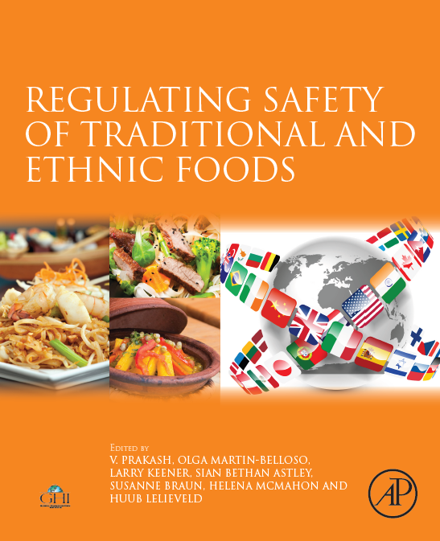
Published by Elsevier
November 2015
Use promo code GHI30 for 30% discount
Notes:
Regulating Safety of Traditional and Ethnic Foods (http://store.elsevier.com/Regulating-Safety-of-Traditional-and-Ethnic-Foods/isbn-9780128006054/)

Slide 35
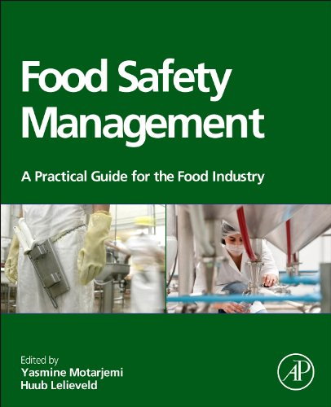
Published by Elsevier
in 2014
Use promo code GHI30 for 30% discount
Notes:
Food safety management: a practical guide for the food industry" (http://store.elsevier.com/Food-Safety-Management/isbn-9780123815040/)

Slide 36
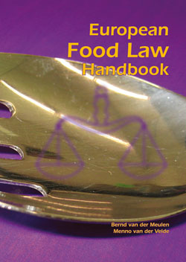
European Food Law Handbook
B. v.d. Meulen and M. v.d. Velde
Wageningen University
Eur. Inst. for Food Law
2008 632 pages
ISBN: 978-90-8686-082-1
Bernd van der Meulen is Legal Advisor (Foods) in GHI and a Member of the Board of GHI
Price (€): 66.00 (excluding VAT)

Slide 37
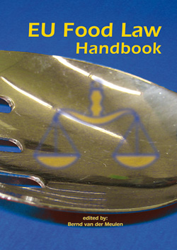
EU Food Law Handbook
B. v.d. Meulen
Wageningen University
Eur. Inst. for Food Law
2014 692 pages
ISBN: 978-90-8686-246-7
Bernd van der Meulen is Legal Advisor (Foods) in GHI and a Member of the Board of GH
Price (€): 75.00 (excluding VAT)

Slide 38
If you are not a member, you are invited to join GHI, just go to

www.globalharmonization.net/user/register
Or email
Info@globalharmonization.net
There is no fee, you only need to qualify as a food scientist
You will influence the future
Z

Slide 39
Thank you for your interest

