Slide 1


About GHI: A Network for Change

Slide 2

GLOBAL HARMONIZATION INITIATIVE
WHO WE ARE
GHI is a network of individual scientists and scientific organizations working together to promote harmonization of global food safety regulations and legislation.
Formed in 2004 as a joint activity of the Institute of Food Technologists (IFT) International Division and the European Federation of Food Science and Technology (EFFoST)
In 2007, GHI officially achieved the status of a nonprofit, charitable association and is registered in Vienna, Austria (ZVR453446383)

Slide 3

GLOBAL HARMONIZATION INITIATIVE
MISSION AND OBJECTIVES
GHI’s mission is to achieve consensus on the science that underlies food regulations and legislation, globally, to ensure the worldwide availability of safe and wholesome food products for all consumers.
GHI’s objectives are to:
Connect scientists and experts from around the world
Construct working group processes and collaborative forums
Communicate findings and recommendations to policymakers, regulators, public health authorities, the media and the public

Slide 4

GLOBAL HARMONIZATION INITIATIVE
MISSION AND OBJECTIVES
GHI facilitates global discussion about scientific issues to better support informed, objective decisions of national governments and international regulatory bodies by:
  Providing the foundation and recommendations for sound, sensible, science-based food safety regulations worldwide
  Creating a forum for scientists and technologists to interact with each other and with regulatory authorities, globally
  Giving industry, regulators and consumers an independent, authoritative information resource

Slide 5

GLOBAL IMPACT OF HARMONIZATION
ON PUBLIC HEALTH POLICY DECISION-MAKING
For governmental and public health agencies responsible for overseeing the safety of the food supply, global harmonization of food regulations and laws will bring:
  Higher levels of confidence that risk-reduction strategies and food safety measures are effective
  Assurance that decisions taken are based on science and not on political agendas that are in conflict with public health goals
  Improved ability to allocate available resources where they have the highest impact on the most pressing foodborne disease, nutrition and food security challenges
Notes:
For governmental and public health agencies responsible for overseeing the safety of the international food supply, harmonization of food regulations will bring:
1. Higher levels of confidence that risk-reduction strategies and food safety measures are effective
2. Assurance that decisions taken are based on science and not on political agendas that are in conflict with public health goals
3. The ability to allocate available resources where they have the highest impact on the most pressing foodborne disease, nutrition and food security challenges

Slide 6
HARMONIZING GLOBAL REGULATIONS WILL...
GHI OBJECTIVES
Eliminate trade barriers that masquerade as food safety protections
When trade barriers are not science-based, but erected for political, not public health, reasons, they:
Reduce effectiveness of public health protection measures
Reduce the availability of food actually safe to consume
Harmonized regulations reduce unnecessary destruction of food and improve food safety and security
Eliminate trade barriers
Harmonize
food safety
laws and regulations
Notes:
GHI anticipates that the elimination of regulatory and legislative differences between countries by providing information that promotes science-based policy-making will have a significant, positive impact on several fronts:
• Global harmonization of food laws will eliminate trade barriers that masquerade as food safety protections. World market interdependence has increasingly exposed widely varying, and sometimes conflicting, national and international food safety laws, regulations and standards that create trade barriers erected for political, not public health, reasons. Differing food safety policies, requirements or rules based on insufficient or contradictory science not only reduce the effectiveness of public health protection measures but can greatly reduce the availability of food that is actually safe to consume.

Slide 7
HARMONIZING GLOBAL REGULATIONS WILL...
GHI OBJECTIVES
Help reduce world hunger, foodborne disease and the potential for pandemic outbreaks
Eliminate trade barriers
Reduce hunger/outbreaks
1 billion people are hungry or malnourished worldwide
Safe food destroyed at borders due to non-science based regulations/laws
Foodborne disease once local, now potential to spread farther
Harmonized regulations support scientifically sound food protection measures
Harmonize food safety laws and regulations
Notes:
GHI anticipates that the elimination of regulatory and legislative differences between countries by providing information that promotes science-based policy-making will have a significant, positive impact on several fronts:
• Global harmonization of food laws will help reduce world hunger and foodborne disease. According to recent FAO estimates, more than 1 billion people are victims of hunger, or one-sixth of humanity. Unfortunately, untold amounts of food are destroyed each day, barred from ports of entry based on unnecessary trade barriers. Harmonized international food regulations will help ensure that safe food is not destroyed for wrong reasons.
• Global harmonization of food laws will help reduce the potential for pandemic foodborne illness outbreaks. Rapid globalization of food trade has increased the potential of adulterated food to negatively affect greater numbers of people worldwide, according to the WHO. As the international food supply chain becomes more interconnected, foodborne disease outbreaks that were once localized now have the potential to become massive in scope. Harmonized regulations will support the use of effective, scientifically sound food protection measures to better address this challenge.

Slide 8
HARMONIZING GLOBAL REGULATIONS WILL...
GHI OBJECTIVES
Boost technological innovation and adoption to improve food safety and quality
Eliminate trade barriers
Reduce hunger/outbreaks
Differing food safety laws and rules create uncertainties in the global regulatory environment
Instability reduces investment in and use of new food safety and quality technologies
Harmonization will make investments in food safety and R&D more attractive
Harmonize food safety laws and regulations
Boost technology innovation
Notes:
: GHI anticipates that the elimination of regulatory and legislative differences between countries by providing information that promotes science-based policy-making will have a significant, positive impact on several fronts:
• Global harmonization of food laws will boost technological innovation. National differences in food safety laws and rules can create an uncertain global regulatory environment that reduces investment in and adoption of new technologies designed to improve food safety and quality for consumers. Harmonization will make it more attractive for the private sector to invest in food safety and R&D, consequently strengthening the competitiveness of each nation's food industry and of the industries supplying the food sector. Harmonizing global regulations will aid in the uptake and application of new technologies to ensure the safety and quality of the food supply for consumers worldwide.

Slide 9
GHI ORGANIZATIONAL STRUCTURE
GENERAL ASSEMBLY
Representatives of scientifically independent organizations and individual scientists responsible to elect the members of the GHI Board and Auditors
BOARD
Manages the association according to the GHI constitution
AUDITORS
Supervise GHI business and accounts
SCIENTIFIC WORKING GROUPS
Collect and analyze scientific evidence; develop consensus statements or position papers
DIRECTORS
Lead, administer and develop programs under the direction of the GHI Board
• Executive Director
• Membership Director
• Ambassador Programme Director
• Course Director
• Communications Director
SUPERVISORY BOARD
Guards the impartiallity of GHI activities and the integrity of the consensus process
EXPERTS
Review and approve consensus statements/position papers produced by working groups
Notes:
GHI develops and manages its consensus-building activities according to the organizational structure shown here.
All positions are staffed by volunteers.
While oversight is provided by the GHI Board, issues are identified and prioritized by the general membership at workshops held at various locations throughout the world. Experts approve consensus statements to ensure impartiality prior to release.

Slide 10

GHI WORKING GROUPS
GOALS
GHI Working Groups provide a platform for member scientists and experts to engage with colleagues to collaborate, build consensus and take collective action within topical areas relevant to our mission.
Members work together to come to agreement on the scientific principles that support informed and objective global regulatory and legislative decision-making.
Working Groups look at each focus area from all sides, examining the scientific and legal issues piece-by-piece and side-by-side to complete the global harmonization puzzle.
Notes:
GHI Working Groups (WGs) provide a platform for GHI member scientists and experts to engage with colleagues to collaborate, build consensus and take collective action within topical areas relevant to our mission.
Members of the GHI WGs — scientists and experts from industry, government and academia with expertise in food safety, nutrition, regulation and trade — work together to come to agreement on the scientific principles that support informed and objective global regulatory and legislative decision-making.
Working Groups look at each focus area from all sides, examining the scientific and legal issues piece-by-piece and side-by-side to complete the global harmonization puzzle.

Slide 11
GHI WORKING GROUPS
THE PROCESS
CONNECT
COLLABORATE
CRAFT
COMMUNICATE
Free membership to qualified food scientists and other experts, worldwide
GHI members may join Working Groups of interest
GHI members may propose new Working Groups
Working Group focus on topics relevant to GHI’s mission
GHI organizes Working Group meetings
Working Groups collect, evaluate scientific evidence
Assess existing (or lack of) food laws and regulations
Identify potential for harmonization of global laws/regs consistent with scientific findings
Working Groups draft position statements
Findings undergo rigorous subject matter review by global experts
GHI issues official white papers or other publications to regulators, legislators, media, public health professionals, and the public
GHI creates communication materials and educational outreach tools based on findings
Articles, social media, blogs, GHI ShareSheets, presentations, etc.
Communications are distributed to the public, press and policymakers
Notes:
Each WG collects and evaluates available scientific evidence in the area of interest, and assesses the existing laws and regulations (or lack thereof) and the potential for harmonization of global laws and regulations consistent with the scientific findings.
The goal of each GHI Working Group is to develop a white paper or consensus statement that promotes globally harmonized, science-based food regulations in a specific focus area.
Each Working Group’s findings undergo a rigorous and international subject matter expert review.
Once finalized, GHI issues official consensus statements via white papers or similar deliverables for global distribution to public health authorities, regulatory agencies, legislative and policymaking bodies.
GHI also communicates the WG findings to the public, press and policymakers through its communications channels, including social media, web blog, digital email and e-newsletter, articles, and conference presentations. GHI ShareSheets are easy-to-read one- or two-page briefs that highlight scinetific principles, global harmonization issues, and working group findings.

Slide 12
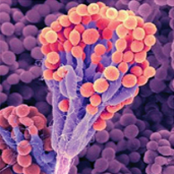

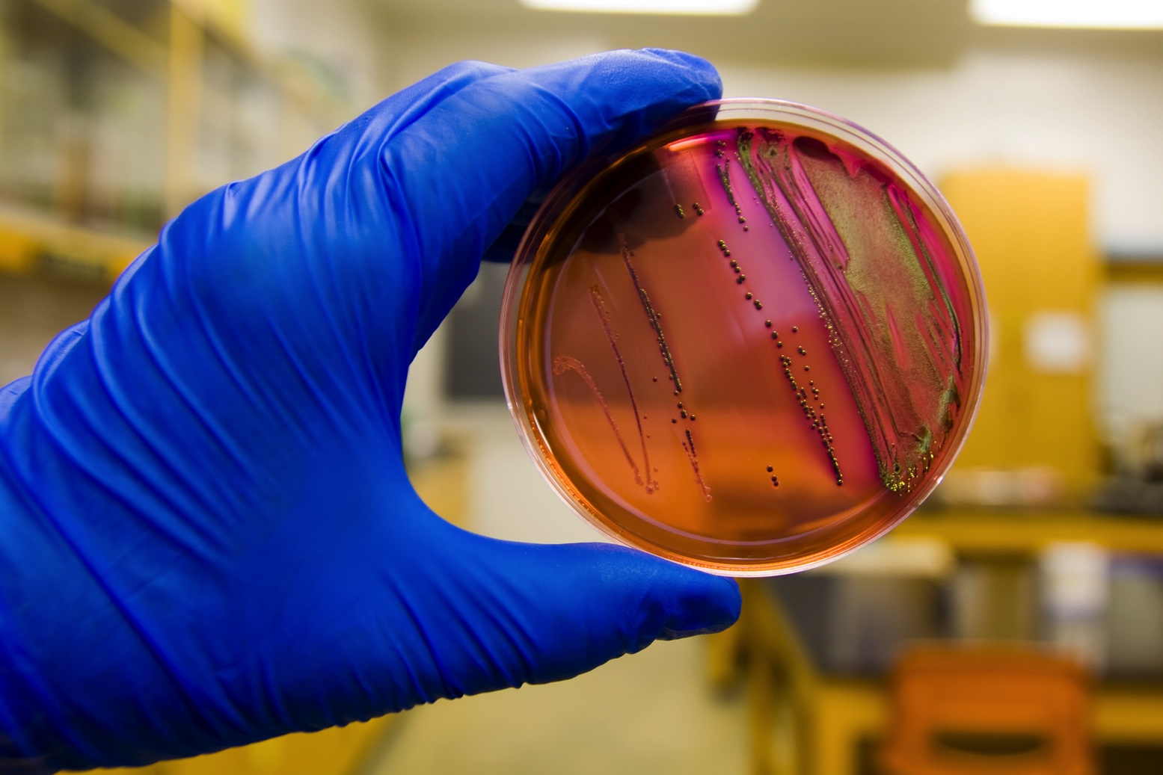

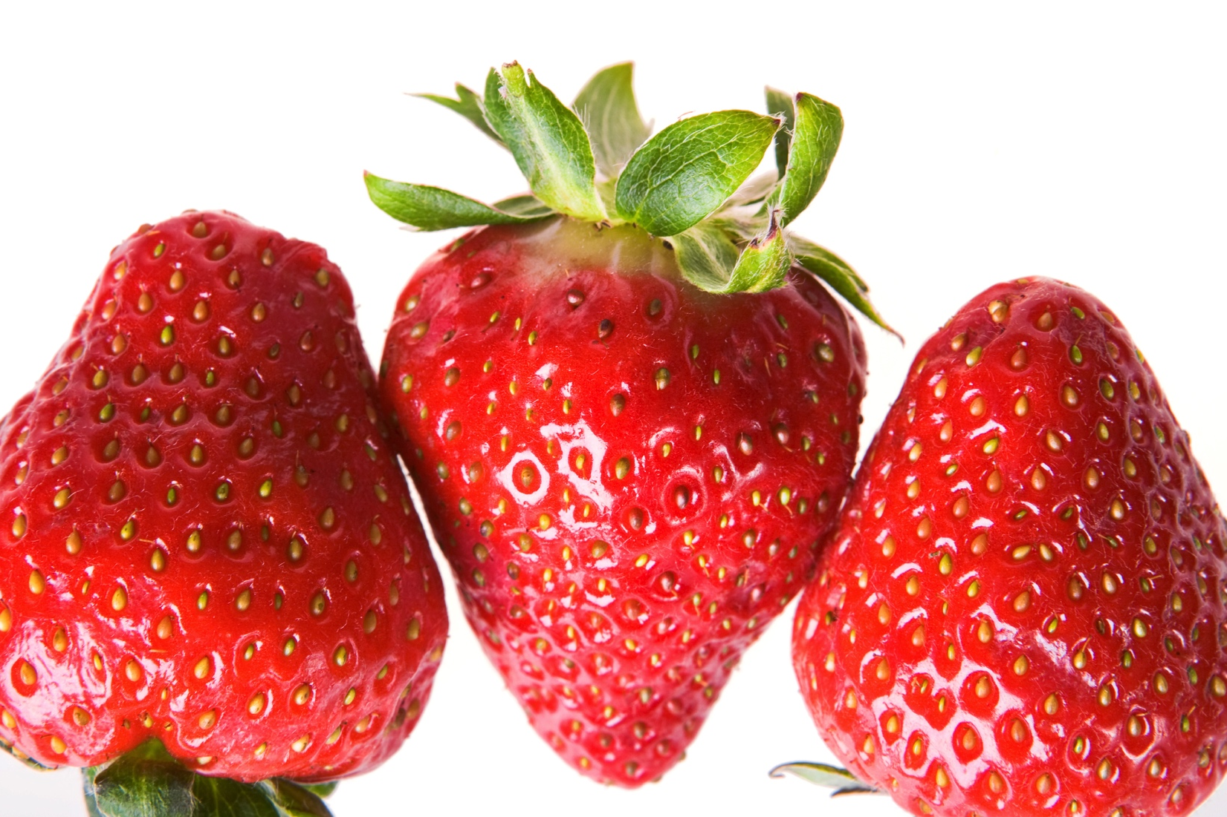
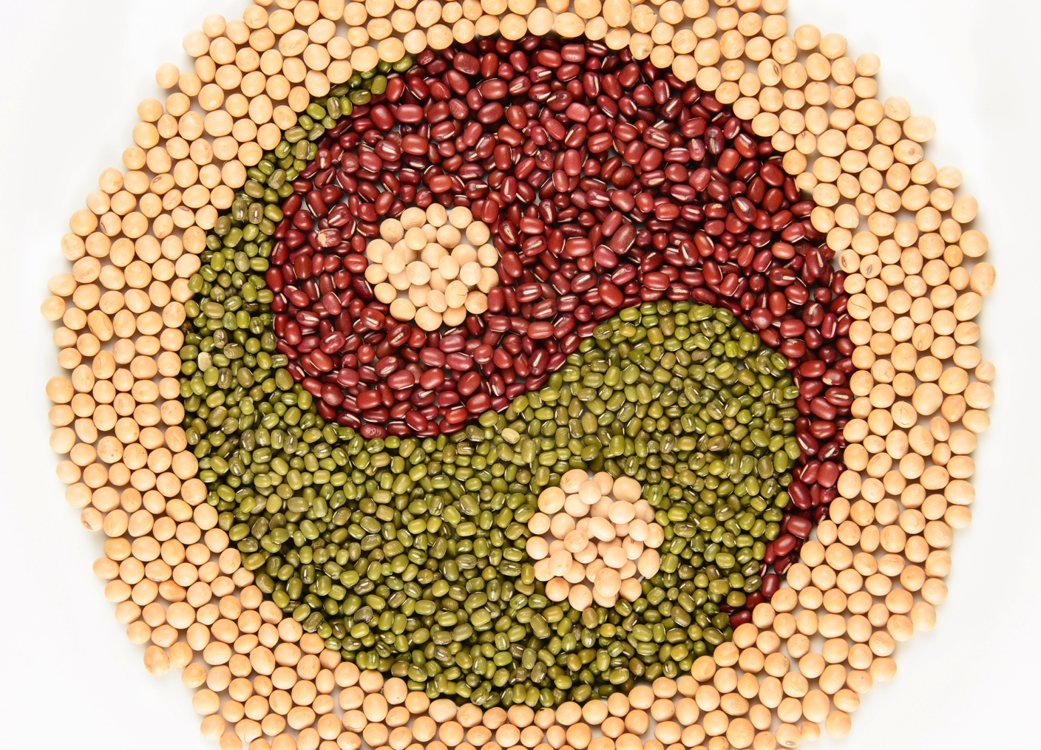


GHI WORKING GROUPS
ACTIVE TOPIC AREAS
Mycotoxins
Chemical Food Safety
Food Microbiology
Nanotechnology
Regulatory Aspects of Reducing Post-Harvest Losses
Food Safety in Relation to Religious Dietary Laws
Nutrition
Genetic Toxicology
Notes:
Standing Working Groups & Chairs
Chemical Food Safety
Dr. Jaap Hanekamp, The Netherlands
Food Microbiology
Dr. Julian Cox, Australia
Genetic Toxicology
Dr. Firouz Darroudi, The Netherlands
Mycotoxins
Dr. Naresh Magan, UK
Dr. Mark Shamtsyan, Russia
Dr. Karina Grigoryan, Armenia
Nanotechnology
Dr. An-I Yeh, Taiwan
Nutrition
Dr. Vishweshwaraiah Prakash, India
Dr. Iuliana Vintila, Romania
Regulatory Aspects of Reducing Post-Harvest Losses
Dr. Kenneth Marsh, USA
Food Safety in Relation to Religious Dietary Laws
Isabella van Rijn, MSc, The Netherlands
Dr. Ismail Odetokun, Nigeria
Members of GHI may join one or more Working Groups of interest. Please visit the Working Group page at www.globalharmonization.net for details on how to join.

Slide 13



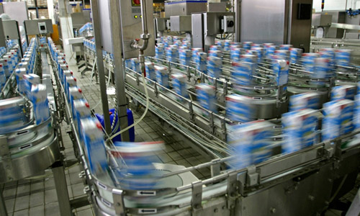
GHI WORKING GROUPS
NOW FORMING
Ethics in the Food Industry
Nomenclature on Food Safety and Quality
Principles of Process Validation
Food Contact Materials
GHI has accepted proposals for a number of new Working Groups on topics of interest.
If you would like to contribute as a member in any of these groups now forming, visit the Working Group area on GHI’s website.
Notes:
GHI has accepted proposals for a number of new Working Groups. If you would like to contribute as a member in any of these groups, please visit the Working Group area online at www.globalharmonization.net, or contact the Working Group Coordinator via email at wg@globalharmonization.net. (Note: Contact information at end of this slide presentation).
The chairs for these proposed Working Groups are:
Ethics in the Food Industry
Irena Šoljić, MSc., Croatia
Food Contact Materials
Mr. Eric Partington, United Kingdom
Principles of Process Validation
Tatiana Koutchma, Canada
Nomenclature on Food Safety and Quality
Dr. Dmitri Chr. Kulyov, Russia
Dr. Ileana Negruzza, Russia
Dr. Roger Fenwick, United Kingdom

Slide 14
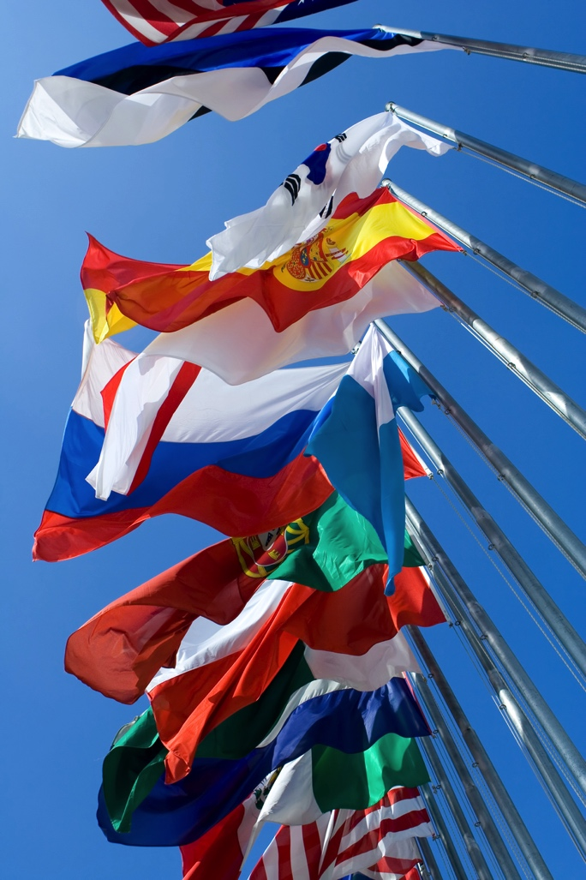
AMBASSADOR PROGRAMME
EMPOWERING CHANGE
GHI Ambassadors are members selected to serve as front‐line representatives of the association on local, regional and national levels.
Ambassadors:
Invite scientists in their regions/countries to join GHI
Foster new opportunities for information-sharing
Share and translate GHI communications materials and messaging
Identify specialists to review position papers and GHI science-based communications
Encourage colleagues and experts to participate in GHI Working Groups
Please visit www.globalharmonization.net for more details about the Ambassador Programme, responsibilities and benefits, and how to apply.
Notes:
The GHI Ambassador Programme empowers selected members to serve as front‐line representatives for GHI.
Ambassadors invite scientists in their regions or countries to enroll as GHI members, foster new opportunities for information-sharing, and identify specialists to comment on consensus documents and science-based communications produced by the association.
GHI seeks scientists willing to promote the goals of the association in their countries or regions. Interested Ambassador Programme applicants must possess:
A willingness to subscribe to the goals and philosophy of GHI
Skills and experience that allow sound scientific assessments
Good communication skills, both verbal and written, in the local language and in English
Interest in food regulations, risk/benefit analysis and the scientific process and in disseminating this information
Willingness to identify specialists and scientific forums, communicate with food safety regulators and discuss issues in the local language
Find out more at the GHI website.

Slide 15

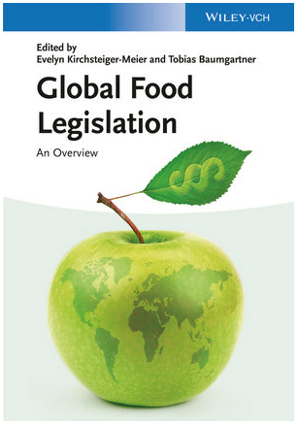




GHI PUBLICATIONS
BOOKS OF INTEREST
2009
2013
2014
2014
2014
2015
Notes:
In addition to the GHI Book Series published by Elsevier/Academic Press, many association members author, edit or contribute books and book chapters on GHI Working Group topics and other subjects related to the global harmonization of food safety legislation and regulation.
Two of the books shown here are in the GHI Book Series, published by Elsevier Academic Press:
Ensuring Global Food Safety: Exploring Global Harmonization
Edited by Christine Boisrobert, Aleksandra Stjepanovic, Sangsuk Oh and Huub Lelieveld
November 2009
Presents science-based arguments to explore the many aspects and considerations that must be taken into account, while arguing that a global regulatory program will lead to nutritional and food supply improvements around the world.
Regulating Safety of Traditional and Ethnic Foods
Edited by V. Prakash, Olga Martin-Belloso, Larry Keener, Sian B. Astley, Susanne Braun, Helena McMahon and Huub Lelieveld
December 2015
Examines a variety of traditional foods from around the world, their risks and benefits, and how regulatory steps may assist in establishing safe parameters for these foods without reducing their cultural or nutritive value in today’s diets.
The other books feature GHI member contributions as editors or authors, and cover some aspects of global harmonization of food safety legislation and regulations.
A 30% discount on selected books is available. Visit GHI’s website for more on these books and to download the discount flier to get the special code!

Slide 16

GHI-FINANCIALS
OUR FUND-RAISING FOUNDATION
In order to ensure GHI’s impartiality, a separate organization, GHI-Financials, has been established to raise funds from industry and governments for the specific support of GHI activities.
GHI-Financials is a non-profit foundation with a constitution established under Dutch law and a board of advisors unrelated to the management of GHI.
Both GHI and GHI-Financials have ANBI status in The Netherlands. The designation — which translates to “Institutions Aimed at the Common Good” — allows gifts from private donors to GHI-Financials to be deducted from income tax.
Notes:
GHI is a registered non-profit association in Austria (ZVR: 453446383). In order to ensure our impartiality, a separate organization, GHI-Financials, has been established to raise funds from industry and governments for the sole support of GHI activities.
GHI-Financials is a non-profit foundation with a constitution established under Dutch law and a board of advisors unrelated to the management of GHI.
In 2012, both GHI and GHI-Financials were granted ANBI status in The Netherlands. The ANBI abbreviation stands for ‘Algemeen Nut Beoogende Instellingen,’ or Institutions Aimed at the Common Good. To receive this designation, at least 90% of an organization's efforts has to be focused on the general good. With the ANBI status, gifts from private donors to GHI-Financials can be deducted against income tax.

Slide 17

GET INVOLVED WITH GHI
SHARE YOUR EXPERTISE
Join our global community of food scientists united in a shared vision that harmonized science-based food safety regulations and legislation will foster trade, fuel innovation and feed people around the world.
GHI membership is free to scientists and experts from industry, government and academia with expertise in food safety, nutrition, regulation, law and trade.
Visit our website at www.globalharmonization.net for details on the benefits of membership and to apply.
Notes:
When you join GHI, you join a global community of food scientists united in a shared vision that harmonized science-based food safety regulations and legislation will foster trade, fuel innovation and feed people around the world. GHI membership provides you with the resources and opportunities to connect and collaborate with your scientific colleagues through our working groups, conference activities and communications network.
Professional membership is free and open to qualified individual food scientists and food safety, nutrition, and legal experts, without regard to their affiliation to industry, government, regulatory bodies, or academic/research institutions. Free membership enables you to contribute your scientific expertise and knowledge in an impartial, authoritative manner.

Slide 18

CONNECT WITH US
ONLINE & SOCIAL MEDIA LINKS
LINKEDin
www.linkedin.com/company/global-harmonization-initiative
FACEBOOK
www.facebook/GHI4FoodSafety
TWITTER
@GHI4FoodSafety
WEBSITE
www.globalharmonization.net
WEBSITE RE-LAUNCH
In Spring 2016, GHI launched a newly redesigned and updated website. Please visit us at www.globalharmonization.net for the latest news, calendar of events, membership sign-up, working group and ambassador updates, and more…

Slide 19
THANK YOU
FOR YOUR TIME AND ATTENTION
QUESTIONS?

