Slide 1
Debunking misinformation about food
Huub Lelieveld and Veslemøy Andersen

Slide 2
Please know that downloading is for personal use only
and
images may be protected by copyright
The source of the pictures is given in the notes

Slide 3
The unconscious mind
The brain uses 20% of the energy spent by the body and most of it for unconsious tasks
We cannot handle our life if we must control consiously where to put our feets to walk, where to put your food to eat, where to direct our eyes to read, what to do to escape a sudden danger
The unconsious mind is continuously learning and evaluating and storing that information for immediate use when needed
The mind in continually influenced by the environment and controls our spontaneous responses
Notes:
Picture: https://lmk88.com/podcast/the-science-of-intuition/attachment/human-active-brain/

Slide 4
What we think and do is not entirely under our conscious control but largely based on history and environment
Ancient mechanisms and fears are used by antis to influence public opinion, similar to other shameless liars like many politicians and contemporary presidents
However, not all antis are liars, some have good reasons
By learning how our responses to our surroundings work in our brain we can strengthen our ability to recognize good and bad thoughts emerging from our unconscious mind
Notes:
https://dedipic.com/render/professional-liar-pinocchio-trump-3d-caricature/

Slide 5
Notes:
https://www.amazon.com/Before-You-Know-Unconscious-Reasons/dp/1501101218

Slide 6
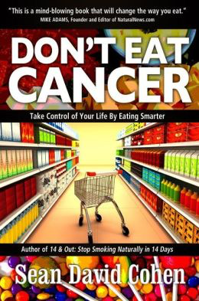
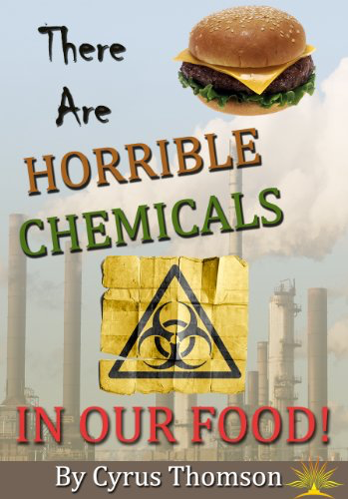
Notes:
https://www.amazon.com/gp/product/B00IN1TIWE/ref=x_gr_w_bb?ie=UTF8&tag=x_gr_w_bb-20&linkCode=as2&camp=1789&creative=9325&creativeASIN=B00IN1TIWE&SubscriptionId=1MGPYB6YW3HWK55XCGG2
https://www.amazon.com/Dont-Eat-Cancer-Modern-Prevention/dp/1940192242

Slide 7
Notes:
http://farmwars.info/wp-content/uploads/2010/07/plan-for-global-food-supply_600.jpg

Slide 8
Barbara H. Peterson
Notes:
http://farmwars.info/?page_id=2

Slide 9
We are already having to deal with food that is injected with foreign genes (GMOs), blasted with pesticides, irradiated beyond recognition, pasteurized, homogenized, scraped off a slaughterhouse floor, and making us sicker by the minute .....
..... just add a little more GMO such as golden rice, chock full of artificial inserted “vitamins” to the food supply and force feed it to the public .....
... so that big pharma can keep us in its death grip and suck the remaining life out of our bones by “treating” the diseases created by our “new and improved” lifestyles with even more “new and improved” designer drugs.
© 2010 Barbara H. Peterson
http://farmwars.info/?p=3261
Notes:
http://farmwars.info/?p=3261

Slide 10
Irradiated food

Slide 11
Notes:
https://fi.m.wikipedia.org/wiki/Tiedosto:EM_Spectrum3-new.jpg

Slide 12
Without a single scientific reference
Notes:
https://www.amazon.in/Zapped-Irradiation-Death-Mark-Worth/dp/1567513689
Fruit picture bought from Dreamstime

Slide 13
(accelerated electrons)
Notes:
https://www.semanticscholar.org/paper/Electron-Beam-Technology-and-Other-Irradiation-in-Pillai-Shayanfar/c6ee72b81a02e455f63ad1666382ca55750a30ca/figure/2

Slide 14
Commodities travel on a high-speed conveyor belt
Beams of accelerated electrons shower the food from two directions
Commodities can be treated in cases or in final retail packaging
Notes:
https://fruitgrowersnews.com/article/food-irradiation-marketed-to-fresh-produce-market/

Slide 15
Notes:
https://www.semanticscholar.org/paper/Electron-Beam-Technology-and-Other-Irradiation-in-Pillai-Shayanfar/c6ee72b81a02e455f63ad1666382ca55750a30ca/figure/1

Slide 16
⁶⁰Co and ¹³⁷Cs
Notes:
https://www.texasgateway.org/resource/153-food-irradiation

Slide 17
Practical use of irradiation
If used to treat food, irradiation:
inactivates microbes
kills insects
prevents sprouting of (e.g.) potatoes
retards ripening of fruits
and hence offers the possibility to keep food longer fit for consumption

Slide 18
Irradiation
The “general public” has difficulty in distincting
irradiated from radioactive
IRRADIATED
WARNING
SAFE
often perceived as warning

Slide 19
Irradiation
Radiation may harm depending on the dose
Radiation does not make the irradiated food radioactive
3 months
1 hour
Notes:
Sunburn modified from
figures: http://clipart-library.com/clipart/rcLopB8Ai.htm

Slide 20
It is correct that irradiation does change the chemistry of food, like it changes the chemistry of microbes and insects and kills them.
So do other preservation technologies, whether heat, high-pressure, pulsed electric fiels or chemical.
The changes
prevent the food from spoilage
influence flavour, structure and taste
all of it is chemistry
The issue is whether it makes the food less safe than fresh food. The only two chemicals that rose concern were benzene (and its derivatives) and alkylcyclobutanones (ACBs). Extensive research showed that the amounts formed were too low (compared with the consumption from other food) to be of concern.
Notes:
(McNeal et al., 1993 = McNeal, T.P., Nyman, P.J., Diachenko, G.W., and Hollifield, H.C. 1993. Survey of benzene in foods by using headspace concentration techniques and capillary gas chromatography. J. AOAC Intl. 76(6): 1213-9.)
and J. Scott Smith, Ph.D., and Suresh Pillai, Ph.D. Irradiation and Food Safety. Food technology 2004, Vol. 58, no. 11. pp. 48-55

Slide 21
Radiophobia
Joseph John Bevelacqua¹ and SM Javad Mortazavi² illustrated in a very clear way the influence on the environment and history on the thinking of people, see the quotation in the next slide.
¹Bevelacqua Resources, 343 Adair Drive, Richland, Washington, WA 99352, USA
²Diagnostic Imaging Department, Fox Chase Cancer Center, Philadelphia, PA 19111, USA
Notes:
https://www.intechopen.com/profiles/115462/joseph-bevelacqua
https://www.foxchase.org/sm-mortazavi

Slide 22
If society applied the radiophobia logic to cooking food, it would also be viewed as a negative technology. A hypothetical example illustrates applying the radiophobia mindset to cooking food with thermal radiation:
Scientists have developed a new technology called thermal radiation (e.g., infrared radiation) as a method that is alleged to improve the taste and edibility of foods. Thermal radiation proponents claim that it kills known pathogens and prolongs the food’s shelf life. Unfortunately, thermal radiation has a number of negative side effects that suggest its use is potentially harmful. Thermal technology produces carcinogenic materials in meat, reduces the vitamin content of fruits and vegetables, and produces hazardous chemical compounds in eggs. Therefore, cooking foods with thermal radiation should be avoided and restricted by regulations until detailed research proves that it is not harmful to human health.
Notes:
Quoted with permission

Slide 23
Irradiation of food or food ingredients is practised in many but by far not all countries and nowhere for all food. In many countries a permission is still required - for political reasons.
Countries where irradiation of food is at least partially approved:
Australia, China, European Union (28 countries), India, Indonesia, Japan, Malaysia, Mexico, South Africa, Thailand, USA, Vietnam
If occupational safety requirements are met and the applied dose is in accordance with the levels proven to be safe, based on scientific data irradiation could be allowed everywhere and without restrictions.

Slide 24
Global Harmonization Initiative (GHI)
Consensus Document on Food Irradiation
“Discordant international regulations of food irradiation are a public health impediment and a barrier to global trade”
Publication date October 2018
In short confirms that
Irradiated food
is safe to consume
is nutritionally adequate
has the same sensory properties as non-irradiated food
Can be downloaded from the library on the GHI website
Notes:
https://www.globalharmonization.net/sites/default/files/pdf/GHI-Food-Irradiation_October-2018.pdf

Slide 25
Genetically Modified Food

Slide 26
Genetically modified foods are foods produced from organisms that have had changes introduced into their DNA using genetic engineering.
Notes:
https://nl.pinterest.com/pin/344666177711821774/

Slide 27
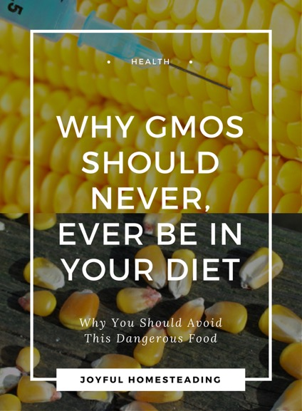
How the Venture to
Genetically Engineer Our Food Has
Subverted Science, Corrupted Government,
and Systematically Deceived the Public
Notes:
http://www.joyfulhomesteading.com/what-are-gmo.html
https://www.pinterest.es/pin/354940014364940967/
https://www.chelseagreen.com/product/altered-genes-twisted-truth/

Slide 28
Ilnesses claimed to be caused by GMO food
Notes:
http://activismcode.com/2017/08/13/40-studies-proves-gmo-foods-destroying-health-and-body-illness/gmo-illnes/

Slide 29
Notes:
http://robalini.blogspot.com/2009/08/hungry-man-franken-food.html
https://i2.wp.com/www.skepticalraptor.com/blog/wp-content/uploads/2014/09/cancer-gmo-flakes-kellogs.png

Slide 30
Activists claim the GM wheat at Rothamsted uses dangerous technology ( Rex Features )
Notes:
https://www.independent.co.uk/hei-fi/news/scientists-plead-with-anti-gm-protesters-not-to-destroy-crop-7788322.html

Slide 31
Hungary has recently burned over one thousand acres of GMO crops. Hungary is one of the few European countries that has banned all types of GMO (seeds and crops).
Notes:
https://bioventures.wordpress.com/2013/12/07/the-fight-against-gmos/

Slide 32
Photo courtesy Philippine Department of Agriculture Regional Field Unit 5
Experimental field of genetically modified Golden Rice in the Philippines being destroyed by antis, 8 August 2013
Notes:
https://slate.com/technology/2013/08/golden-rice-attack-in-philippines-anti-gmo-activists-lie-about-protest-and-safety.html

Slide 33
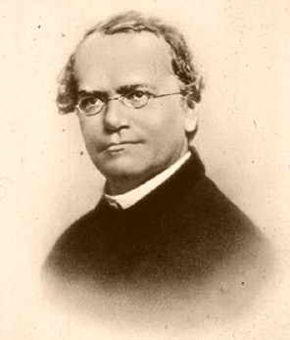
Genetic modification
Nature does it
without permission and at random
Farmers do it
by selection, cross-breeding, mutation, trying and selecting improved traits – no permission needed
Scientists do it
under controlled conditions – CRISPR cas9; not allowed in only the EU without following the long and expensive GMO regulations
Gregor Mendel, 1866
Notes:
https://askabiologist.asu.edu/explore/solving-genetic-mystery

Slide 34
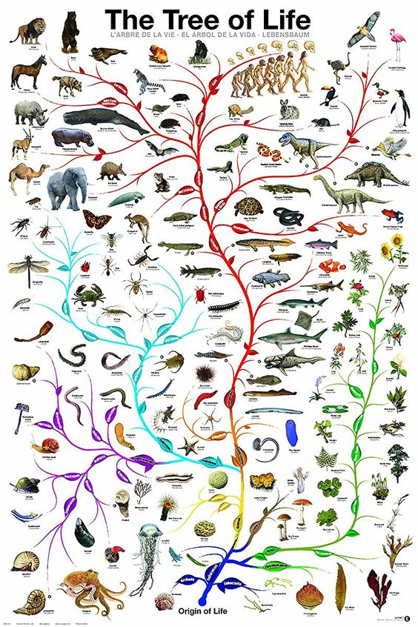
Nature modified genes since life started
does so now and will do so in the future
There is no control
and no evidence that nature does it for the benefit mankind
Why would "natural" be better than “modified by man”?
Everything living in nature tries to kill competing living things, including man
Mankind evolved and survives using gathered knowledge
Notes:
https://bananaroad.com/products/tree-of-life-evolution-amoeba-to-man-24x36-poster?utm_medium=Social&utm_source=Pinterest

Slide 35
Gene editing
Cross breeding,
mutagenesis and
CRISPR-Cas9
Nature does it all the time but at random without permission
Notes:
https://www.yourgenome.org/facts/what-is-genome-editing

Slide 36
Potential benefits of GMOs
Herbicide tolerance (soy)
Insect resistance (e.g. cotton bollworm)
Disease resistance
bacteria
moulds (bananas modified to resist the Black Sigatoka fungus)
viruses (tomatoes, pumpkins, papayas)
ß-carotene (pro-vitamine A, 14 million children under 5 suffer from lack of vitamin A Golden Rice
Environmental stress resistance
drought
heat
frost
acid soil
salty soil
flooding
Delayed ripening
Notes:
http://nuffieldbioethics.org/report/gm-crops-developing-countries-2/benefits-gm-crops-developing-countries

Slide 37
Ziaul Hasan Rana
Notes:
https://www.slideshare.net/woolencastle/genetically-modified-food-and-its-consequences-on-human-health-and-nutrition

Slide 38
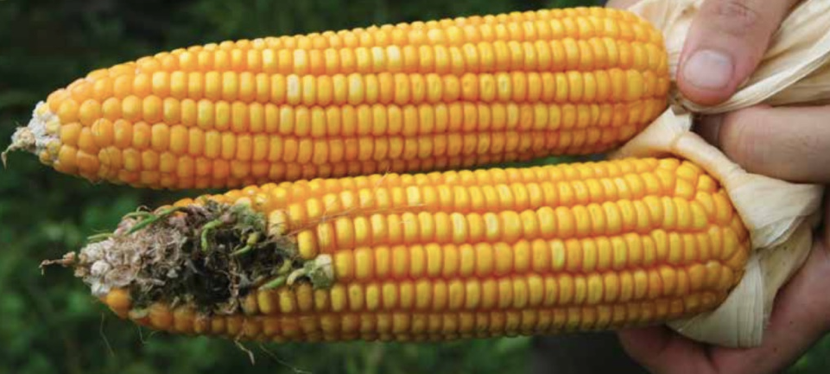
In South Africa 80-90% of the maize produced is GM
Notes:
https://pdfs.semanticscholar.org/503e/945c2ddeb74bbae2215023b0c76b61c9e67e.pdf

Slide 39
Biotechnologist Priver Namanya in the laboratory just outside Kampala
Notes:
https://www.volkskrant.nl/kijkverder/2018/voedselzaak/artikelen/bananenrepubliek-oeganda-omarmt-de-genetisch-gemodificeerde-banaan/

Slide 40
In Uganda GM food is still forbidden
but the Uganda government is funding GM food research

Slide 41
Potential dangers of GMOs
Antibiotic resistance
if genes for antibiotics are inserted, possibly, no evidence but should be investigated
Carcinogenicity
There is no indication anywhere that GMO foods would increase or decrease cancer risk.

Slide 42
Potential dangers of GMOs (continued)
Allergic reactions
In 2017 research has been thoroughly reviewed (reference below)
Conclusion:
GM products do not appear more allergenic than their conventional counterparts
The allergenicity of genetically modified foods from genetically engineered crops - A narrative and systematic review
S. Eliza Dunn, John L. Vicini, Kevin C. Glenn, David M. Fleischer, Matthew J. Greenhawt.
Ann Allergy Asthma Immunol 119 (2017) 214-222

Slide 43
There is no evidence that GM food would be either more or less safe than “normal” food
A decade of EU-funded GMO research (2001 – 2010)
European Commission - EUR 24473
ISBN 978-92-79-16344-9
http://ec.europa.eu/research/biosociety/pdf/a_decade_of_eu-funded_gmo_research.pdf
Statement by the AAAS Board of Directors on Labelling of Genetically Modified Foods
American Association for the Advancement of Science
20 October 2012
http://www.aaas.org/news/releases/2012/media/AAAS_GM_statement.pdf
Notes:
European report and American statement about GMOs. AAAS is the publisher of Science, one of the two most recognised scientific publications.

Slide 44
2016
National Academies of Sciences, Engineering, and Medicine (NASEM)
Genetically Engineered Crops: Experiences and Prospects
20 experts, review of more than 1,000 studies, testimony from 80 experts and 700 comments submitted by the public.
No difference between genetically modified (GM) and conventionally grown crops
to human health
to the environment
National Academies of Sciences, Engineering, and Medicine. 2016. Genetically Engineered Crops: Experiences and Prospects. Washington, DC: The National Academies Press. doi: 10.17226/23395

Slide 45
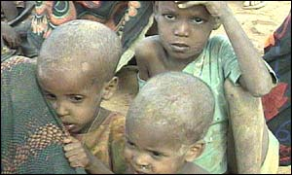
Genetically modified food
Without GM food, millions of people would die of starvation. GM food is not more or less risky than normal food.
Mass famine in Africa
November 2002
Africa Renewal, Vol. 16 #4, Feb. 2003
Notes:
During the massive famine in Southern Africa, in 2001, several governments in the region objected to genetically modified (GM) grain, especially Zambia and Zimbabwe, the countries hardest hit by the drought. Citing health and environmental concerns, Zimbabwe blocked the GM food aid from entering the country. In Zambia, where some GM grain had already arrived, the government placed it under lock and key, banned its distribution and then blocked another 40,000 tonnes that were in the pipeline. Source: Africa Renewal, Vol.16 #4 (February 2003), page 5. This is the result of overwhelming activities of antis, in particular in Europe, who claim with no evidence that GM food is dangerous. The reality is that hundreds of millions of people consume GM food daily and there is not a single report of a health incident related to GM food. The local governments choose to let their citizens starve to death rather than giving them GM food.

Slide 46
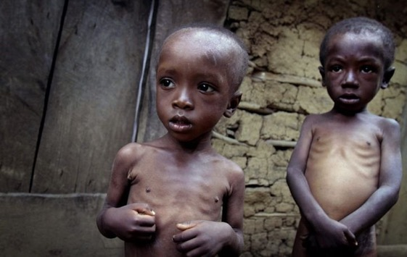
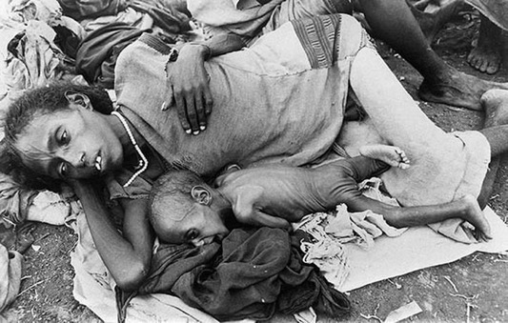
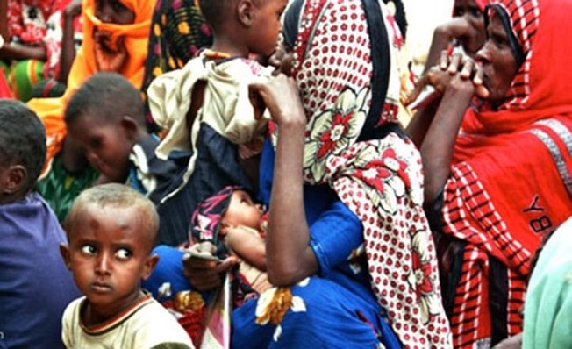
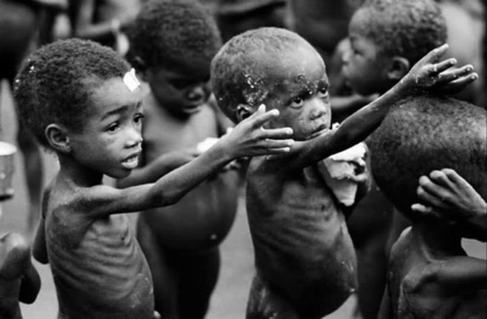
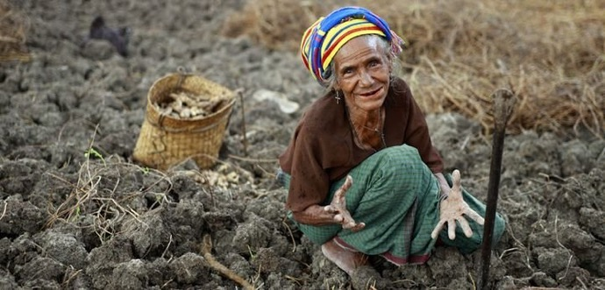
2015
Haïti
Ethiopia
Eritrea
Timor-Leste
Burundi
Notes:
https://www.scoopwhoop.com/world/countries-starving-to-death/

Slide 47
29 June 2016
To the Leaders of Greenpeace, the United Nations and Governments around the world
“Opposition based on emotion and dogma contradicted by data must be stopped.
How many poor people in the world must die before we consider this a “crime against humanity”?
2016-06-29 Nobel Laureates in medicine, chemistry, physics and economics to Greenpeace, the UN and Governments around the world
Notes:
http://supportprecisionagriculture.org/nobel-laureate-gmo-letter_rjr.html

Slide 48
Labelling

Slide 49
What consumers need to know
and thus
should want to know
and would ask
if they would have been correctly informed

Slide 50
Poison is in everything, and no thing is without poison. The dosage makes it either a poison or a remedy.
Notes:
https://www.europeana.eu/portal/en/record/9200332/BibliographicResource_3000095412623.html
https://commons.wikimedia.org/wiki/File:Hirschvogel_Paracelsus.jpg

Slide 51
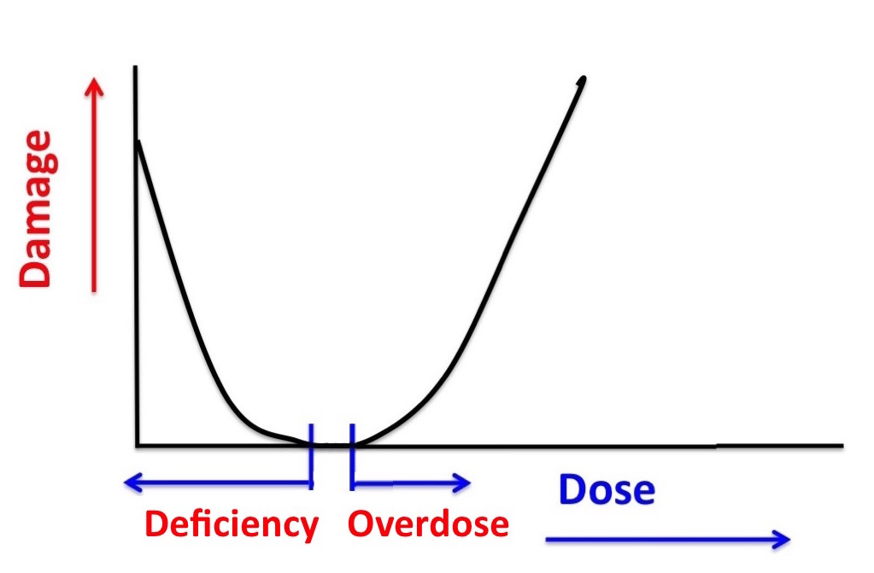
Many substances are harmless in the right amounts but harmful if too much or not enough
Notes:
For many substances the situation is as Paracelsus discovered: if the dose is too high, damage is done. However sometimes a too low dose of the substance is also a health risk, as it is the case with vitamins and minerals. Without them we get ill and may die, but too high a dose has the same results.
https://www.globalharmonization.net/sites/default/files/pdf/final_ghi_ShareSheet1_FeedPeople_Feb2016.pdf

Slide 52
How to scare people and sell books
How clean is your label?
Pick up some rustic-looking salami and even the most guarded shoppers might relax when they notice rosemary extract on the ingredients list. But rosemary extracts are clean label substitutes for old guard of techie-sounding antioxidants. Manufacturers use them to slow down the rate at which food go rancid. Rosemary extracts do have an E number (E392) but manufacturers prefer to label them more poetically as ‘extract of rosemary’, and loose off ending E. because that way they sound like lovingly made Slow Food ingredients
Notes:
http://www.joannablythmanwriting.com/books.html
https://www.theguardian.com/lifeandstyle/2015/feb/21/a-feast-of-engineering-whats-really-in-your-food

Slide 53
How to scare people and sell books
They use E-numbers to hide that your food contains chemicals
Chemical names are used to hide the
E-numbers in your food
What is in your food
Notes:
https://www.bol.com/nl/p/wat-zit-er-in-uw-eten/1001004005600642/?Referrer=ADVNLPPce87cb00cdbf9297004d16b03d010001197

Slide 54
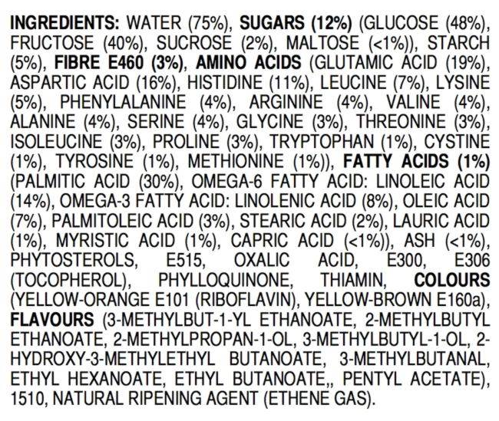
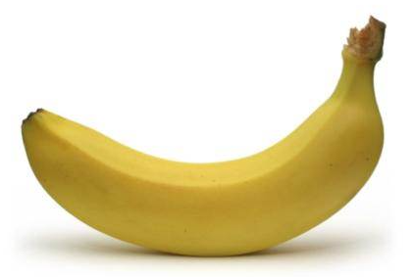
NOT SAFE
TO EAT?
AND
MANY MORE
⬅
ALL-NATURAL BANANA
Notes:
https://jameskennedymonash.wordpress.com/2013/12/12/ingredients-of-an-all-natural-banana/

Slide 55
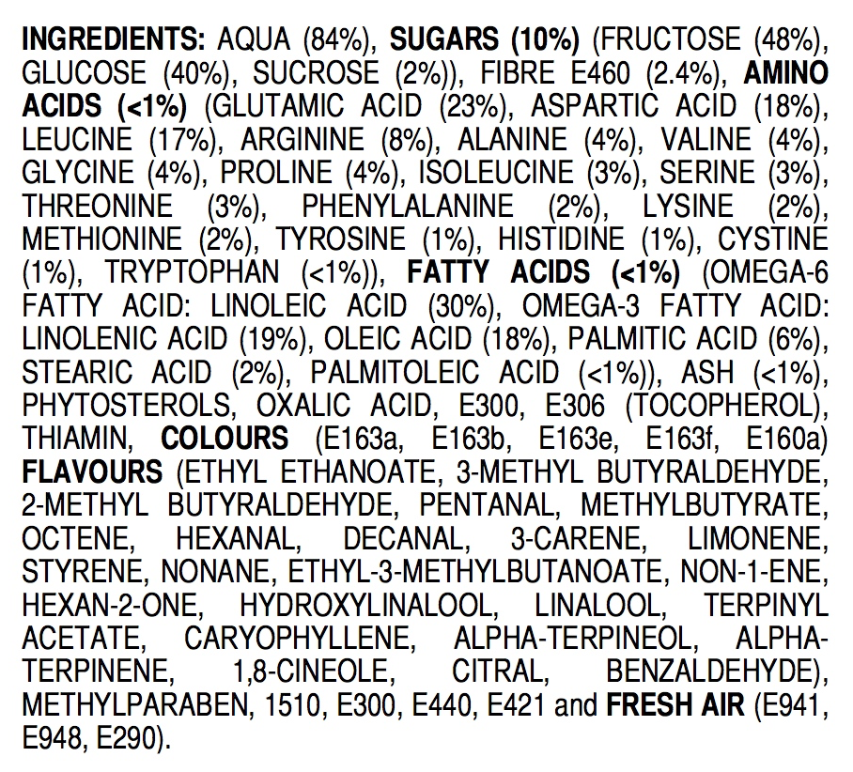
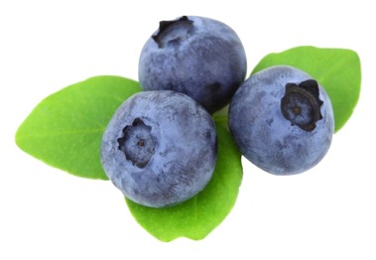
ALL-NATURAL BLUEBERRIES
NOT SAFE
TO EAT?
AND
MANY MORE
⬅
Notes:
https://jameskennedymonash.wordpress.com/2013/12/20/ingredients-of-all-natural-blueberries/

Slide 56
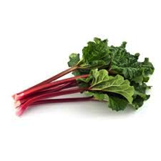
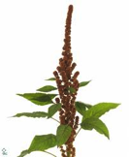
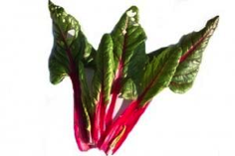
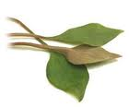
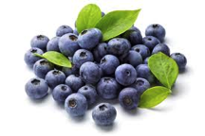
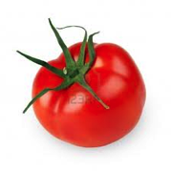
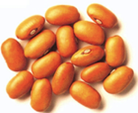
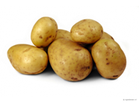
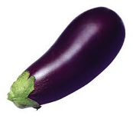
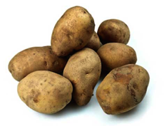
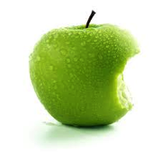
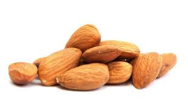
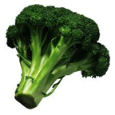
All food contains potentially toxic substances
Notes:
Many constituents of ALL foods become toxic if eaten in too high amounts.

Slide 57
Natural, potentially toxic substances in food
Lectins (or hemaglutinins) (pulses)
Enzyme inhibitors (soy, peas, beet, cereals)
Piperidines (black pepper)
Caffeine, theobromine, theophyline (coffee, chocolate, tea)
Solanine (potatoes, tomatoes, aubergines)
Tomatine (tomatoes)
Oxalates (rhubarb, spinach, parsley, chives, purslane, cassava, amaranth, chard, taro leaves, radish, kale, monstera fruit)
Coumarin (cinnamon, peppermint, green tea, chicory, blueberries)
Glucosinolates such as sinigrin, progoitrin (cabbage, broccoli, brussels sprouts, cauliflower, turnip, radish, horseradish, mustard, rapeseed)
Cyanogenic glycosides, such as amygdalin (almond, laurel) and linamarin (cassave)
Saponins (peanut, soy, spinach, broccoli, potato, apple)
Notes:
All foods contain substances (chemicals) that are toxic if consumed in too high amounts. This and the next two slides give examples. There are no exceptions. People who do not eat food with (potentially toxic) chemicals will starve to death.

Slide 58
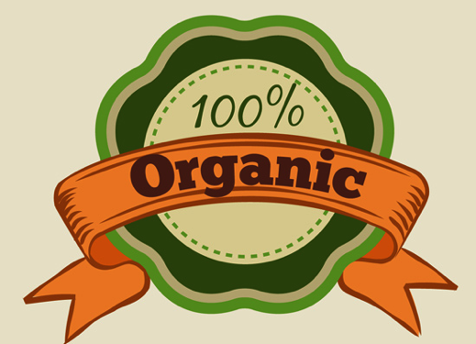
Most pesticides
are
organic
Notes:
A very important issue. See in particular:
Swirsky Gold L., Slone T.H. and Ames B.N., ‘Prioritization of possible carcinogenic hazards in food’. In: Food Chemical Risk Analysis, ed Tennant D R, New York, Chapman and Hall, 1997 267–295.
Complete text also on: http://toxnet.nlm.nih.gov/cpdb/text/maff.html

Slide 59
Bruce N. Ames, Margie Profet, and Lois Swirsky Gold
Dietary pesticides (99.99% all natural)
Proc. Natl. Acad. Sci. USA Vol. 87, pp. 7777-7781, October 1990
MedicalSciences

Slide 60
Organic pesticides may be more toxic than syntethic pesticides
Organic pesticides are not subjected to the rigorous testing requirements that apply to synthetic pestcides
If there is enough interest, GHI may start a
Working Group “Organic Foods”

Slide 61
Knowledge that is useful and should be on the label
in addition to information about storage and preparation
Constituents that
may be harmful if too much is consumed (such as sugar and oxalic acid)
are essential nutrients and may be lacking in a monotonous diet (such as vitamins)
may give allergic reactions
may be unsuitable for some people (like gluten and lactose)
Manufacturer and internet link for more details

Slide 62
Diets

Slide 63
If you stick to a decent diet, you may have control over your weight and stay healthy
The wheel of five is a good guide
Diets that cut out food groups may result in deficiences and that is not healthy
A gluten-free diet makes sense only for people with celiac disease or gluten sensivity and that is not 10% of any population
Vegetarian diets are healthy provided sufficient protein is consumed from vegetarian sources
Vegan diets are healthy but it is more difficult to ensure intake of sufficient essential nutrients
Other diets are either nonsense or even unhealthy and often difficult to sustain
Claims that probiotics are good for health are at least doubtful

Slide 64
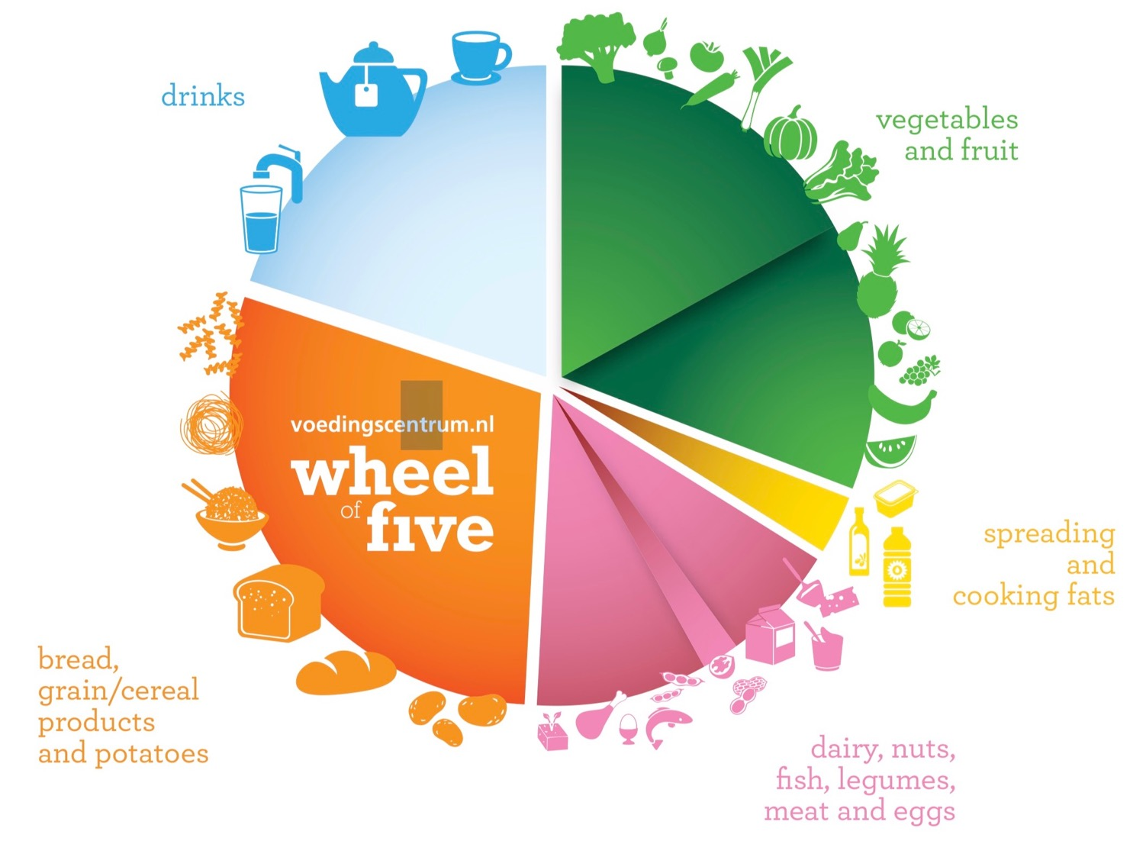
Notes:
https://www.voedingscentrum.nl/nl/pers/factsheets/fact-sheets-in-english.aspx

Slide 65
Varying menus will provide all nutrients needed for healthy people
paying attention to the wheel of five
not eating too much
not adding more than a little salt
not adding sugar
consuming 2 litre water a day (also as part of other food)
ensuring enough physical activity
In case of weight problems that cannot be solved by these points: consult a reliable nutritionist
Saving money on dietary books and costly diets

Slide 66
Recommendations

Slide 67
Use the information of this presentation to teach your students, colleagues, management, politicians and whoever else you may be able to influence
Always look for peer-reviewed scientific evidence
Address regulations that benefit mostly industries and hardly society
Books that provides peer-reviewed scientific information:
Genetically Modified and Irradiated Food
Controversial Issues: Facts versus Perceptions
Editor: Veslemøy Andersen
Elsevier, 2019 ISBN: 9780128172407

Slide 68
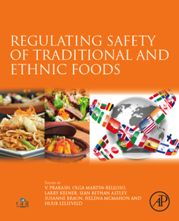
Ensuring Global Food Safety - Exploring Global Harmonization. Editors: Christine Boisrobert, Aleksandra Stjepanovic, Sangsuk Oh and Huub Lelieveld. Elsevier/Academic Press, 2009. ISBN: 9780080889306
Regulating Safety of Traditional and Ethnic Foods. Editors: V. Prakash, Olga Martin-Belloso, Larry Keener, Siân Astley, Susanne Braun, Helena McMahon and Huub Lelieveld. Elsevier/Academic Press, 2016. ISBN: 978-0-12-800605-4
Nutritional and Health Aspects of Food in Nordic Countries. Editors: Veslemøy Andersen, Eirin Bar and Gun Wirtanen. Elsevier/Academic Press, 2018. ISBN: 978-0-12-809456-3

Slide 69
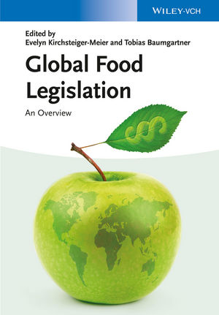
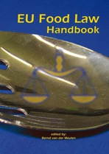
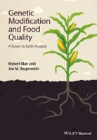
Global Food Legislation: An Overview. Editors: Evelyn Kirchsteiger-Meier and Tobias Baumgartner. Wiley, 2014. ISBN: 978-3-527-33555-8
EU Food Law Handbook. Editor: Bernd van der Meulen. Wageningen University Press, 2014. ISBN: 978-90-8686-246-7
Genetic Modification and Food Quality: A Down to Earth Analysis. Robert Blair and Joe M. Regenstein. Wiley, 2015. ISBN: 978-1-118-75641-6

Slide 70
Global legislation for food contact materials. Editor: Joan Sylvain Baughan. Elsevier / Woodhead Publishing, 2015. ISBN 978-1-78242-014-9
The Use of Nanomaterials in Food Contact Materials - Design, Application, Safety - Editor: Rob Veraart. DEStechpublications, 2017. ISBN: 978-1-60595-136-2
Hygiene in Food Processing. Editors: Huub Lelieveld, John Holah and David Napper. Elsevier / Woodhead Publishing, 2014. ISBN: 9780857094292

Slide 71
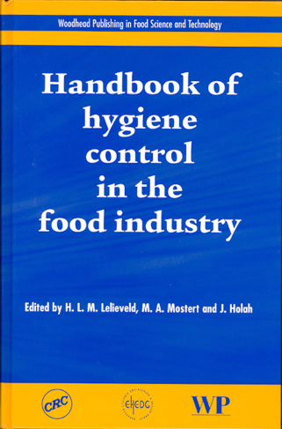
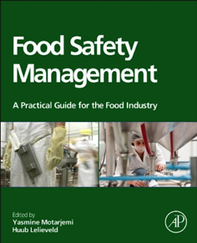
Handbook of Hygiene Control in the Food Industry. Editors: Huub Lelieveld, John Holah and Domagoj Gabrić. Elsevier / Woodhead Publishing, 2016. ISBN: 978-0-08-100155-4
Hygienic Design of Food Factories. Editors: John Holah and Huub Lelieveld. Elsevier / Woodhead Publishing, 2011. ISBN: 978-1-84569-564-4.
Food Safety Management – A Practical Guide for the Food Industry. Editors: Yasmine Motarjemi and Huub Lelieveld. Elsevier/Academic Press, 2013. ISBN: 9780123815057

Slide 72
CreateSpace Independent Publishing Platform (29 May 2012)
ISBN-10: 1469985713
ISBN-13: 978-1469985718

Slide 73
Use promo code GHI30 for 30% discount

Slide 74
Thank you for your attention

