Slide 1
CHEMOFOBIA
Huub Lelieveld
Global Harmonization Initiative (GHI)

Slide 2
CHEMICALS IN FOOD
Chemicals that are not allowed but nevertheless present in food are not necessarily additives. Most man-made chemicals occur in nature in concentrations that can be detected now, but not previously. They are produced by
animals
microbes (bacteria, fungi, parasites)
plants
geochemical processes (e.g. volcanos)
they include chlorinated organic compounds. More than 5000 different natural organic halogens have been identified in nature.
Notes:
G.W. Gribble. Chemosphere 52 (2003), 289–297 and Heterocycles, 84 (1) (2011), 157-207

Slide 3
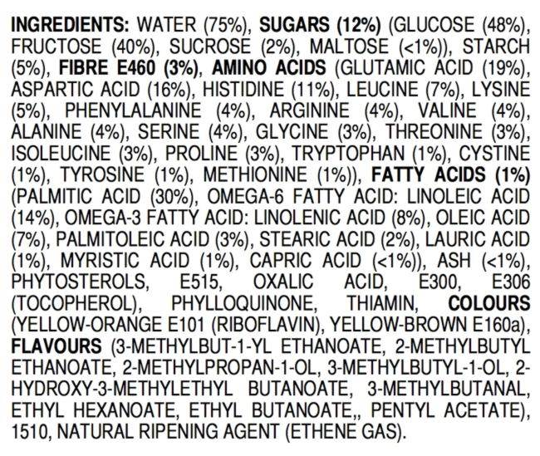
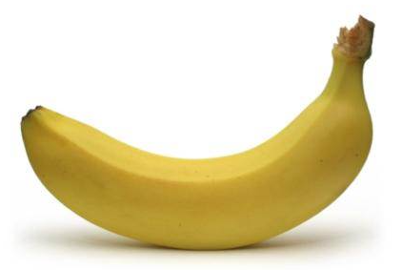
NOT SAFE
TO EAT?
AND
MANY MORE
⬅
ALL-NATURAL BANANA
Notes:
https://jameskennedymonash.wordpress.com/2013/12/12/ingredients-of-an-all-natural-banana/

Slide 4
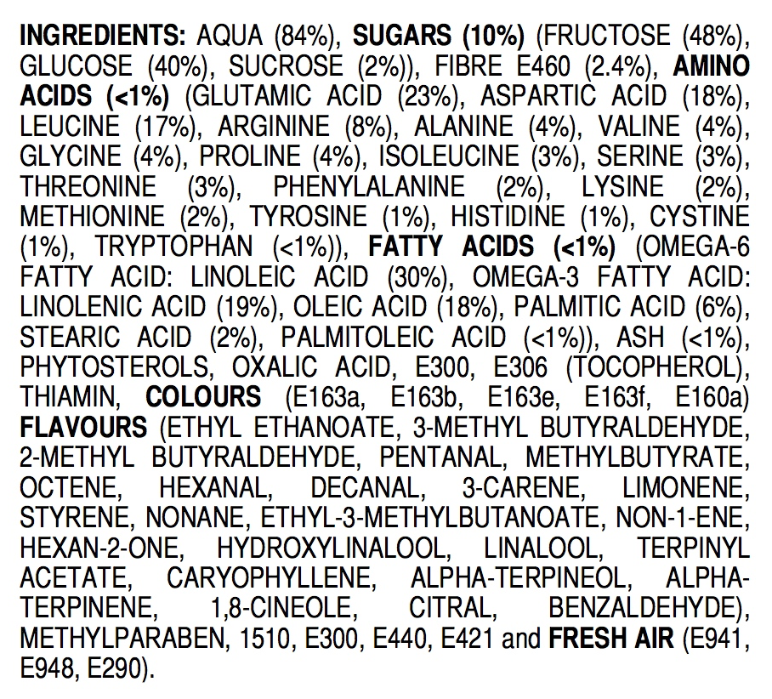
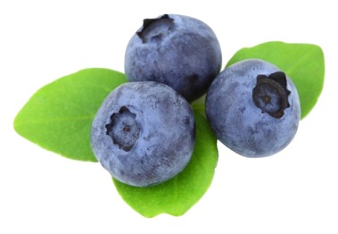
ALL-NATURAL BLUEBERRIES
NOT SAFE
TO EAT?
AND
MANY MORE
⬅
Notes:
https://jameskennedymonash.wordpress.com/2013/12/20/ingredients-of-all-natural-blueberries/

Slide 5
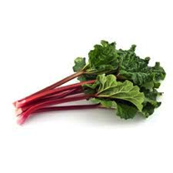
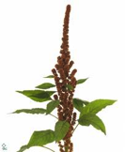
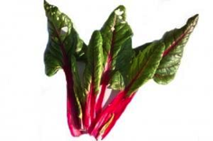
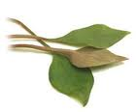
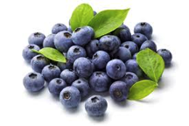
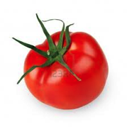
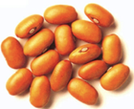
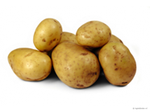
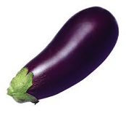
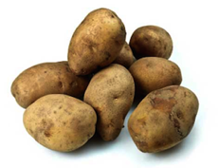
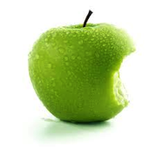
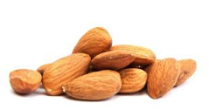
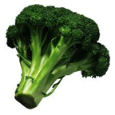
All food contains potentially toxic substances
Notes:
Many constituents of ALL foods become toxic if eaten in too high amounts.

Slide 6
Natural, potentially toxic substances in food
Lectins (or hemaglutinins) (pulses)
Enzyme inhibitors (soy, peas, beet, cereals)
Piperidines (black pepper)
Caffeine, theobromine, theophyline (coffee, chocolate, tea)
Solanine (potatoes, tomatoes, aubergines)
Tomatine (tomatoes)
Oxalates (rhubarb, spinach, parsley, chives, purslane, cassava, amaranth, chard, taro leaves, radish, kale, monstera fruit)
Coumarin (cinnamon, peppermint, green tea, chicory, blueberries)
Glucosinolates such as sinigrin, progoitrin (cabbage, broccoli, brussels sprouts, cauliflower, turnip, radish, horseradish, mustard, rapeseed)
Cyanogenic glycosides, such as amygdalin (almond, laurel) and linamarin (cassave)
Saponins (peanut, soy, spinach, broccoli, potato, apple)
Notes:
All foods contain substances (chemicals) that are toxic if consumed in too high amounts. This and the next two slides give examples. There are no exceptions. People who do not eat food with (potentially toxic) chemicals will starve to death.

Slide 7
Acetaldehyde
Benzaldehyde
Benzene
Benzofuran
Benzo(a)pyrene
Caffeic Acid
Catechol
1,2,5,6-dibenzanthracene
Formaldehyde
Furan
Furfural
Hydroquinone
Isoprene
Limonene
Styrene
Toluene
Xylene
Etc.
Notes:
Some of the chemicals in coffee. All potentially (geno)toxic/carcinogenic, but toxicity is a matter of amounts. See later.

Slide 8
A Comprehensive Overview of the Risks and Benefits of Coffee Consumption by L. Kirsty Pourshahidi, Luciano Navarini, Marino Petracco, and J.J. Strain
Investigation of 1277 studies (1970-2015)
Conclusions
Overall, results of this comprehensive review show that the health benefits (or null effects) clearly outweigh the risks of moderate coffee consumption in adult consumers for the majority of health outcomes considered........
Notes:
2016 Institute of Food Technologists®
doi: 10.1111/1541-4337.12206 Vol. 00, 2016
Comprehensive Reviews in Food Science and Food Safety

Slide 9
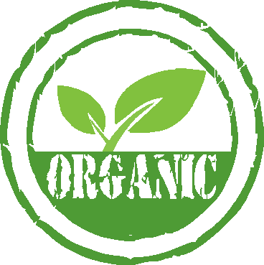
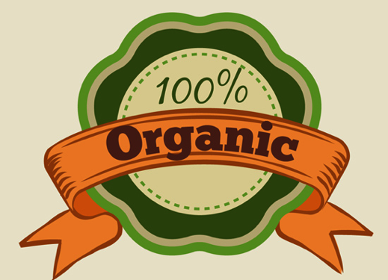
Most pesticides
are
organic
Notes:
A very important issue. See in particular:
Swirsky Gold L., Slone T.H. and Ames B.N., ‘Prioritization of possible carcinogenic hazards in food’. In: Food Chemical Risk Analysis, ed Tennant D R, New York, Chapman and Hall, 1997 267–295.
Complete text also on: http://toxnet.nlm.nih.gov/cpdb/text/maff.html

Slide 10
Bruce N. Ames, Margie Profet, and Lois Swirsky Gold
Dietary pesticides (99.99% all natural)
Proc. Natl. Acad. Sci. USA Vol. 87, pp. 7777-7781, October 1990
MedicalSciences

Slide 13
Organic pesticides may be more toxic than syntethic pesticides
Organic pesticides are not subjected to the rigorous testing requirements that apply to synthetic pestcides
If there is enough interest, GHI may start a
Working Group “Organic Foods”

Slide 14
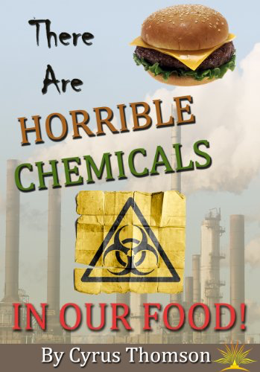
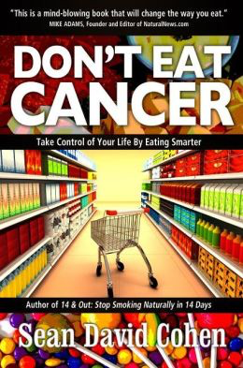
It is easy to make much money by scaring consumers

Slide 15
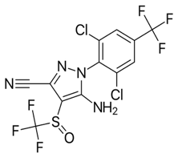
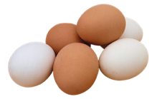
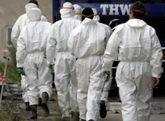
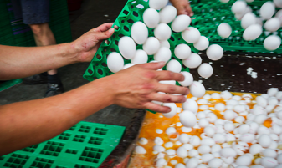
Fipronil
Insecticide
Not harmful for humans
Harmful for useful insects (bees)
Use on farms is illegal
Will be banned to protect bees
Traces in eggs are harmless
Consumers were warned not to eat eggs, industries told to destroy the eggs. Chickens to be destroyed or weeks on diet. Estimated damage in Netherlands alone > € 100 million
Squad to destroy chickens that are contaminated with less fipronil than people treating their cats and dogs against flees (legally)
Notes:
For relevant details, see: EFSA (European Food Safety Authority), 2017. Scientific Report of EFSA on scientific support for preparing an EU position in the 49th Session of the Codex Committee on Pesticide Residues (CCPR). EFSA Journal 2017;15(7):4929, 162 pp. https://doi.org/10.2903/j.efsa.2017.4929
ISSN: 1831-4732 © 2017 European Food Safety Authority. EFSA Journal published by John Wiley and Sons Ltd on behalf
of European Food Safety Authority.

Slide 16
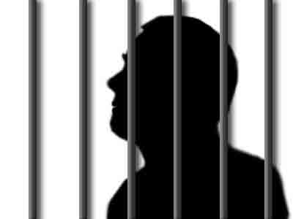
If chemicals have been added illegally:
those responsible should be prosecuted
the product should be confiscated
but if safe, the product should not be destroyed

Slide 17
Damage
Dose
The perception of the general public
Notes:
This figure shows the interpretation of toxicity by the general public: a toxic substance does damage independent of the dose, i.e. damage can be prevented only if the substance is totally absent. This leads to absurd regulations, as those that lead to the destruction of safe and nutritious food. Also some chemicals are no longer allowed for use in packaging materials or process equipment even when the concentration resulting from leaching into the food is so low (sometimes below the natural concentration in the food), that harm is not possible and indeed never has been reported.

Slide 18
Damage
Dose
Understanding of most politicians and policy makers
Notes:
This figure shows what most politicians and policy makers may believe and make the regulators apply: the higher the concentration the more damage to health, but a very low concentration where e.g. only one person on a million will suffer is acceptable. Still the idea is that there is always damage and no damage will require total absence.

Slide 19
Damage
Dose
Threshold
Toxicologists: there is a threshold of no concern (NOAEL, no adverse effect level). All food contains potential toxins.
Notes:
This figure shows the evidence-based opinion of toxicologists: there is a threshold below which there is no effect. That means below a certain dose there will be no damage. That is why the human body for instance has a liver and kidneys.

Slide 20
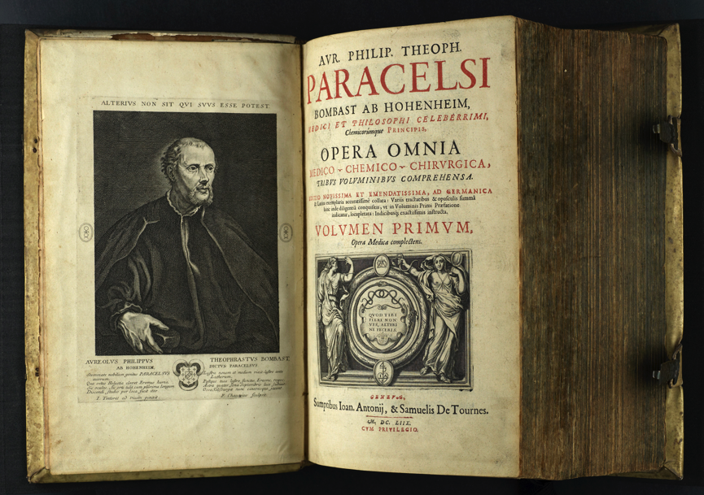
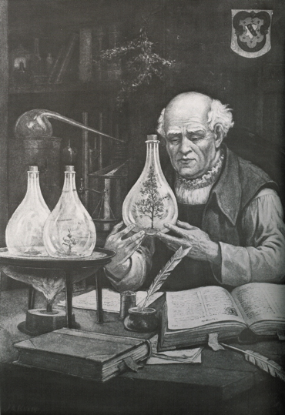
Everything is poisonous if the amount is high enough
or
There are no toxic substances, only toxic amounts
Notes:
Already about 500 years ago, Paracelsus had concluded that toxicity depends on amounts.

Slide 21
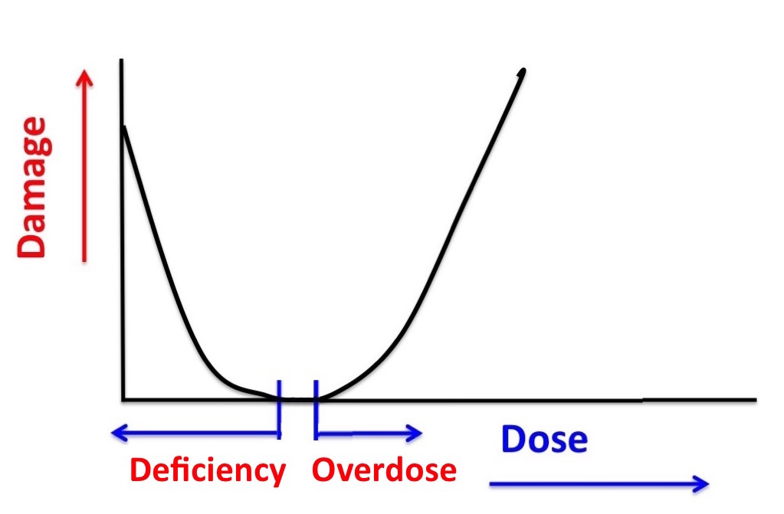
Many substances are harmless in the right amounts but harmful if too much or not enough
Notes:
For many substances the situation is as Paracelsus discovered: if the dose is too high, damage is done. However sometimes a too low dose of the substance is also a health risk, as it is the case with vitamins and minerals. Without them we get ill and may die, but too high a dose has the same results.

Slide 22
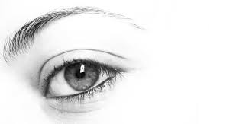
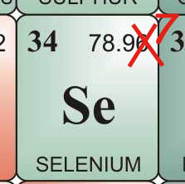
Vitamin A
Adults: needed 1 mg per day
harmful at 3 mg per day
Seleen
Adults: needed 50-150 μg per day
harmful at 300 μg per dag
(Netherlands Health Council)
Notes:
Examples:
Vitamin A and Selenium are essential for your health but too much is harmful. The amount consumed determines whether it is healthy or toxic. Sometimes the difference is very small.

Slide 23
Evolution
Humans and their predecessors have been exposed to all those most scary chemicals for millions of years and developed a biological system (with liver, kidneys, etc.) to cope with them or even use them beneficially.
The system, however, can be overloaded and then the chemical becomes toxic.

Slide 24
Thank you for your interest

