Slide 1
Food Safety and Lobbying
Huub Lelieveld
Global Harmonization Initiative (GHI)

Slide 2
The making of food safety regulations
The main problem is the lack of understanding of toxicity by
politicians
general public
activists (antis)
press
and the strong influence of professional lobbyists
Notes:
Politicians have a strong tendency to promise to do what makes them look good so that they will be re-elected. They do not use time to look at facts and most of them find scientists just troublemakers who they do not trust.
The general public has the information from newspapers. Most journalist prefer to publish negative messages, because that is what the publisher wants, it sales better. Writing in a newspaper that all is fine and right does not sell.
Many activists are just against. The topic often does not matter. In the case of food. Everything is wrong, because governments want to control people and industries want to make money, all at the expense of the people. So they try to make “the people” believe this and be against e-numbers, preservatives, processed food, etc. etc.
With - in most countries - just a few exceptions, the press cares about how many copies they can sell, not about correctness of the information. Checking the information takes too much time.

Slide 3
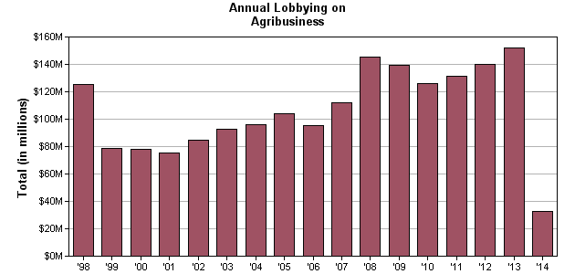
Lobbying
USA
2013
Total for Agribusiness: $151,730,315
Total Number of Clients Reported: 453
Total Number of Lobbyists Reported: 1,154
Notes:
This is from the webpage https://www.opensecrets.org/lobby/indus.php?id=A
All lobbying expenditures on this page come from the Senate Office of Public Records. Data for the most recent year were downloaded on April 28, 2014.
The amount of money spent on trying to influence the politicians, to get them doing what is good for the industry is huge, more that 150 million US$ (or far more than € 100 million).

Slide 4
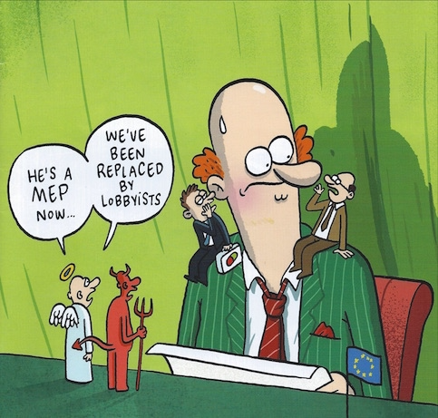
Notes:
Cover BrusselsTimesMagazine-Oct-Nov 2015
MEP = Member of Parliament

Slide 5
ACTIVISTS
General public
LOBBYISTS
PRESS
Politicians
Scientists
Regulators
Notes:
Politicians get most of the signals on which they base their decisions from Activists and lobbyists. The activists receive their donations from that part of the public that is easily influence by activists. The regulations are paid to do that the politicians have decided. Scientists communicate with each other but hardly with those who could make a difference.

Slide 6
Thank you for your interest

