Slide 1
Why harmonize food regulations
and if harmonized,
how to make it work in practice?
Huub Lelieveld
Global Harmonization Initiative
Notes:
Ambassadors, if agreeing with the contents, may replace "Huub Lelieveld" by their own name of or add their name.
Slides may be changed to adapt to the audience and the language may be translated too.

Slide 2
Differences in regulations
Hamper trade
Can be used for protectionism
Cause confiscation and destruction of food in a world where almost a billion people starve
Facilitate food fraud and crime
Require multiple (inadequate) animal testing
Frustrate innovation
When and how will such differences disappear?
Notes:
Food fraud: what is a part ppb? See later: there can be a million times difference between these words in English and English (American).
What does a name of a product or an additive mean? When is a substance and additive?
What is absence? Judge will say that absence = absence, i.e. 1 molecule in a shipload is NOT absence. Absence is 0 (zero) molecules.
What is the relation between animals and humans? In many cases laws require proof of safety obtained by animal testing. There is overwhelming evidence that in many cases, e.g. when determining mutagenicity, there is NO relation between humans and animals. There are tube-tests that are 100% relevant – not accepted by law.

Slide 3
Food safety regulations are
essential
An estimated 600 million – almost 1 in 10 people in the world – fall ill after eating contaminated food and 420,000 die every year *
largely correct in many, not all countries
often different between countries, even neighbouring countries
often not based on scientific evidence and sometimes even absurd
often not clear to those who need to follow them
useless if there is no adequate inspection
* WHO 2015
Notes:
Source incidents: http://www.who.int/mediacentre/factsheets/fs399/en/
Often regulations are in a language that is difficult to understand by those who need to apply them.

Slide 4
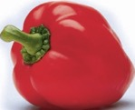
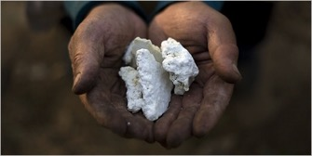
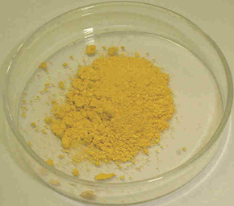
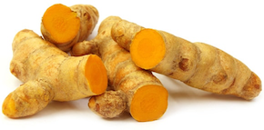
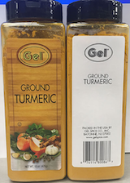
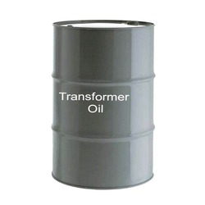
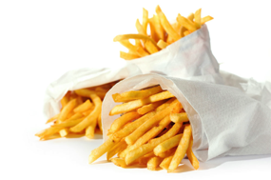
Food fraud / crime
Lead oxide
Melamine
Lead chromate
French fries
Diethylene glycol
Notes:
1. In Hungary, in 1994, lead oxide was added to dried paprika to enhance the colour and that way made low-quality product look better. Source: Williams Carol J. Market Focus : Tainted Paprika Poisons Hungary's Culinary Pride : Fifty-nine people are arrested in the scandal, which sent 46 to the hospital. The health of the industry is also at stake. Los Angeles Times, 11 October 1994.
2. This is a well known, similar case. Adding melamine and water to increase the apparent amount of milk, the nitrogen content being adjusted by the melamine. It increased the nitrogen value (Kjeldahl analysis) giving the impression that the protein concentration was correct.
3. In spring 1999, it was found that some 500 tons of feed contaminated with polychlorinated biphenyls (PCBs) and dioxins were fed to farm animals in Belgium and to a lesser extent in the Netherlands, France and Germany.
4. Diethylene Glycol in wine (Austria) and toothpaste.
5. Lead chromate to enhance the color of curcumin. Curcumin picture: https://upload.wikimedia.org/wikipedia/commons/d/da/Lead_chromate.JPG

Slide 5
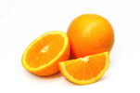
Carbendazim in orange juice
Carbendazim is approved as pesticide in many countries, but no longer in the United States.
MRLs (maximum residual levels) for carbendazim (ppb)
EU: 100 - 700
Canada: 500 - 6000
USA (per 30-03-2013): 10
US Environmental Protection Agency
“... consumption of orange juice with carbendazim at the low levels that have been reported does not raise public health concerns.”
Notes:
Requiring absence makes that the methods of analysis determine how much is allowed. In the past 50 or so years, the detection limits for many chemicals have gone down by a factor of about a million. That means that absence now is a million times less than 50 years ago. Not because of scientific evidence of toxicity, but only because of the improvement in analysis.

Slide 6
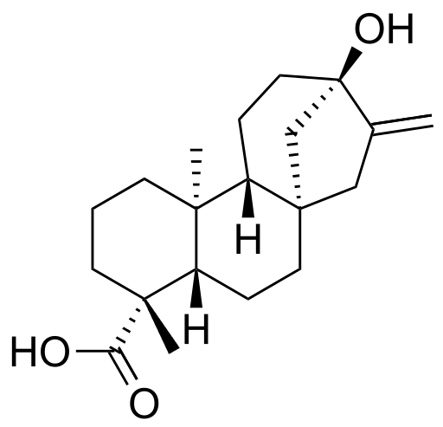
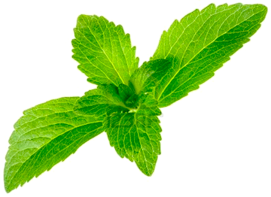
Very actual
Steviol glycosides as food additive
They are up to 350 x sweeter than sucrose. Stevia is a plant that has been used for cooking in South America for hundreds of years but in 2017:
EU Approved
Canada Approved
USA Not approved (with some exceptions)
Notes:
Source: FoodBev April 2017. page 23
Picture of structure of steviol: Ed (Edgar181) - Own work, Public Domain, https://commons.wikimedia.org/w/index.php?curid=16879511

Slide 7
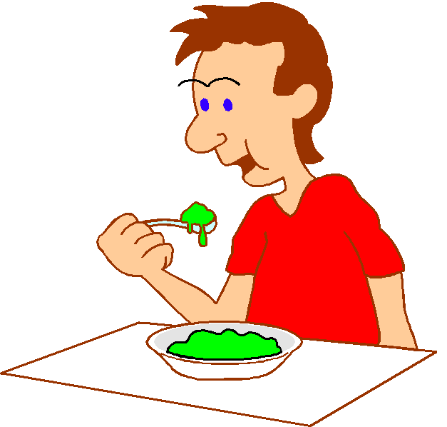
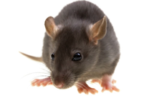
Absurd regulations
ZERO-TOLERANCE = TOTAL ABSENCE = FREE FROM
Antibiotics in food
Sudan Red
Judges are not toxicologists
20.000 kg/day
800.000 kg/day
A few ppt* in products with ingredients form China
* About 1 grain of 2 mm in an
Olympic swimming pool
800 liter/day life long
Notes:
Antibiotics may no be added to food and therefore, if present in food, governments seize the food and destroy it. Even entire shiploads. The amount of antibiotics, however, is very far below the level at which it can do harm. The same antibiotics are given to people and even babies in million times higher amounts. For a very small chance of harm, a baby would have to eat 20,000 kilograms of the antibiotic-containing food per day the rest of its life. Adults even more of course. The regulations are in such cases absurd. If an antibiotic is added to food and that is illegal, the perpetrator should be prosecuted, but destroying the food is totally useless – senseless, does not protect anybody.
The same applies to many other chemicals present in food (added ot naturally present). Sudan Red is an example of absurd measures taken by a govenment. A person (actually assuming he or she is a rat) who drinks 800 liter per day of worchester sauce (just an example) for the rest of his life has a chance to suffer damage from the chemical. Nevertheless, the UK government at the time demanded the recall and destruction of huge amounts of food, worths more than € 15,000,000.
Dr Jon Bell, chief executive of the Food Standards Agency, said yesterday: "Sudan 1 could contribute to an increased risk of cancer. At the levels present the risk is likely to be very small but it is sensible to avoid eating any more. There is no risk of immediate ill health." Dr Julie Sharp, of Cancer Research UK, said the people who had already eaten foods that had been contaminated had no reason to panic. She said: "The risk of cancer in humans from Sudan I has not been proven and any risk from these foods is likely to be very small indeed." (BBC News, Published: 2005/02/18 19:31:02 GMT; http://news.bbc.co.uk/go/pr/fr/-/2/hi/health/4277677.stm).

Slide 8
Organizations that desire or intend to produce "harmonized" food regulations

Slide 9
The World Trade Organization (WTO) deals with the global rules of trade between nations. Its main function is to ensure that trade flows as smoothly, predictably and freely as possible.
The Codex Alimentarius was established by FAO and the WHO to develop harmonised international food
standards, which protect consumer health
and promote fair practices in food trade.
The Organization for Economic Cooperation and Development (OECD) promotes policies to improve the economic and social well-being of people around the world.
The Global Food Safety Initiative (GFSI) promotes a harmonized approach to managing food safety across the food industry

Slide 10
Intergovernmental
Industrial
Impartial
Non-governmental / Non-industrial
Notes:
Strongly influenced by economic and strategic interests – but not GHI

Slide 11
Harmonization of nomenclature

Slide 12
When representatives of countries (negotiators, not necessarily scientists) discuss topics to reach agreement, they may THINK that they have reached agreement, while unknowingly they have been talking about different things.
Even if they talk about concentrations of substances in food the confusion can be dramatic, differences up to a factor of a million, 1,000,000.

Slide 13
Differences in regulations
Example: Food additive definitions
Canada
Substances that, when added to the food, can become part of the food or alter its characteristics, with the exception of mineral nutrients and vitamins (added to enhance nutritional value), spices, seasonings, flavorings, agricultural chemicals, and substances added to the packaging material.
Japan
Substances used in or on food in the process of manufacturing food, or substances used for the purpose of processing or preserving food.
USA
Any substance the intended use of which results or may reasonably be expected to result -directly or indirectly - in its becoming a component or otherwise affecting the characteristics of any food.
EU
Food additives are substances added intentionally to foodstuffs to perform certain technological functions, for example to colour, to sweeten or to preserve. Food additives are defined in community legislation as "any substance not normally consumed as a food in itself and not normally used as a characteristic ingredient of food whether or not it has nutritive value, the intentional addition of which to food for a technological purpose results in it or its by-products becoming directly or indirectly a component of such foods". (for full definition see: article 1(2) of directive 89/107/eec ).
Codex Alimentarius Commission
Any substance not normally consumed as a food by itself and not normally used as a typical ingredient of the food, whether or not it has nutritive value, the intentional addition of which to food for a technological (including organoleptic) purpose in the manufacture, processing, preparation, treatment, packing, packaging, transport or holding of such food results, or may be reasonably expected to result (directly or indirectly), in it or its by-products becoming a component of or otherwise affecting the characteristics of such foods. The term does not include contaminants, or substances added to food for maintaining or improving nutritional qualities, or sodium chloride.
NO NEED TO READ!
Notes:
The difference in length alone indicates there are large differences.

Slide 14
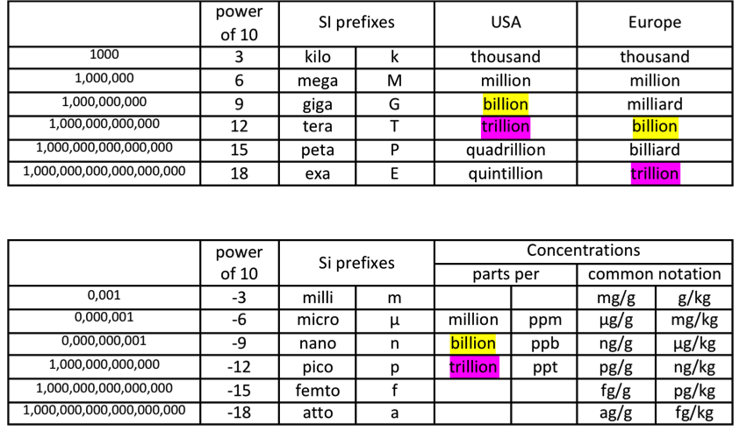
Differences that cause misinterpretation
0,001
0,000,001
0,000,000,001
0,000,000,000,001
0,000,000,000,000,001
0,000,000,000,000,000,001
Notes:
Differences between Europe (inlcuding UK) and the USA: billion and trillion and consequently parts per billion or trillion differ by a factor 10³ and 10⁶.

Slide 15
It is crucial that terminology will be "harmonized"
Working Group
Nomenclature on Food Safety and Quality
To harmonize between intitially Russian and English, then Spanish, French and Italian and thereafter all other languages
Where needed pictures will be used
Chairs:
Dr. Dmitry Kulev, All-Russia Research Institute for Food Additives, St. Petersburg.
Dr. Roger Fenwick, Norwich, UK
Dr. Ileana Negruzza (linguist), St. Petersburg, Russia.

Slide 16
Topics covered
1. Food (definition)
2. Raw materials
3. Micro-ingredients
4. Technical processing aids (incl. lubricants)
5. Food flavours
6. Information on labels and packages
7. Hygienic and aseptic processing of food
8. Shelf life
9. Legislative and regulatory authorities (abbreviation and explanation)
10. Danger, risks, safety
11. Quality and nutrition value
12. Specialised food
13. Probiotics and prebiotics
14. Baby food

Slide 17
Harmonization of methods

Slide 18
The Top 5 Causes of Cancer
1
Diet & Nutrition
2
Tobacco
3
Infections
4
Occupational exposures
5
Environmental pollution

Slide 19
Correct determination of genotoxicity is essential
For decades genotoxicity for humans is mostly determined using animals
Costly
Time consuming
Large number of animals
Impopular
Little relation between animals and humans

Slide 20
Genotoxicity for humans can be tested in vitro using competent human liver cells (HepG2)
Cheap
Fast
No animals
Standardised and validated
100% relevant to humans
Details and references in e.g., Chapter 7 "Testing for Food Safety Using Competent Human Liver Cells", pages 125-138 in:
"Ensuring Global Food Safety – Exploring Global Harmonization"

Slide 21
GHI Working Group
Genetic Toxicology
Chair: Dr. Firouz Darroudi, MD
Senior research consultant to: IAEA, WHO, UNESCO
Director of Biomedical Research and Head of Section of Radiation Genetic and Chemical Mutagenesis Department of Health Sciences, University College North Atlantic,
Doha. State of Qatar
Director of Center of Human Safety & Health and Diagnostic Genome Analysis, Red Crescent Hospital, Dubai, United Arab Emirates

Slide 22
Differences between regulations are in most cases not the result of differences in scientific opinions
With respect to food safety there is largely consensus among scientists, globally
If they do not agree, they have scientific methods to resolve the disagreement
Scientists, however, tend to talk to each other
but fail to communicate effectively
with others: the general public, opinion makers and politicians
Notes:
GHI started a Working Group Science Communication in 2018.

Slide 23
The result is the lack of understanding of toxicity, carginogenicity and microbiology by
the general public - demanding a new law after every incident
politicians - who want to be re-elected
presidents of states who have "Alternative Facts" to replace the inconvenient truth
activists (antis) – who claim that everything is only in the interest of industry or governments
chemophobics – won't drink dihydrogenoxide
press – bad news sells better than good news
and the strong influence of professional lobbyists with little interests in facts
Notes:
Politicians have a strong tendency to promise to do what makes them look good so that they will be re-elected. They do not use time to look at facts and most of them find scientists just troublemakers who they do not trust.
The general public has the information from newspapers. Most journalist prefer to publish negative messages, because that is what the publisher wants, it sales better. Writing in a newspaper that all is fine and right does not sell.
Many activists are just against. The topic often does not matter. In the case of food: Everything is wrong, because governments want to control people and industries want to make money, all at the expense of the people. So they try to make “the people” believe this and be against e-numbers, preservatives, processed food, etc.
With - in most countries - just a few exceptions, the press cares about how many copies they can sell, not about correctness of the information. Checking the information takes too much time.

Slide 24
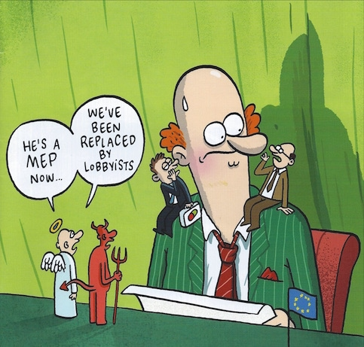
Notes:
Cover BrusselsTimesMagazine-Oct-Nov 2015
MEP = Member of Parliament

Slide 25
Make regulations known and understood
using
Understandable language
Local language
Notes:
GHI will publish important information into many languages. The first "multilingual" document, about the principles of toxicity, is ShareSheet 1.
See https://www.globalharmonization.net/share-sheets-and-whitepapers. More languages will follow.
The next document probably will be on food irradiation and thereafter one about microorganisms.

Slide 26
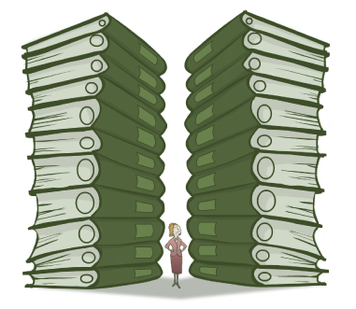
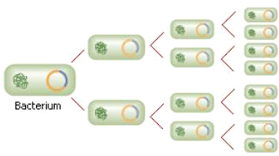
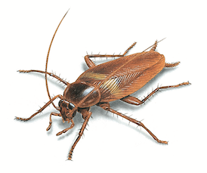
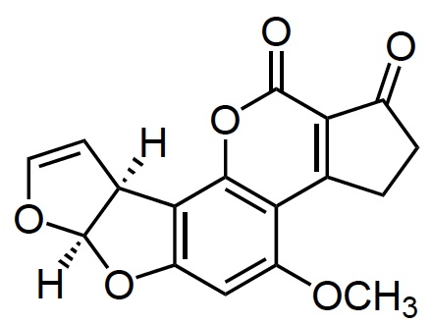
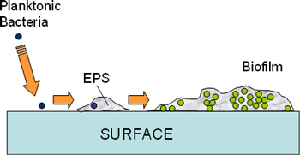
Education and training
Understanding the supply chain
Ethics
Regulations
Microbiology
Microbial growth
Decontamination
Preservation
Chemistry
Entomology
Hygiene and hygienic design
Inside of equipment
Biofilms
Cleaning and disinfection
Proper use of gloves
Notes:
Ethics picture: http://www.rabla.info/images/server1.png
Regulations picture: http://www.heritage.org/~/media/images/reports/2009/econhitshome6/binders.ashx?w=381&h=331&as=1
Multiplying microbes: http://www.desktopclass.com/wp-content/uploads/2011/01/Fig.-20.1-the-introduction-of-human-gene-into-a-bacterium-abd-production-of-insulin.jpg
Valve: http://www.alfalaval.com/globalassets/images/products/fluid-handling/valves/seat-valves/single-seat-valves/unique_ssv_valve_right_side_640x360.png
Biofilm:http://www.asph.sc.edu/enhs/decho/images/fig1.jpg
Gloves: http://www.premierhh.co.uk/media/catalog/product/cache/1/small_image/210x/9df78eab33525d08d6e5fb8d27136e95/6/7/6750_ppe_vinyl_gloves_web.jpg

Slide 27
Education and training
At all levels to an appropriate degree
Children – at primary schools
Parents – courses in local quarters
Street vendors – by well-trained governmental staff
Teachers – during their formal education
Inspectors – special training courses
Politicians – special training courses
Judges, lawyers, prosecutors – special training courses
Notes:
GHI Working Group Education

Slide 28
Essential knowledge

Slide 29
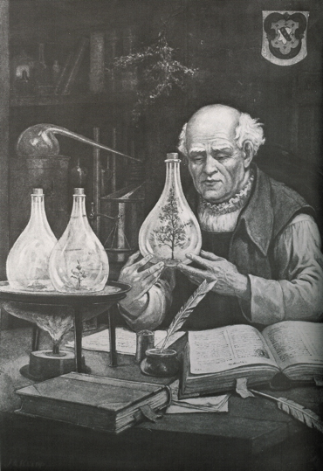
Paracelsus
Everything is poisonous if the amount is high enough
or
There are no toxic substances, only toxic concentrations
Notes:
Already about 500 years ago, Paracelsus had concluded that toxicity depends on amounts.

Slide 30
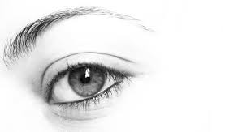
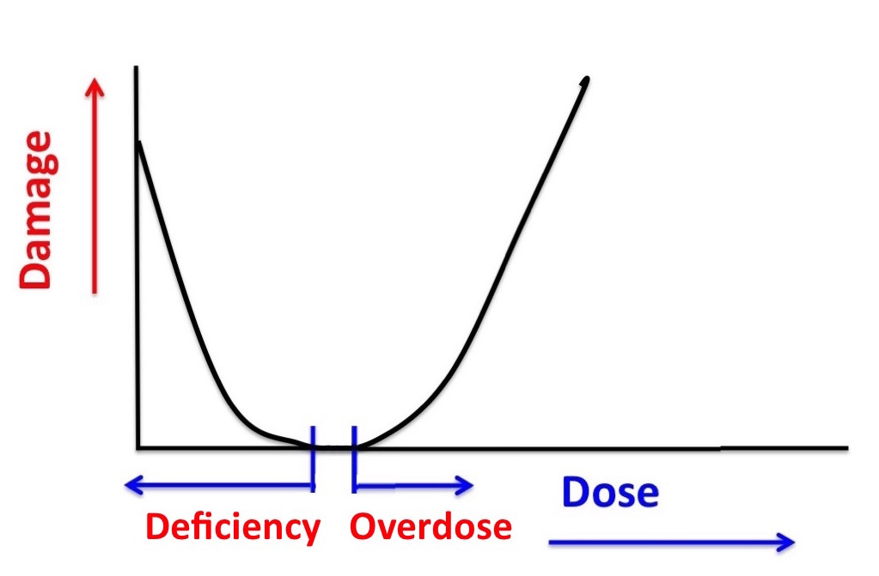
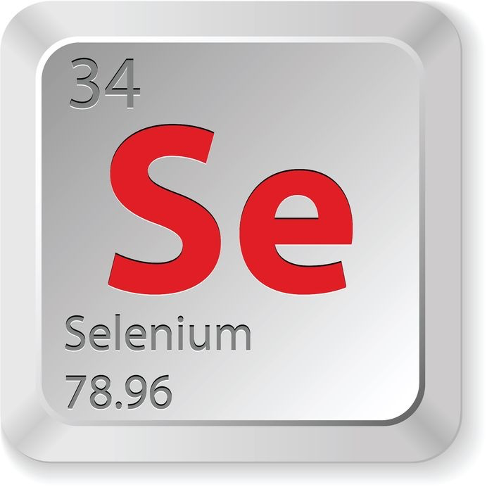
Vitamin A
Many substances are harmless in the right amounts but harmful if too much or not enough
Notes:
For many substances the situation is as Paracelsus discovered: if the dose is too high, damage is done. However sometimes a too low dose of the substance is also a health risk, as it is the case with vitamins and minerals. Without them we get ill and may die, but too high a dose has the same results.
See picture: http://www.endocrineweb.com/sites/default/files/imagecache/gallery-large/wysiwyg_imageupload/14572/2015/09/14/selenium-16703895_M_1.jpg

Slide 31
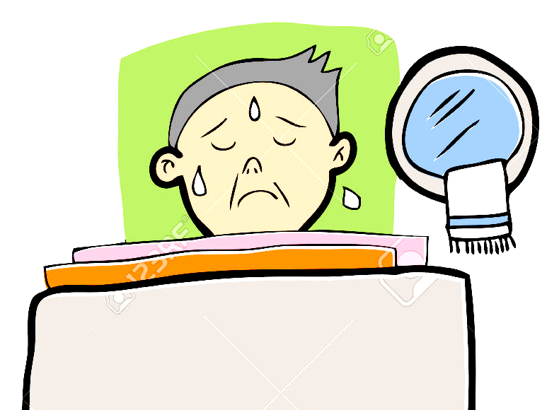
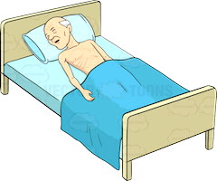
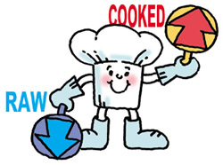
Cross contamination – hygiene in food handling
Most microbes are healthy and needed for our health. A few regrettably are not.
Notes:
Handwash pictures: http://www.webquestcreator2.com/majwq/ver/vert/12383
Magnifying glass: https://cdn2.iconfinder.com/data/icons/bacteria/512/bacteria_4-512.png
Man in bed: http://vectortoons.com/wp-content/uploads/2014/09/medical-patients-collection-2-002.jpg
Sick man: http://previews.123rf.com/images/tawesit/tawesit1408/tawesit140800027/30342634-Anciano-enfermo-con-fiebre-de-dibujos-animados-Foto-de-archivo.jpg
Raw cooked: http://www.cfs.gov.hk/english/multimedia/multimedia_pub/images/fse_200801/SafeGuide_raw_cook_e.jpg

Slide 32
Education and training
Materials – depending on target group
For most target groups material is available but
need to be adapted to the audience
may have to be translated into the local language,
understandable for the students
For the largest group (street handlers; owners of very small companies) material must be developed
universal language
suitable for illiterates (cannot read)
visual
suggestions?

Slide 33
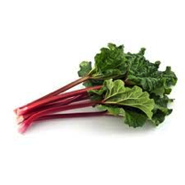
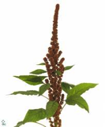
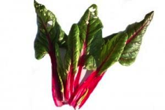
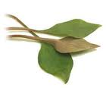
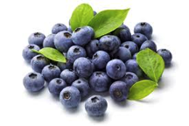
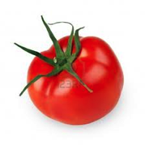
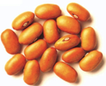
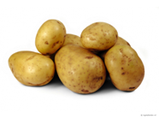
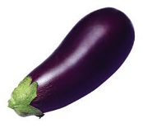
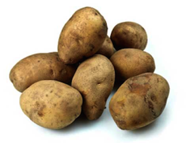
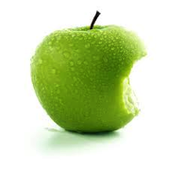
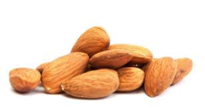
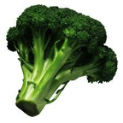
All food contains potentially toxic substances
Notes:
Many constituents of ALL foods become toxic if eaten in too high amounts.

Slide 34
Natural, potentially toxic substances in food
Lectins (or hemaglutinins) (pulses)
Enzyme inhibitors (soy, peas, beet, cereals)
Piperidines (black pepper)
Caffeine, theobromine, theophyline (coffee, chocolate, tea)
Solanine (potatoes, tomatoes, aubergines)
Tomatine (tomatoes)
Oxalates (rhubarb, spinach, parsley, chives, purslane, cassava, amaranth, chard, taro leaves, radish, kale, monstera fruit)
Coumarin (cinnamon, peppermint, green tea, chicory, blueberries)
Glucosinolates such as sinigrin, progoitrin (cabbage, broccoli, brussels sprouts, cauliflower, turnip, radish, horseradish, mustard, rapeseed)
Cyanogenic glycosides, such as amygdalin (almond, laurel) and linamarin (cassave)
Saponins (peanut, soy, spinach, broccoli, potato, apple)
Notes:
All foods contain substances (chemicals) that are toxic if consumed in too high amounts. This and the next two slides give examples. There are no exceptions. People who do not eat food with (potentially toxic) chemicals will starve to death.

Slide 35
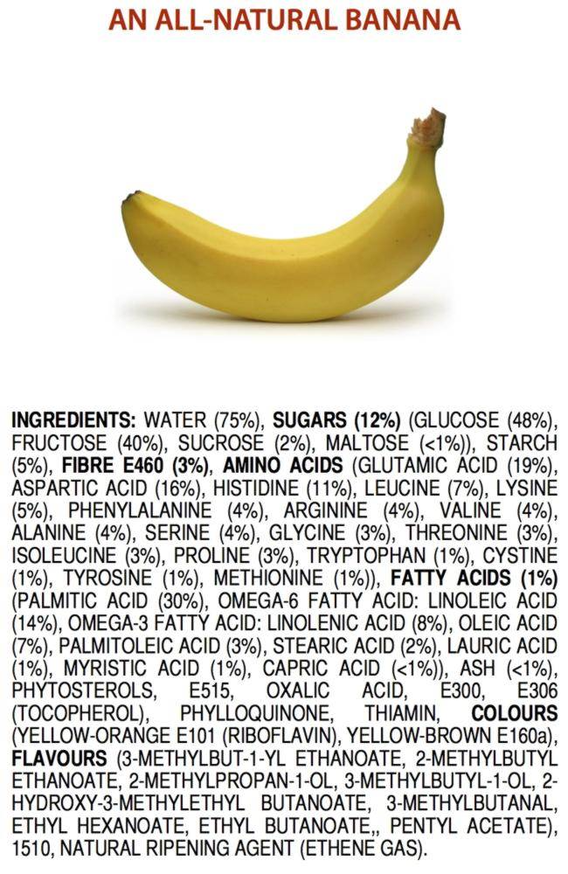
Notes:
James Kennedy, VCE Chemistry Teacher at Haileyburt, Australia
https://jameskennedymonash.wordpress.com/order-prints/

Slide 36
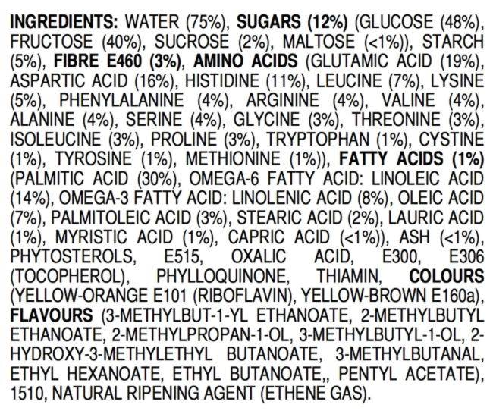
BANANA

Slide 37
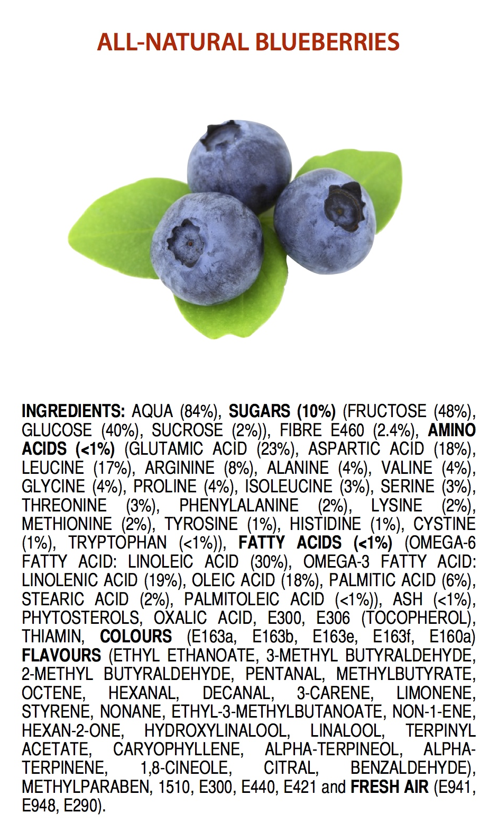
Notes:
James Kennedy, VCE Chemistry Teacher at Haileyburt, Australia
https://jameskennedymonash.wordpress.com/order-prints/

Slide 38
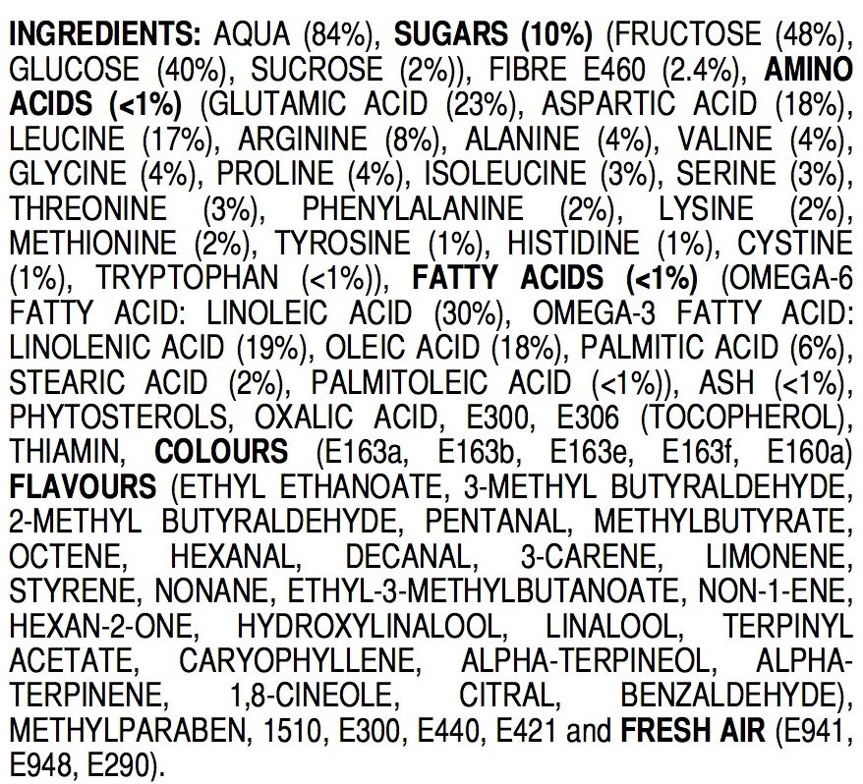
BLUEBERRIES

Slide 39
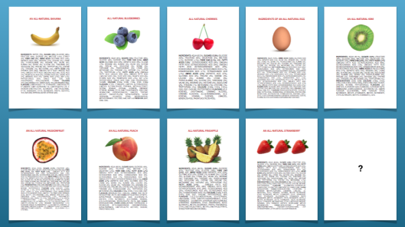
Notes:
James Kennedy, VCE Chemistry Teacher at Haileyburt, Australia
https://jameskennedymonash.wordpress.com/order-prints/

Slide 40
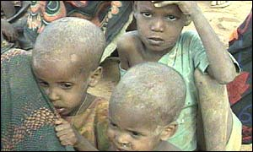
Genetically modified food
Without GM food, millions of people would die of starvation. GM food is not more of less risky than normal food.
Mass famine in Africa
November 2002
Africa Renewal, Vol. 16 #4, Feb. 2003
Notes:
During the massive famine in Southern Africa, in 2001, several governments in the region objected to genetically modified (GM) grain, especially Zambia and Zimbabwe, the countries hardest hit by the drought. Citing health and environmental concerns, Zimbabwe blocked the GM food aid from entering the country. In Zambia, where some GM grain had already arrived, the government placed it under lock and key, banned its distribution and then blocked another 40,000 tonnes that were in the pipeline. Source: Africa Renewal, Vol.16 #4 (February 2003), page 5. This is the result of overwhelming activities of antis, in particular in Europe, who claim with no evidence that GM food is dangerous. The reality is that hundreds of millions of people consume GM food daily and there is not a single report of a health incident related to GM food. The local governments choose to let their citizens starve to death rather than giving them GM food.

Slide 41
There is no evidence that GMO food would be either more or less safe than “normal” food
A decade of EU-funded GMO research (2001 – 2010)
European Commission - EUR 24473
ISBN 978-92-79-16344-9
http://ec.europa.eu/research/biosociety/pdf/a_decade_of_eu-funded_gmo_research.pdf
Statement by the AAAS Board of Directors on Labelling of Genetically Modified Foods
American Association for the Advancement of Science
20 October 2012
http://www.aaas.org/news/releases/2012/media/AAAS_GM_statement.pdf
Notes:
European report and American statement about GMOs. AAAS is the publisher of Science, one of the two most recognised scientific publications.

Slide 42
In South Africa almost 80-90% of the maize produced is GM

Slide 43
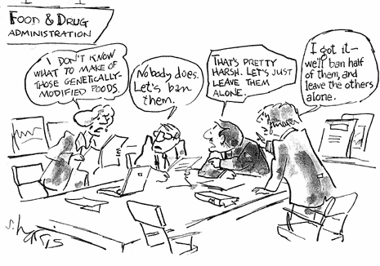
Notes:
From a newspaper – by S. Harris

Slide 44
Acetaldehyde
Benzaldehyde
Benzene
Benzofuran
Benzo(a)pyrene
Caffeic Acid
Catechol
1,2,5,6-dibenzanthracene
Formaldehyde
Furan
Furfural
Hydroquinone
Isoprene
Limonene
Styrene
Toluene
Xylene
Etc.
Notes:
Some of the chemicals in coffee. All potentially (geno)toxic/carcinogenic, but toxicity is a matter of amounts. See later.

Slide 45
A Comprehensive Overview of the Risks and Benefits of Coffee Consumption by L. Kirsty Pourshahidi, Luciano Navarini, Marino Petracco, and J.J. Strain
Investigation of 1277 studies (1970-2015)
Conclusions
Overall, results of this comprehensive review show that the health benefits (or null effects) clearly outweigh the risks of moderate coffee consumption in adult consumers for the majority of health outcomes considered........
Notes:
2016 Institute of Food Technologists®
doi: 10.1111/1541-4337.12206 Vol. 00, 2016
Comprehensive Reviews in Food Science and Food Safety

Slide 46
and
Joint GHI / IFA Working Group
Education
Development of material for training and education of food handlers all over the world
Working Group Chairs
Dr. Jamuna Prakash (India)
Dr. Amalia Mitelut (Romania)
Dr. Jesus Frias (Ireland)

Slide 47
Global Food Safety Curriculum Initiative
The goal is to provide food safety students globally with a science-based education in food safety
Food Hygiene and Sanitation
(incorporating plant design)

Slide 48
Conclusion
Food laws and regulations often are not based on scientific evidence and there are important differences between countries. This has caused and will continue to cause many problems.
To counter these problems, conscientious scientists everywhere should continue to work together to provide scientific evidence that then may be used by stakeholders to influence negotiations and try to convince local authorities that harmonization is in the interest of the global society.
This is what the Global Harmonization Initiative (GHI) tries to do and you are invited to join in the effort.

Slide 49
To join, go to the GHI website:
www.globalharmonization.net
and complete the application form.
For food scientists and scientists in related field, membership is free.
Your membership will help to improve the world a little, an important little.

Slide 50
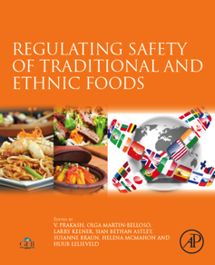
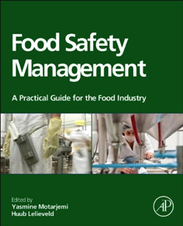
Published by Elsevier
Use promo code GHI30 for 30% discount

Slide 51
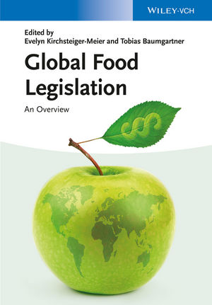
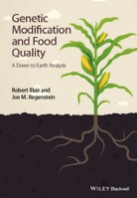
Some other books by or with chapters by active members of GHI
Global Food Legislation: An Overview – Edited by Evelyn Kirchsteiger-Meier and Tobias Baumgartner. ISBN: 978-3-527-33555-8; Wiley, 2014
EU Food Law Handbook – Edited by Bernd van der Meulen. ISBN: 978-90-8686-246-7; , Wageningen University Press, 2014
Genetic Modification and Food Quality: A Down to Earth Analysis. Robert Blair and Joe M. Regenstein. ISBN: 978-1-118-75641-6; Wiley, 2015

Slide 52
Under development
Nutrition and health aspects of traditional and ethnic foods
A series of 26 volumes
covering all countries
The first volume (Nordic Countries) will be published on 1 September 2018
Notes:
See https://www.elsevier.com/books/nutritional-and-health-aspects-of-traditional-and-ethnic-foods-of-nordic-countries/andersen/978-0-12-809416-7

Slide 53
TIME TO CHANGE
To use available scientific knowledge to improve
food safety
and
food (nutrient) security
globally

Slide 55
Thank you for your attention
and
feel free to ask questions
now or later

Slide 57
New technologies

Slide 58
LOSS OF
COLOUR - TASTE - NUTRIENTS
Notes:
Everybody needs nutrients. To preserve food, traditionally heat is used, heat affects the quality of the food.
We need to ask for permission for the use of the pictures taken from the internet, or make other ones. The technical picture is ok to use, as it has been made by Huub Lelieveld.

Slide 59
PEF CHAMBER
Notes:
Much money has been invested in research for preservation methods that do not or much less affect the quality of food (the EU alone for more than 100 million over the past decade). To be allowed to use new technologies and ingredients, the safety must be demonstrated. Because of the differences in regulations between counties, this has to be done many times and the regulations require evidence based on animal testing. If there would be a harmonised protocols and regulations would be the same everywhere, testing by one accredited laboratory should be sufficient for the entire world. Moreover, animals are not needed, see other slides. This picture is about the used of pulsed electric field (PEF) processing that electromechanically destroys cell membranes but does not cause chemical changes.
We need to ask for permission for the use of the pictures or make other ones. The PEF chamber picture, however, is Huub Lelieveld’s.

Slide 60
New technologies tend to scare people
science based regulations are needed
1963
PEF treatment
1960
1895
nanotechnology
high-pressure treatment
cold plasma
photosensitization
Notes:
Examples of “new” technologies that often are not so new. They are perceived a new.
PEF and high-pressure treatment pictures are Huub Lelieveld’s.
Formvar support for viruses, for electron microscopy is also Huub Lelieveld, 1963.
Simian viruses: V.N. Reingold, N.M. Shestopalova & M.P. Chumakov, 1964.
The cold plasma picture is from Hennie Mastwijk (Wageningen University)
The photosensitization picture comes from the internet and possibly is from Zivile Luksiene
We need to get the references and check if we can use them without asking for permission (likely) or otherwise we need to ask.

Slide 61
Working Group
Food Contact Materials
Stainless Steel + Polymer Materials + Lubricants
Fe
Cr
Ni
C
Mo
Ti
Etc.
Polymers
Plasticisers
Catalyst
Stabiliser
Fillers
Pigments
Oils
Antimicrobials
Antioxidants
Rust Inhibitor
Anti Foam
Viscosity Extender
Conveyor Belt
Notes:
A conveyor belt consists of components made from stainless steel, polymer materials and lubricants. All of these materials consist of other materials that should not make the food unsafe (e.g. by leaching or chemical reactions). The EHEDG Yearbook 2011-2012 (freely downloadable) has two articles about food contact materials explaining the issues in detail.

Slide 62
Packaging materials in contact with food
Examples
phthalates
perfluorooctanoic acid
bisphenol-A
aluminium
iron
Notes:
If the concentrations are high enough, these chemicals (and many others) present in food packaging materials may be unsafe for human consumption. The question is what doses are dangerous. Iron can be very toxic in high concentrations but helps to prevent anemia.
Picture of can: http://teenology101.seattlechildrens.org/wp-content/uploads/can.jpg
Picture of plastic bottle: http://assets.babycenter.com/ims/2013/09Sepb/144871875_4x3_soundoff2.jpg
Picture of plastic wrapping material: http://pimg.pack.cn/uploadfiles/ware//img/product/2007/8/31/214058448.jpg
Picture of lid of jar: http://www.meatsandsausages.com/public/images/canning-equipment/equipment-jar-lid-continuous-thread-1.jpg
Picture of aluminium can: http://www.wastenet.org.nz/~/media/WasteNet/Images/OrangePages/AluminiumCanshutterstock101028916%20Small.ashx?as=1&w=158

Slide 63
Requirements for Food contact materials
USA (FDA)
A list of restricted substances. If none of these are present in the raw material, the plastic is FDA approved.
Does not take into account chemicals that are formed or changed when the plastic raw materials are mixed or during the equipment production process.
Does not take into account any reaction of the plastic material with foods
EU (EFSA)
Evidence based
Migration tests
Declarations of compliance with regulations

