Slide 1
About GHI: Ambassador Programme
1st GHI WORLD CONGRESS ON FOOD SAFETY AND SECURITY
(24-28 March 2019, Leiden, The Netherlands)
Alina-Ioana Gostin
Notes:
Multumeste-i lui Hpentru prezentarea data care a fost chiar in detaliu si chiar cu informatii fresh, chiar eu am aflat lucrurui noi/new advancements which haave been made in the organizatuin such as the one with encouraging young students to get involved in gHIs activities.
Nu numai ca au acees la info diversa pribind carti discount, conference and workshop discounts si isi dezvolta CV, dar au si oportunitatea de a invata lcururi noi related to food safety quality science regulstions and legiltion lucrand cu GHI ambasadori, directors etc.. Si cum ai evidentiat este deosebit de importanta education on food safety from early stages.

Slide 2
GLOBAL HARMONIZATION INITIATIVE
OVERARCHING GOAL
GLOBALLY BILLIONS OF TONS OF FOOD AT RISK OF DESTRUCTION
GLOBALLY OVER A BILLION PEOPLE SUFFER SEVERE UNDER-NUTRITION
“Achieving consensus on the science of food regulations and legislation to ensure the global availability of safe and wholesome food products for all consumers.”
Notes:
A number of food scientists from all over the world find it unacceptable that one billion people in the world go hungry while safe and nutritious food is destroyed each year due to differences in food safety regulations that cannot be scientifically justified.
As a result, the Global Harmonization Initiative (GHI), an international non-profit network of scientific organizations and individual scientists working together to promote harmonization of global food safety regulations and legislation, was officially established in 2007.
GHI strives to develop scientific consensus on key food safety matters to assure safety while reducing unnecessary food destruction, and works to support consistent, science-based food regulations that promote trade and international health.

Slide 3
AMBASSADOR PROGRAMME
EMPOWERING CHANGE
GHI Ambassadors are members selected to serve as front‐line representatives of the association on local, regional and national levels.
The standard ambassadorship is limited to 3 years. Afterwards this is prolonged automatically for another 3 years and so on, subject to positive evaluation of one's involvement.
Ambassadors:
Invite scientists in their regions/countries to join GHI
Foster new opportunities for information-sharing
Share and translate GHI communications materials and messaging
Identify specialists to review position papers and GHI science-based communications.
Notes:
The GHI Ambassador Programme is designed to support this goal by empowering selected members to serve as front-line representatives for GHI.
[The GHI Ambassador Programme empowers selected members to serve as front‐line representatives for GHI. ]
Ambassadors invite scientists in their regions or countries to enrol as GHI members, foster new opportunities for information-sharing, and identify specialists to comment on consensus documents produced by the association.

Slide 4
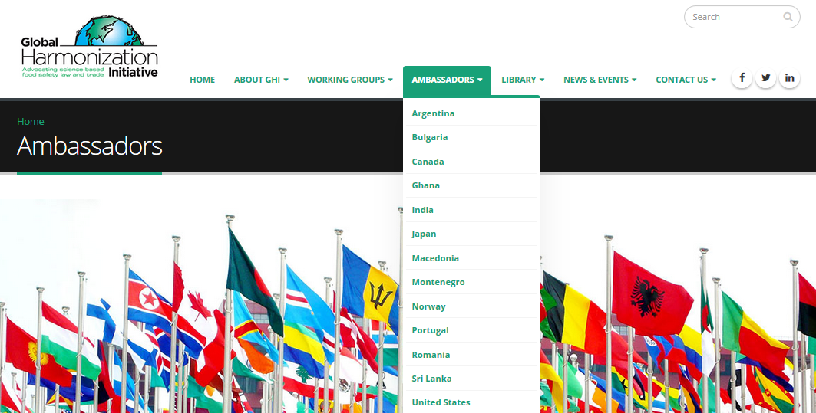
GHI Ambassadors BY COUNTRY
CURRENT COVERAGE AND FURTHER PROSPECTS
ARGENTINA
ARMENIA
AUSTRALIA
BANGLADESH
BELGIUM
BOSNIA AND HERZEGOVINA
BULGARIA
BRAZIL
CAMBODIA
CANADA
CHILE
CHINA
COSTA RICA
CROATIA
CZECH REPUBLIC
CYPRUS
GEORGIA
GERMANY
GHANA
GREECE
HUNGARY
INDIA
INDONESIA
IRAN
ITALY
JAPAN
JORDAN
KENYA
KOREA
LEBANON
LITHUANIA
MACEDONIA
MALAYSIA
MALTA
MEXICO
MONTENEGRO
NIGERIA
NORWAY
PAKISTAN
PORTUGAL
QATAR
ROMANIA
RUSSIA
SENEGAL
SERBIA
SOUTH AFRICA
SPAIN
SRI LANKA
SWITZERLAND
SYRIA
TAIWAN
TANZANIA
THAILAND
THE NETHERLANDS
TURKEY
UGANDA
UKRAINE
UNITED ARAB EMIRATES
URUGUAY
USA
VENEZUELA
VIETNAM
85 Ambassadors from 62 countries
In 18 countries with more than one Ambassador
Notes:
60 ambassadors from 45 countries
countries with more than 1 ambassador: 1 brazil 2 georgia 3 germany 4 greece 5 iran 6 macedonia 7 romania 8 russia 9 south africa 10 turkey 11 uruguay 12 usa 13 vietnam
And we are looking to become trully global, so we aare expanding

Slide 5
EXPANDING OUR NETWORK
BECOMING GHI AMBASSADOR
Interested Ambassador Programme applicants must possess:
Willingness to subscribe to the goals and philosophy of GHI
Skills and experience that allow sound scientific assessments
Good communication skills in the local language and in English
Interest in food regulations, risk/benefit analysis and the scientific process and in disseminating this information
Willingness to identify specialists and scientific forums, communicate with food safety regulators and discuss issues in the local language
Notes:
GHI seeks scientists willing to promote the goals of the association in their countries or regions. Interested Ambassador Programme applicants must possess:
A willingness to subscribe to the goals and philosophy of GHI
Skills and experience that allow sound scientific assessments
Good communication skills, both verbal and written, in the local language and in English
Interest in food regulations, risk/benefit analysis and the scientific process and in disseminating this information
Willingness to identify specialists and scientific forums, communicate with food safety regulators and discuss issues in the local language

Slide 6
GHI Ambassador GUIDELINES
Resources & Outreach Materials
GHI provides Ambassadors with membership and educational outreach materials to promote the ideas and objectives of GHI and to encourage membership of scientists in the country or region.
GHI Ambassadors will receive:
Presentation Slides
Support Materials
GHI Ambassadors Contact List
GHI Presentation Slide Deck
Active Working Groups List
Dedicated Ambassador page on the GHI website
Complimentary Book
Ensuring Global Food Safety: Exploring Global Harmonization,
edited by Christine E. Boisrobert, Aleksandra Stjepanovic,
Sangsuk Oh and Huub L.M. Lelieveld
Notes:
Ambassadors will receive:
Presentation Slides
We have many slides that outline the work and objectives of GHI and that may be used as part of presentations. If needed, these may be adapted to the target audience. The slides also may be used as stand-alone presentations.
Support Materials
A number of information sheets in PDF format, designed to assist GHI Ambassadors in mutual communication and for educational and membership outreach activities are available, including:
GHI Ambassadors Contact List
GHI Presentation Slide Deck
Active Working Groups List
Dedicated Ambassador page on the GHI website
Please visit the GHI website at www.globalharmonization.net to download these and other materials of interest, or request more information from the GHI Ambassador Programme Director.
Complimentary Book
As an Ambassador for GHI, you will receive a free copy of the organization’s first book, Ensuring Global Food Safety: Exploring Global Harmonization, edited by Christine E. Boisrobert, Aleksandra Stjepanovic, Sangsuk Oh and Huub L.M. Lelieveld. The book is an excellent way for Ambassadors to gain valuable insight into GHI’s objectives and structure, global harmonization issues and the benefits of a science-based global regulatory framework – insights that can be shared with prospective members and scientific organizations in your country or region. We are negotiating free or reduced price copies of other GHI books.

Slide 7
GHI Ambassador GUIDELINES
The Ambassador’s Role & Responsibilities
Make GHI known in the region
Publish about GHI in food-related magazines and journals
Participate in and represent GHI at local conferences
Organize sessions or GHI general meetings, give presentations, contribute with GHI materials to tabletop/exhibit booths
Share and disseminate information about GHI publications
Write reviews
Translate GHI documents into the local language
Make GHI known in the region
Harmonize
food safety
laws and regulations
Notes:
GHI Ambassadors are the association’s proactive representatives and advocates at the local and regional level. The responsibilities of all Ambassadors include the following:
Make GHI known in their region in a variety of ways, such as:
Publishing about GHI in food-related magazines and journals
Participating in and representing GHI at local conferences, including organizing sessions or GHI general meetings, giving presentations, contribute GHI materials to tabletop/exhibit booths
Sharing and disseminating information about GHI publications
Writing reviews on GHI books, such as “Ensuring Global Food Safety: Exploring Global Harmonization”
Translating GHI documents, such as Working Group consensus documents, GHI brochures and information sheets, into the local language for publication on the GHI website or in other local/ regional print and online media

Slide 8
GHI Ambassador GUIDELINES
The Ambassador’s Role & Responsibilities
Communicate GHI messages and share consensus documents with local, regional and national
government officials and policymakers
Identify experts/specialists in their regions and localities to:
Make GHI known in the region
Communicate/share GHI messages
Identify experts GHI
Harmonize
food safety
laws and regulations
Harmonize food safety laws and regulations
Join GHI as members
Participate in consensus-building activities through GHI Working Groups related to their scientific field or professional discipline
Provide expert review of GHI consensus documents
Contribute to GHI books as authors
Notes:
Communicate GHI messages and share consensus documents with local, regional and national government officials and policymakers, such as food safety authorities, parliaments and congressional bodies, and municipalities
Identify experts/specialists in their regions and localities who can or will do one or more of the following:
Join GHI as members
Participate in consensus-building activities through GHI Working Groups related to their scientific field or professional discipline
Provide expert review of GHI consensus documents
Contribute to GHI books as authors

Slide 9
GHI Ambassador GUIDELINES
The Ambassador’s Role & Responsibilities
Respond to local misinformation, with approval and assistance from GHI Working Groups
Report activities conducted on behalf of GHI in your region, such as:
Make GHI known in the region
Communicate/share GHI messages
Identify experts GHI
Harmonize food safety laws and regulations
presentations made at symposia or conferences
document translations
articles published, etc.
Respond to misinformation
Report GHI activities
Notes:
Respond to local misinformation, with approval and assistance from GHI Working Groups. When GHI Ambassadors read or view local or regional news stories on food safety issues that misinterpret or miscommunicate scientific facts, GHI will assist you in correcting the record. Articles or video transcripts in question will be translated by the Ambassador into English and sent through the Ambassador Programme Director to the GHI Executive Board and/or appropriate Working Groups for a science-based response or official comment on the respective matter. The response will be sent back to the Ambassador who will translate it into local language and disseminate it as soon as possible to the local media.
Report activities conducted on behalf of GHI in your region, such as presentations made at symposia or conferences, document translations, articles published, etc.

Slide 10
GET INVOLVED WITH GHI
SHARE YOUR EXPERTISE
Join our global community of food scientists united in a shared vision that harmonized science-based food safety regulations and legislation will foster trade, fuel innovation and feed people around the world.
GHI membership is free to scientists and experts from industry, government and academia with expertise in food safety, nutrition, regulation, law and trade.
Visit our website at www.globalharmonization.net for details on the benefits of membership and to apply.
Notes:
When you join GHI, you join a global community of food scientists united in a shared vision that harmonized science-based food safety regulations and legislation will foster trade, fuel innovation and feed people around the world. GHI membership provides you with the resources and opportunities to connect and collaborate with your scientific colleagues through our working groups, conference activities and communications network.
Professional membership is free and open to qualified individual food scientists and food safety, nutrition, and legal experts, without regard to their affiliation to industry, government, regulatory bodies, or academic/research institutions. Free membership enables you to contribute your scientific expertise and knowledge in an impartial, authoritative manner.
GHI Ambassadors are GHI members.

Slide 11
CONNECT WITH US
ONLINE & SOCIAL MEDIA LINKS
LINKEDin
www.linkedin.com/company/global-harmonization-initiative
FACEBOOK
www.facebook/GHI4FoodSafety
TWITTER
@GHI4FoodSafety
WEBSITE
www.globalharmonization.net
WEBSITE RE-LAUNCH
In Spring 2016, GHI launched a newly redesigned and updated website. Please create the Ambassador page for your country! https://www.globalharmonization.net/ambassador-country-list

Slide 12
THANK YOU
FOR YOUR TIME AND ATTENTION
QUESTIONS?

